Slide 1
NC Department of Health and Human Services
EtE Measure Update 2023
Division of Public Health/Epidemiology Section/Communicable Disease Branch
HIV/STD/Viral Hepatitis Surveillance Unit
July 2024

Slide 2
2023 North Carolina Newly Diagnosed HIV Continuum of Care
88%
80%
*People ≥ 13 years of age and diagnosed in and living through December 31 of each calendar year. Data includes labs and services from CAREWare (all Ryan White services excluding Part A), HIV Medication Assistance Program (HMAP), and Medicaid data sources. Data are preliminary (do not include vital records or national death matches).
**At least 1 care marker (CD4 or VL test, HMAP dispense, or Medicaid claim) in the given period.
^Virally suppressed is defined as the last viral load during the year being <200 copies/ml.
Data Sources: enhanced HIV/AIDS Reporting System (eHARS) (July 2024) and NC ECHO (July 2024).

Slide 3
Percent of PLWH With a Suppressed Viral Load Result Within 45 days of HIV Diagnosis Date
Among People with Viral Load Result, North Carolina
Note: 2020 data should be treated with caution due to reduced availability of testing caused by the COVID-19 pandemic. Data is shaded for this reason.
*Based on people newly diagnosed each calendar year.
Data Source: enhanced HIV/AIDS Reporting System (eHARS) (data as of July 2024).

Slide 4
Percent of NC PLWH Retained in Care
Note: 2020 data should be treated with caution due to reduced availability of testing caused by the COVID-19 pandemic. Data is shaded for this reason.
*Based on most recent address or age in eHARS as of December 31 of the given year.
Data Source: enhanced HIV/AIDS Reporting System (eHARS) (data as of July 2024).

Slide 5
Percent of People Living with HIV with Chlamydia, Gonorrhea, or Early Syphilis who have the STD While not Virally Suppressed
Note: 2020 data should be treated with caution due to reduced availability of testing caused by the COVID-19 pandemic. Data is shaded for this reason.
Data Source: enhanced HIV/AIDS Reporting System (eHARS) (data as of July 2024) and North Carolina Electronic Disease Surveillance System (NC EDSS) (data as of November 2024).

Slide 6
Disparities in New HIV Diagnoses by Year of Diagnosis*
Note: 2020 data should be treated with caution due to reduced availability of testing caused by the COVID-19 pandemic. Data is shaded for this reason.
*Race/Ethnicity disparity in new diagnoses (measured as the rate of new HIV diagnoses among people of color [Black/African American, American Indian/Alaska Native, Asian/Pacific Islander, Hispanic/LatinX, and people reporting multiple race identities] divided by the rate among White/Caucasians.
Data Source: enhanced HIV/AIDS Reporting System (eHARS) (data as of August 2022).

Slide 7
HIV New Diagnosis Rate by Race/Ethnicity
Note: 2020 data should be treated with caution due to reduced availability of testing caused by the COVID-19 pandemic. Data is shaded for this reason.
Data Source: enhanced HIV/AIDS Reporting System (eHARS) (data as of July 2024).

Slide 8
Number of New Diagnoses Per Year
Note: 2020 data should be treated with caution due to reduced availability of testing caused by the COVID-19 pandemic. Data is shaded for this reason.
Data Source: enhanced HIV/AIDS Reporting System (eHARS) (data as of July 2024).

Slide 9
Rate of New HIV Diagnoses Per Year
Note: 2020 data should be treated with caution due to reduced availability of testing caused by the COVID-19 pandemic. Data is shaded for this reason.
Data Source: enhanced HIV/AIDS Reporting System (eHARS) (data as of July 2024).

Slide 10
Rate of HIV Diagnosed Late in Disease Course*
Note: 2020 data should be treated with caution due to reduced availability of testing caused by the COVID-19 pandemic. Data is shaded for this reason.
*AIDS diagnosis within 6 months of an initial HIV diagnosis.
Data Source: enhanced HIV/AIDS Reporting System (eHARS) (data as of July 2024).

Slide 11
People on PrEP per 100,000 NC Residents
Data Source: AIDSVu.org PrEP map (accessed November 12, 2024) AIDSVu note: Data mapped underestimates the total number of PrEP users in the U.S.

Slide 12
Percent of Counties with a PrEP Provider
Data Source: NC DPH Communicable Disease Branch HIV Care and Prevention Unit (data as of August 10, 2022).

Slide 13
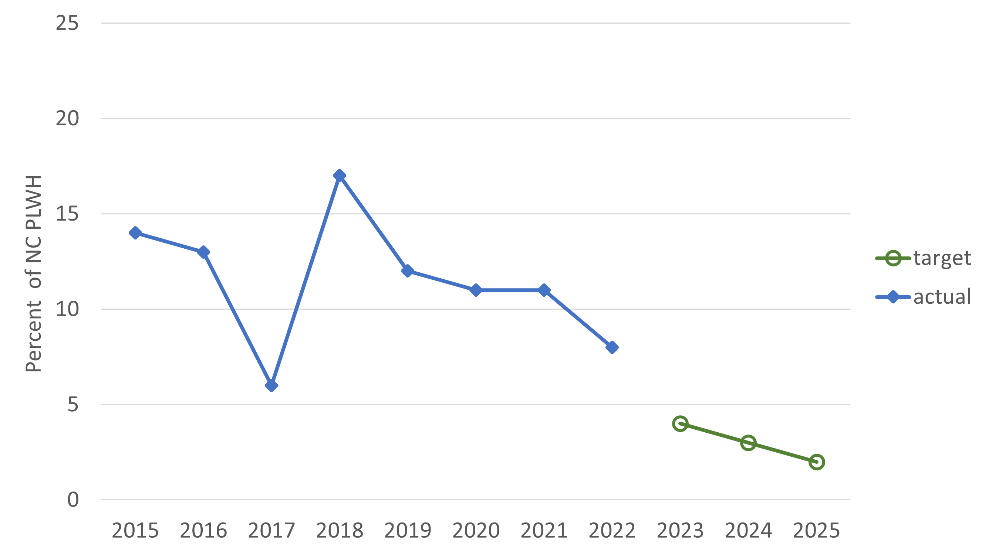
PLWH agreeing with “Having HIV makes me feel like I’m a bad person”
Data Source: North Carolina Medical Monitoring Project data from 2015-2022, as supplied from the CDC Medical Monitoring Project.

Slide 14
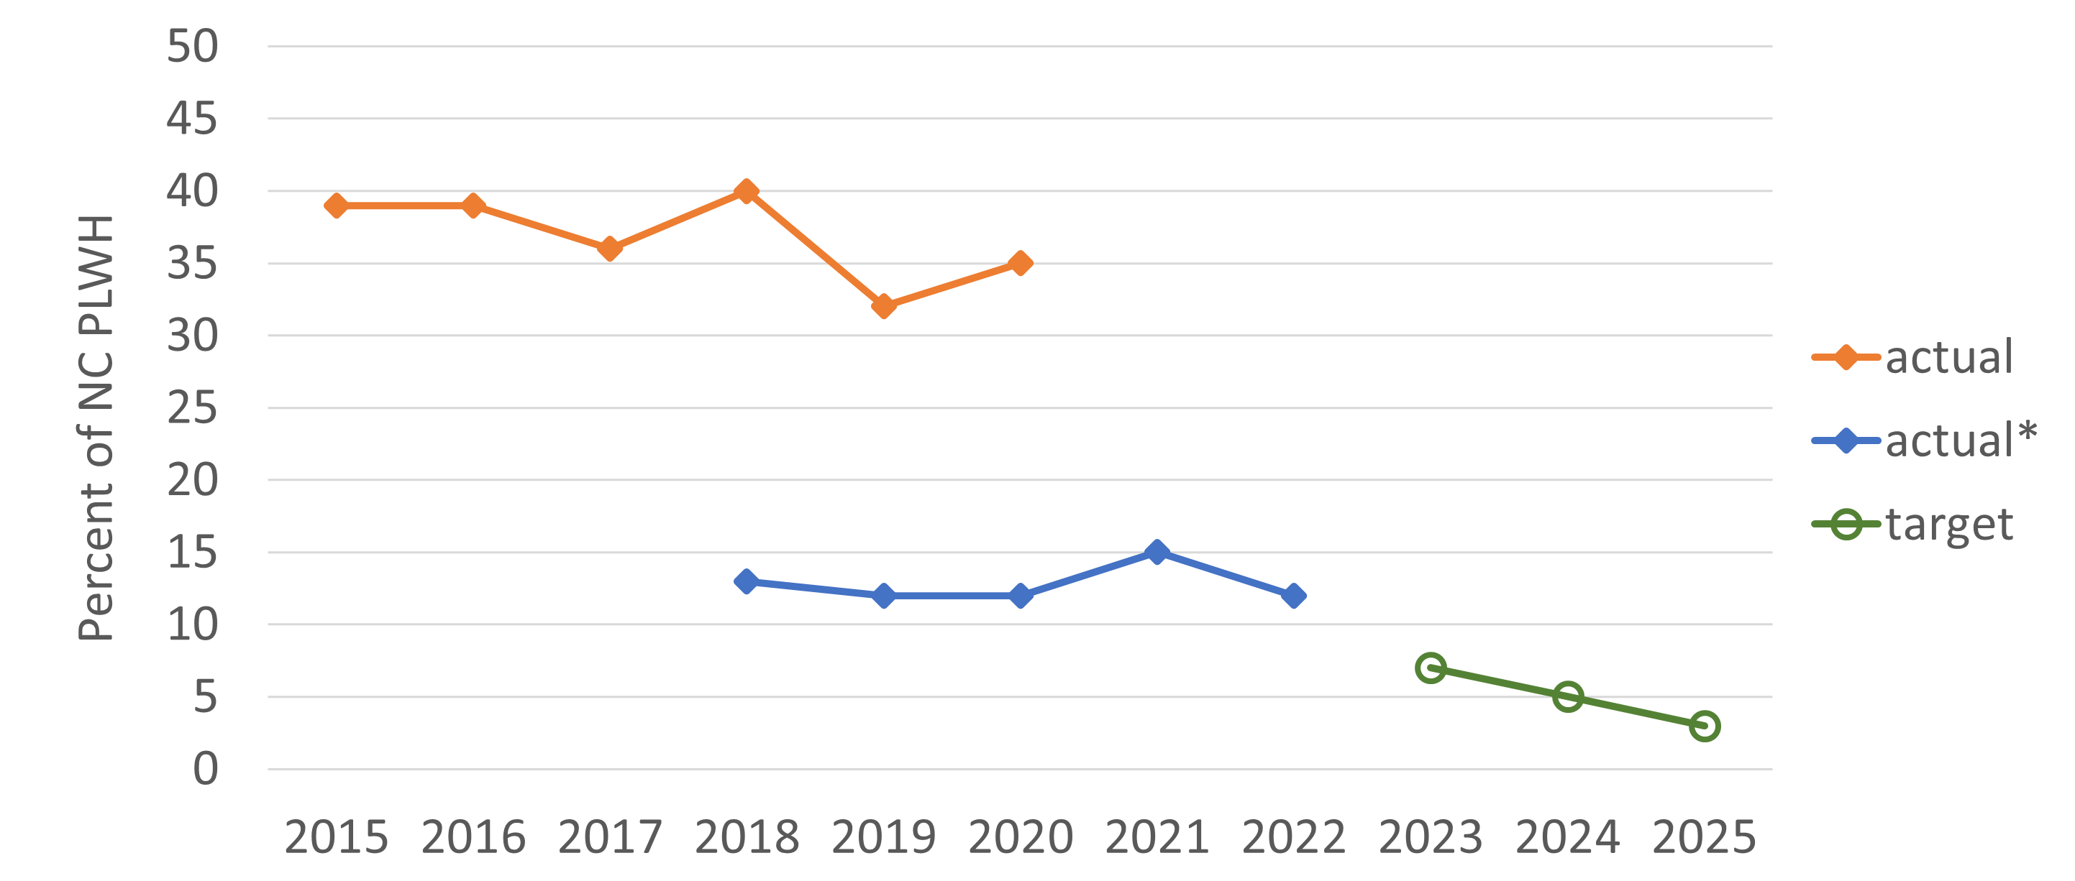
PLWH agreeing with “I have been hurt by how people reacted to learning I have HIV”
Up until 2021, data reflects agreement over the respondent’s lifetime.
*Beginning in 2018 and later, data reflects whether respondent agreed with this statement in the 12 months prior to the interview.
Data Source: North Carolina Medical Monitoring Project data from 2015-2022, as supplied from the CDC Medical Monitoring Project.

