Slide 1
Hepatitis B Investigation and NCEDSS Training
Dianne D. Brewer RN, BSN
Viral Hepatitis Nurse Consultant II
Josh Moore, MPH
Viral Hepatitis Epidemiologist
September 12, 2024

Slide 2
Objectives:
Review Hepatitis B (HBV) basics
Interpret and Understand HBV tests
Understand the Serologic Course of Acute and Chronic HBV
Discuss the 2024 HBV Acute and Chronic Case Definitions
Differentiate HBV Case Classification
Interpret HBV Case Classification by Initial Serologic Results Algorithm
Interpret HBV Case Classification by Case Definition Algorithm
Assess the Steps for Evaluating a New HBV Case
Determine How to Report an HBV Event in NCEDSS
Evaluating an HBV "Lab Condition Report"
Identify Steps for Deduplicating HBV Events in NCEDSS
Recognize Steps for Completion of the HBV Subsequesnt Report Package

Slide 3
Hepatitis B
What is Hepatitis B?
How is it transmitted?
Hepatitis B is a vaccine-preventable liver infection caused by the hepatitis B virus (HBV).
HBV infection can be short (acute) or long-term (chronic).
About 50% of persons with chronic hepatitis B do not know they are infected
In 2022, 26,971 persons diagnosed with chronic hepatitis B were residing in North Carolina. Many more infections go undiagnosed and unreported.
HBV is transmitted when blood, semen, or another bodily fluid from an infected persons enters the body of someone who is uninfected
HBV can be transmitted through:
Birth from a person infected with HBV
Sexual contact with an infected person
Sharing equipment contaminated with blood such as needles, syringes, or medical equipment (e.g. glucose monitors)
Direct contact with blood of a person infected with HBV
Poor infection control practices in health care facilities
Sharing personal items such as toothbrushes or razors (less common)
Source: North Carolina Electronic Disease Surveillance System (NC EDSS) (data as of July 1, 2023); https://www.cdc.gov/hepatitis-b/about/index.html

Slide 4
HBV Test Types and Interpretation
A range of serological tests are utilized to diagnose HBV infection and determine whether a person lacks immunity to HBV
HBV Tests Types: (Highlighted tests are included in the case definition)
Hepatitis B Surface Antigen (HBsAg): Detection indicates active infection, except in the case of recent vaccination
Hepatitis B e Antigen (HBeAg): Detection indicates active infection and is typically associated with elevated HBV DNA levels and high infectivity
Hepatitis B DNA: Detection indicates an active infection
IgM antibody to Hepatitis B Core Antigen (IgM anti-HBc): Detection indicates acute infection within the previous 6 months
Total Antibody to Hepatitis B Core Antigen (Total anti-HBc):Detection indicates past exposure or current infection. Total anti-HBc includes the IgM and IgG anti-HBc and is not detected following immunization. Negative total anti-HBc can assist in ruling out hepatitis B infection.
Hepatitis B Surface Antibody: Detection indicates immunity either through recovery from natural infection or HBV vaccination
Antibody to Hepatitis B e Antigen (anti-HBe): Detection indicates a favorable immune response to HBV infection
Reference: https://www.hepatitisb.uw.edu/go/screening-diagnosis/diagnosis-hbv/core-concept/all#hbv-tests

Slide 5
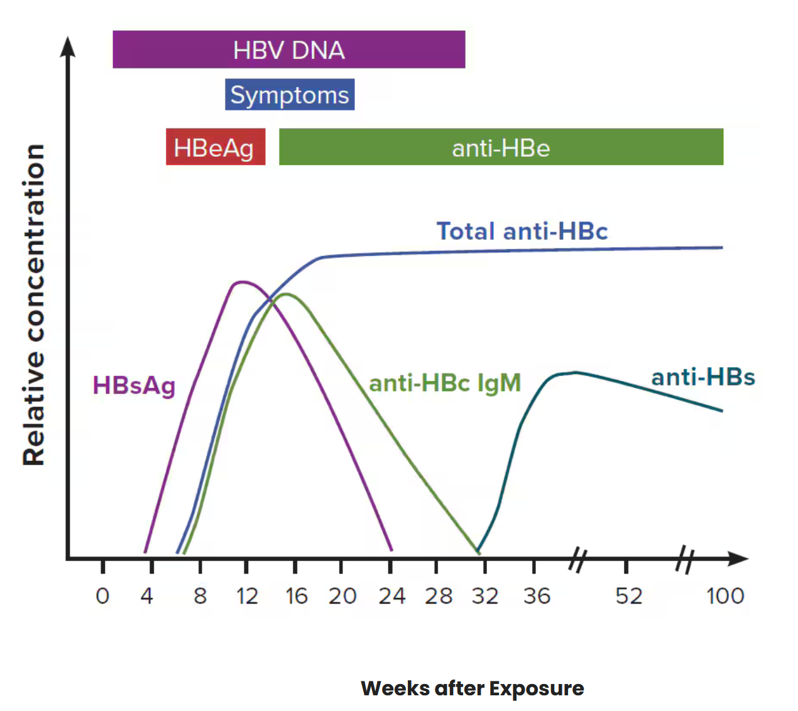
Acute Hepatitis B
Persons with acute HBV infection can have mild or no symptoms. When present, symptoms typically occur 90 days after exposure (range 60-150 days)
Notable Signs/Symptoms:
Acute Hepatitis B in NC in 2022:
Nearly half (47%) of reported cases were between 40 to 54 years old
Two-thirds (65%) were among men
One-quarter (27%) of cases reported injection drug use as a risk factor
Typical serologic course of acute hepatitis B to recovery
Abdominal pain
Nausea and/or vomiting
Fatigue
Fever
Dark urine
Jaundice
Joint pain
Loss of appetite
Additional Resources: CDC’s Hepatitis B Serology Training Seminar: https://www.youtube.com/watch?v=21eVTf0otUw
Source: https://epi.dph.ncdhhs.gov/cd/stds/figures/2022-Hep-Annual-Report_Final.pdf https://www.hhs.gov/hepatitis/learn-about-viral-hepatitis/hepatitis-b-basics/index.html

Slide 6
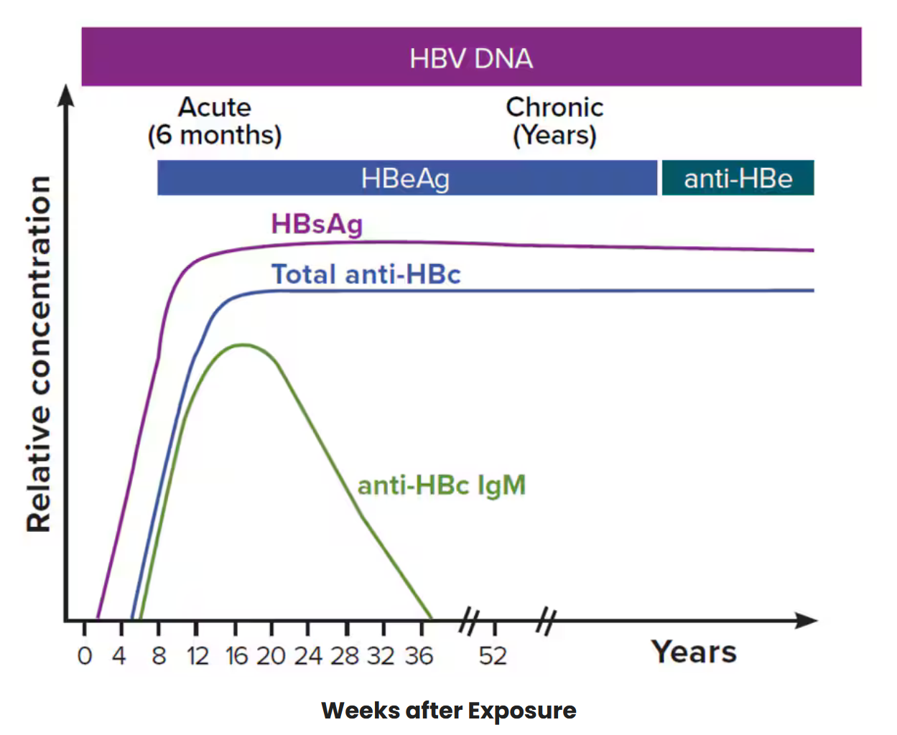
Chronic Hepatitis B
Around 5-10% of persons infected with HBV develop a lifelong chronic infection.
Many people infected with HBV do not experience symptoms and therefore may not know they are infected
Untreated chronic hepatitis B can cause serious health complications, including liver damage, cirrhosis, liver cancer, and even death
Chronic Hepatitis B in NC in 2022:
Men accounted for 60% of reported cases
Two-thirds (67%) of cases reported were among persons 40 years and older
Asian and Pacific Islanders accounted for nearly one-quarter (23%) of reported cases
Typical serologic course of the progression to chronic hepatitis B
Additional Resources: CDC’s Hepatitis B Serology Training Seminar: https://www.youtube.com/watch?v=21eVTf0otUw
Source: https://epi.dph.ncdhhs.gov/cd/stds/figures/2022-Hep-Annual-Report_Final.pdf https://www.hhs.gov/hepatitis/learn-about-viral-hepatitis/hepatitis-b-basics/index.html

Slide 7
Hepatitis B, Acute 2024 Case Definition
Clinical Description
In the absence of a more likely, alternative diagnosis*, acute onset or new detection of at least one of the following:
Jaundice,
Total bilirubin > 3.0mg/dL, or
Elevated serum alanine aminotransferase (ALT) levels > 200 IU/L.
* Alternative diagnoses may include evidence of acute liver disease due to other causes or advanced liver disease due to hepatitis B reactivation (see section VIB), pre-existing chronic HBV infection, other causes including alcohol exposure, other viral hepatitis, hemochromatosis, or conditions known to produce false positives of hepatitis B surface antigen, etc.
Source: https://ndc.services.cdc.gov/case-definitions/hepatitis-b-acute-and-chronic-2024/

Slide 8
Hepatitis B, Acute 2024 Case Definition
Laboratory Criteria for Diagnosis
Tier 1
Detection of HBsAg AND Detection of IgM anti-HBc OR
Detection of HBeAg AND Detection of IgM anti-HBc OR
Detection of HBV DNA AND Detection of IgM anti-HBc OR
Detection of HBsAg, HBeAg OR
HBV DNA within 12 months (365 days) of a negative HBsAg test result. (i.e., HBsAg seroconversion)
Tier 2
Detection of HBV surface antigen (HBsAg) AND
IgM antibody to HBV core antigen (IgM anti-HBc) test not done or result not available OR
Detection of HBV DNA AND IgM anti-HBc test not done or result not available
Source: https://ndc.services.cdc.gov/case-definitions/hepatitis-b-acute-and-chronic-2024/

Slide 9
Hepatitis B, Acute 2024 Case Definition
Presumptive Laboratory Evidence:
Detection of IgM anti-HBc, AND
Negative or not done for HBsAg, HBV DNA, or HBeAg
Source: https://ndc.services.cdc.gov/case-definitions/hepatitis-b-acute-and-chronic-2024/

Slide 10
Hepatitis B, Acute Case Classification
Confirmed
Meets Tier 1 confirmatory laboratory evidence of acute HBV infection OR
Meets clinical criteria AND Tier 2 confirmatory laboratory evidence of acute HBV infection
Probable
Meets clinical criteria AND presumptive laboratory evidence of acute HBV infection
*** Individuals born in the US, under or equal to the age of 24 months, and born to a mother with documented evidence of hepatitis B infection should be reporting using the Perinatal Hepatitis B Position Statement (16-ID-06), unless there is evidence that exposure occurred via a non-perinatal mechanism (e.g., healthcare acquired).
Source: https://ndc.services.cdc.gov/case-definitions/hepatitis-b-acute-and-chronic-2024/

Slide 11
Hepatitis B, Chronic 2024 Case Definition
Clinical Description
No symptoms are required. Persons with chronic hepatitis B virus (HBV) infection may have no evidence of liver disease or may have a spectrum of disease ranging from chronic hepatitis to cirrhosis or liver cancer.
Laboratory Criteria for Diagnosis
Detection of HBsAg in two clinical specimens taken ≥ 6 months apart, OR Detection of HBeAg in two clinical specimens taken ≥ 6 months apart, OR Detection of HBsAg or HBeAg AND total anti-HBc, OR Detection of HBsAg AND HBeAg, OR Detection of HBV DNA.
Presumptive Laboratory Evidence
Detection of HBsAg or HBeAg AND IgM anti-HBc test negative, not done, or result not available
Source: https://ndc.services.cdc.gov/case-definitions/hepatitis-b-acute-and-chronic-2024/

Slide 12
Hepatitis B, Chronic Case Classifications***
Confirmed
Meets confirmatory laboratory evidence of chronic HBV infection.
Probable
Meets presumptive laboratory evidence of chronic HBV infection
*** Individuals born in the US, under or equal to the age of 24 months, and born to a mother with documented evidence of hepatitis B infection should be reporting using the Perinatal Hepatitis B Position Statement (16-ID-06), unless there is evidence that exposure occurred via a non-perinatal mechanism (e.g., healthcare acquired).
Source: https://ndc.services.cdc.gov/case-definitions/hepatitis-b-acute-and-chronic-2024/

Slide 13
Criteria to Distinguish a New Case of Acute or Chronic Hepatitis B from Reports or Notifications which Should Not be Enumerated as a New Case for Surveillance
A case of HBV infection classified under the Perinatal HBV position statement (16-ID-06) can additionally be considered a confirmed case of chronic HBV infection if a positive HBV viral detection test (HBsAg, HBeAg, or HBV DNA) is obtained after the case is greater than 24 months of age.
A confirmed acute case of HBV infection may also be considered a new confirmed chronic case of HBV infection if a positive HBV viral detection test is reported 6 months or longer after acute case onset or, if asymptomatic, after the initial positive test result.
An acute case of HBV infection should not have been previously reported as a case of either acute or chronic HBV infection.
A chronic case of HBV infection should not have been previously reported as a case of chronic HBV infection.
Source: https://ndc.services.cdc.gov/case-definitions/hepatitis-b-acute-and-chronic-2024/

Slide 14
Source: https://epi.dph.ncdhhs.gov/cd/hepatitis/HBV_Serology_Algorithm_01102024.pdf

Slide 15
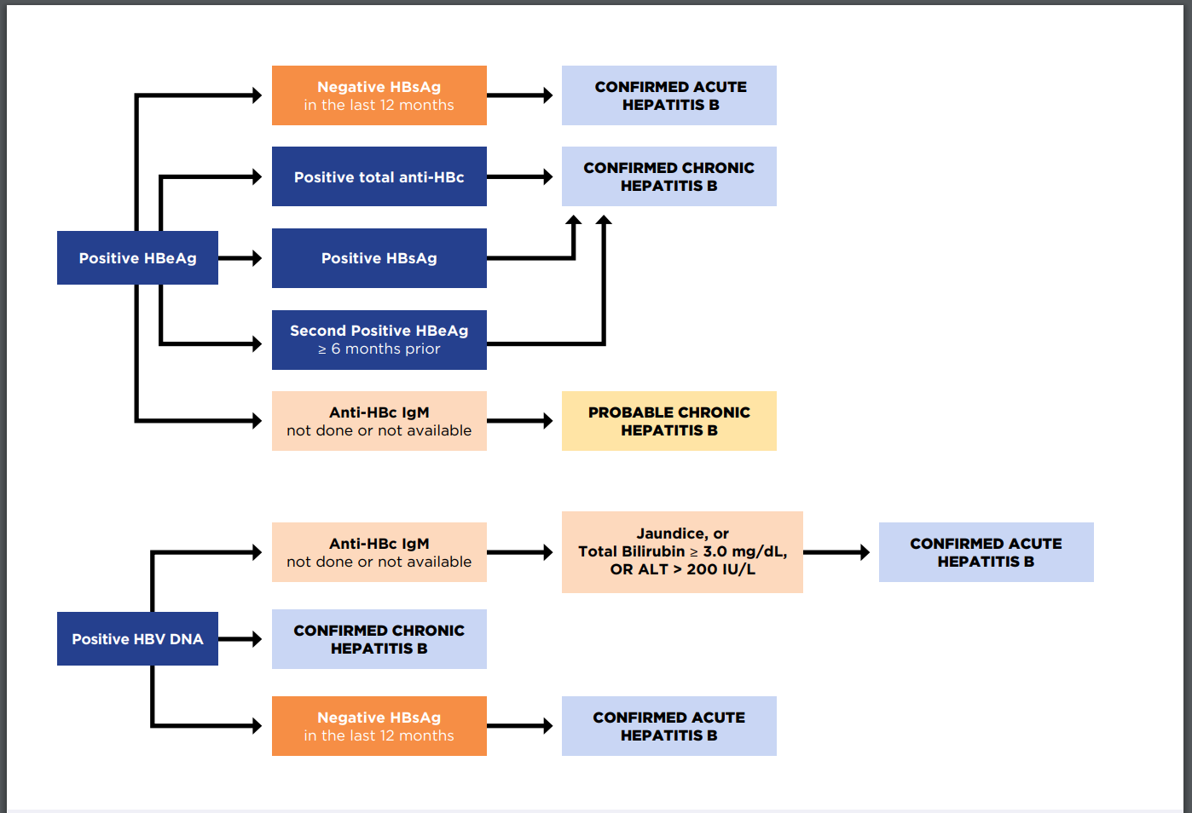

Slide 16
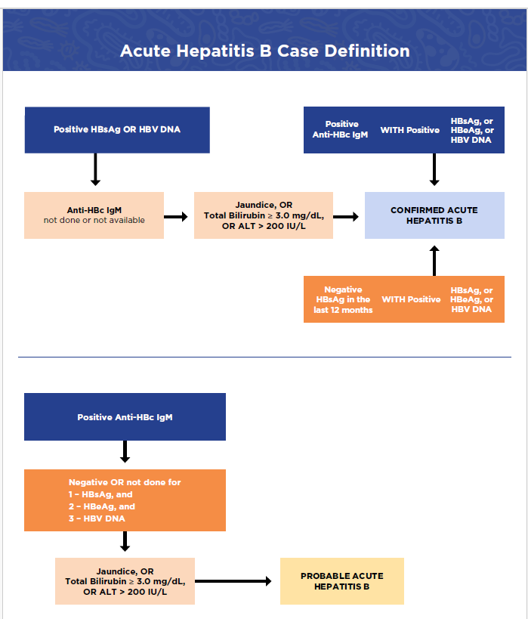
Source: https://epi.dph.ncdhhs.gov/cd/hepatitis/HBV_Case_Definition_Algorithm_01102024.pdf

Slide 17
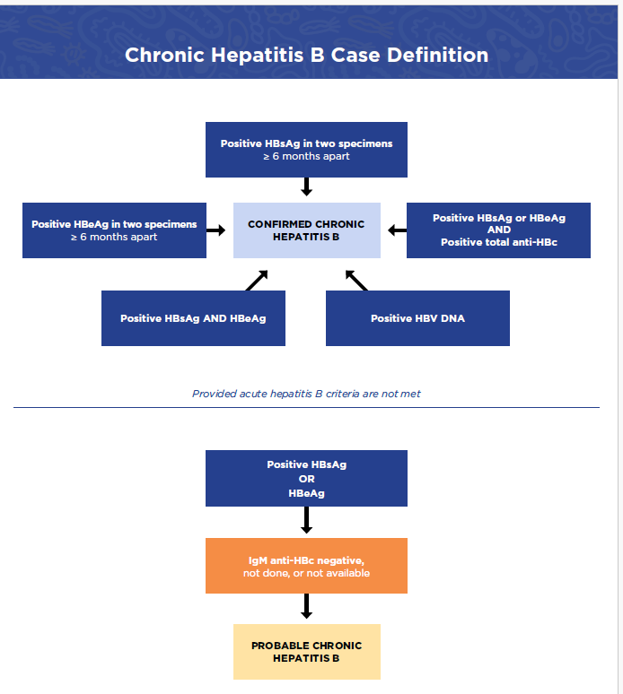
Source: https://epi.dph.ncdhhs.gov/cd/hepatitis/HBV_Case_Definition_Algorithm_01102024.pdf

Slide 18
Useful Criteria for Acute and Chronic HBV Case Ascertainment
Acute Hepatitis B
Chronic Hepatitis B
The presence of any of clinical criteria:
Jaundice
Total bilirubin > 3mg/dL
Elevated serum ALT > 200 IU/L
Detection of IgM anti-HBc
Recent HBsAg seroconversion
Detection of HBsAg, HBeAg, or HBV DNA within 12 months of a negative HBsAg test result
Person with a previous history of hepatitis B including:
Acute hepatitis B
Perinatal hepatitis B
Chronic hepatitis B not previously reported in NC
Test not done or negative IgM anti-HBc result in someone without clinical signs/symptoms

Slide 19
General Steps for Investigating Newly Reported Cases:
Verify whether the labs meet case criteria
Collect info from the provider or medical records
Demographics
Clinical Features
Pregnancy status
Additional testing results
Vaccination info
Risk behaviors
Interview the patient
Collect risk info
Link to care if needed
Provide control measures

Slide 20
Reporting Hepatitis B in NCEDSS
Event Types in NCEDSS:
Hepatitis B – Acute
Hepatitis B – Chronic Carrier
Hepatitis B – Lab/Condition Report
Hepatitis B – Perinatally Acquired

Slide 21
Hepatitis B – Lab/Condition Report
Most hepatitis B events start out as a lab/condition report. This event type functions as a place holder and is typically used:
When a case is created and cannot be classified without additional information (created by a local user, state staff, or via ELR)
When an individual has been previously reported
Instances where events may be sent back to the state as lab condition reports:
Person was previously reported as acute (and new labs are not more than 6 months apart), and/or chronic.
Event will not meet case definition (Please ensure there is enough info documented in the event for us to verify this)
Event is out-of-state and requires interstate transfer
Pregnant female that has been previously reported
Notes:
Most hepatitis B events start out as a lab/condition report. These events are created automatically from electronic laboratory reports or when NC DPH receives a paper laboratory report. This event type functions similar to a place holder and is used to:
Create events that cannot be classified without additional information that is typically collected during investigation
OR
When an individual has previously been reported for hepatitis B and additional laboratory results are received.
In some instances, lab/condition reports do not need to be changed to another event type. This primarily occurs when:
A person has been previously reported for acute or chronic hepatitis B
The event does not meet case definition. When returning these events, please ensure that there is enough info document in the event for the state disease registrar to confirm that it does not meet criteria.
The event requires an interstate transfer
The event is in a pregnant person that has been previously reported in NCEDSS
County investigators are responsible for changing the event type to the correct disease type (acute or chronic) f the person has never been reported. For help with this they can contact the NCEDSS helpdesk or a member of the viral hepatitis staff.

Slide 22
When a Hepatitis B Lab/Condition Report is received on a person not previously reported:
Start by assessing whether they met case definition
(Note this may require collecting additional information from the provider).
If case definition is met:
Control measures are required. Convert the event to an acute or chronic event and document all additional lab tests, clinical signs/symptoms, control measures, risk history, and vaccination information in NCEDSS.
If the case definition is not met:
Control measures are not required. Complete the subsequent report package, document all info needed to verify the case does not meet criteria, and return to the state disease registrar
Notes:
If a person has not been reported before, information must be gathered to determine if the person reported meets case definition. Sometimes the lab results that are initially received in NCEDSS are enough to determine whether the person is a confirmed carrier or does not meet case definition. However, often the initial information received needs to be supplemented with additional information from the provider, such as additional laboratory results or clinical assessments. The information requested in the Hepatitis B Confidential Communicable Disease Report—Part 2 form or the clinical and risk history and vaccination packages of acute or chronic hepatitis B events serve as a guide for obtaining the required information.
When a person meets a case definition, they are considered infectious and require public health actions to not only control further spread of the disease but to also identify potential contacts and provider education and offer vaccination to those who meet the requirements.
If a person does not meet a case definition, control measures are not required. However, education about preventative measures may be warranted if the person has risks for the disease discovered in the investigation.

Slide 23
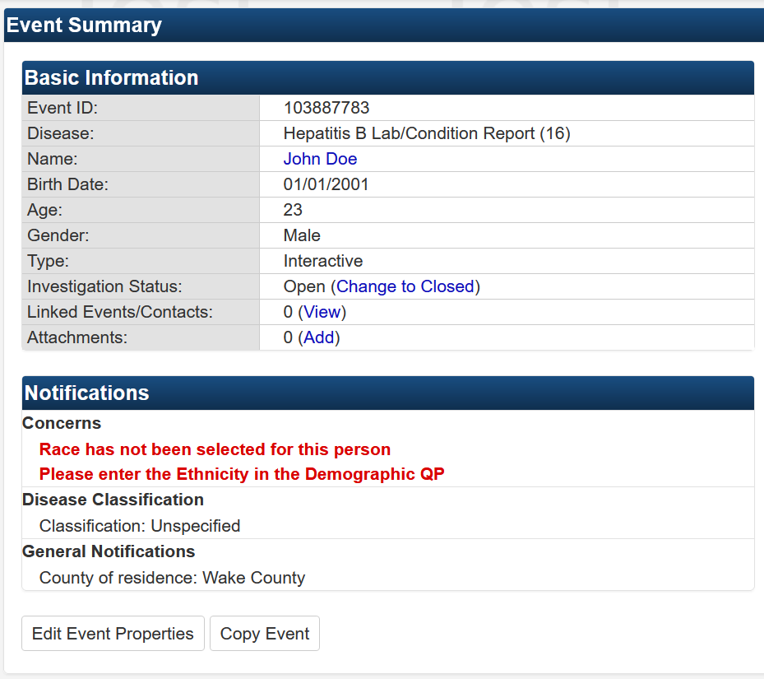
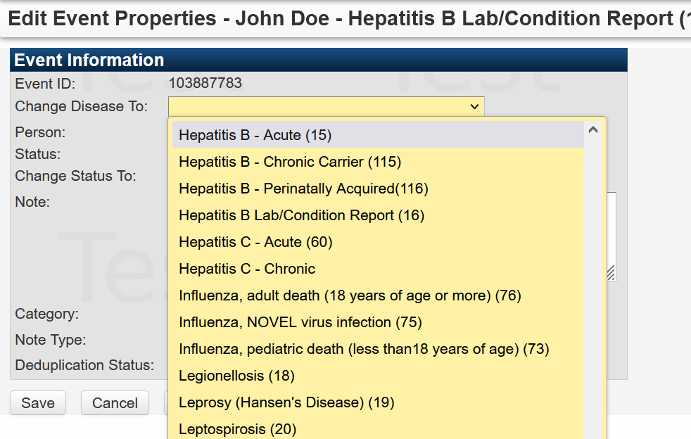
Converting a Lab/Condition Report to an Acute or Chronic Event in NCEDSS
To change an event type in NCEDSS:
Open the lab/condition report in NCEDSS
Select “Edit Event Properties”
3) Select the appropriate event type
4) Click save
Please contact the NCEDSS helpdesk (NCEDSSHelpDesk@dhhs.nc.gov) or contact a member of the viral hepatitis team for assistance with converting a lab/condition report to an acute or chronic event

Slide 24
Hepatitis B – Acute
Questions to prioritize during investigation:
Was any additional HBV testing done?
Previous history of hepatitis B?
Were signs/symptoms present?
Is there an alternative diagnosis?
Is the patient pregnant?
What risk factors were present?
Did the patient reside in a congregate living facility in the 6 months prior to onset? (e.g. LTCF or prison)

Slide 25
Hepatitis B – Chronic
Questions to prioritize during investigation:
Was any additional HBV testing done?
Do they have a previous history of hepatitis B?
Were they born in an area with a high incidence? (i.e. Asia, the Pacific Islands, and Africa)
Are they linked to care?

Slide 26
When a Hepatitis B Lab/Condition Report is received on a person previously reported:
The previous event is a chronic carrier:
Leave the event as a lab/condition report, complete the subsequent report package and reassign to the state (if the person is pregnant assign to the state perinatal case management)
The previous event was an acute case with additional positive labs received < 6 months after the initial event date:
Leave the event as a lab/condition report, complete the subsequent report package and reassign to the state (if the person is pregnant assign to the state perinatal case management)
The previous event was an acute case with new lab results indicative of HBV infection are received ≥ 6 months after the initial event date:
Convert the event to a chronic event and complete the clinical, risk history, and vaccination packages before reassigning to the state (if the person is pregnant assign to the state perinatal case management)
Notes:
When a person has already been reported for hepatitis B in NCEDSS then we do not need to change the event type unless they are an acute case with new labs results indicative of HBV infection that were received > 6 months after the initial event date. For these persons, please convert to a chronic event and then complete the risk history, clinical package, and vaccination packages. Note, you can use info from the original event to fill-in this information.
If the person has a previous event that is a: - chronic carrier or an acute event < 6 months old then please complete the subsequent report package and reassign the event to the state.
Note if the person is pregnant, please assign the event to the state perinatal case management team.

Slide 27
Local Health Department Users Should Never Deduplicate Hepatitis B Events in NCEDSS For assistance deduplicating events in NCEDSS, please contact a member of the viral hepatitis team or the NCEDSS helpdesk (NCEDSSHelpDesk@dhhs.nc.gov)

Slide 28
Completing the Subsequent Report Package in NCEDSS
A subsequent report package should be completed for all persons who have a previously reported hepatitis B event in NCEDSS. This package is used to provide additional information on the status of the case and document whether additional follow-up is required (e.g. perinatal case management)
Pregnancy status should be determined for ALL positive HBV lab results received for women of childbearing age (14-50 years) and documented in the subsequent report package or clinical package.
Step 1: Enter the new event and open the subsequent report package tab

Slide 29
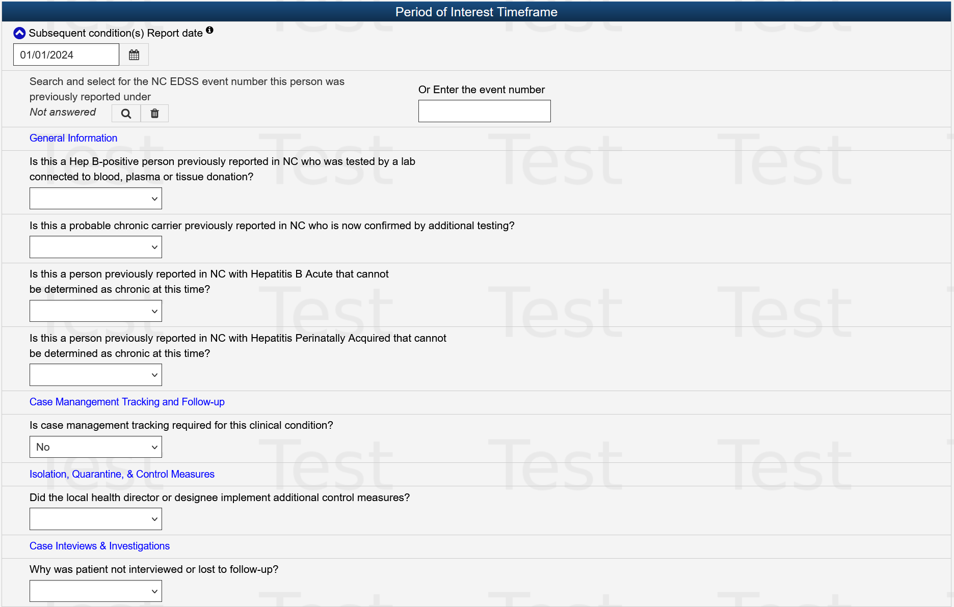
Completing the Subsequent Report Package in NCEDSS
Step 2: If the person has a previous event in your county, click on the magnifying glass to search for the event in NCEDSS
Step 2: If the person has a previous event in another county, hand enter the event number here
OR

Slide 30
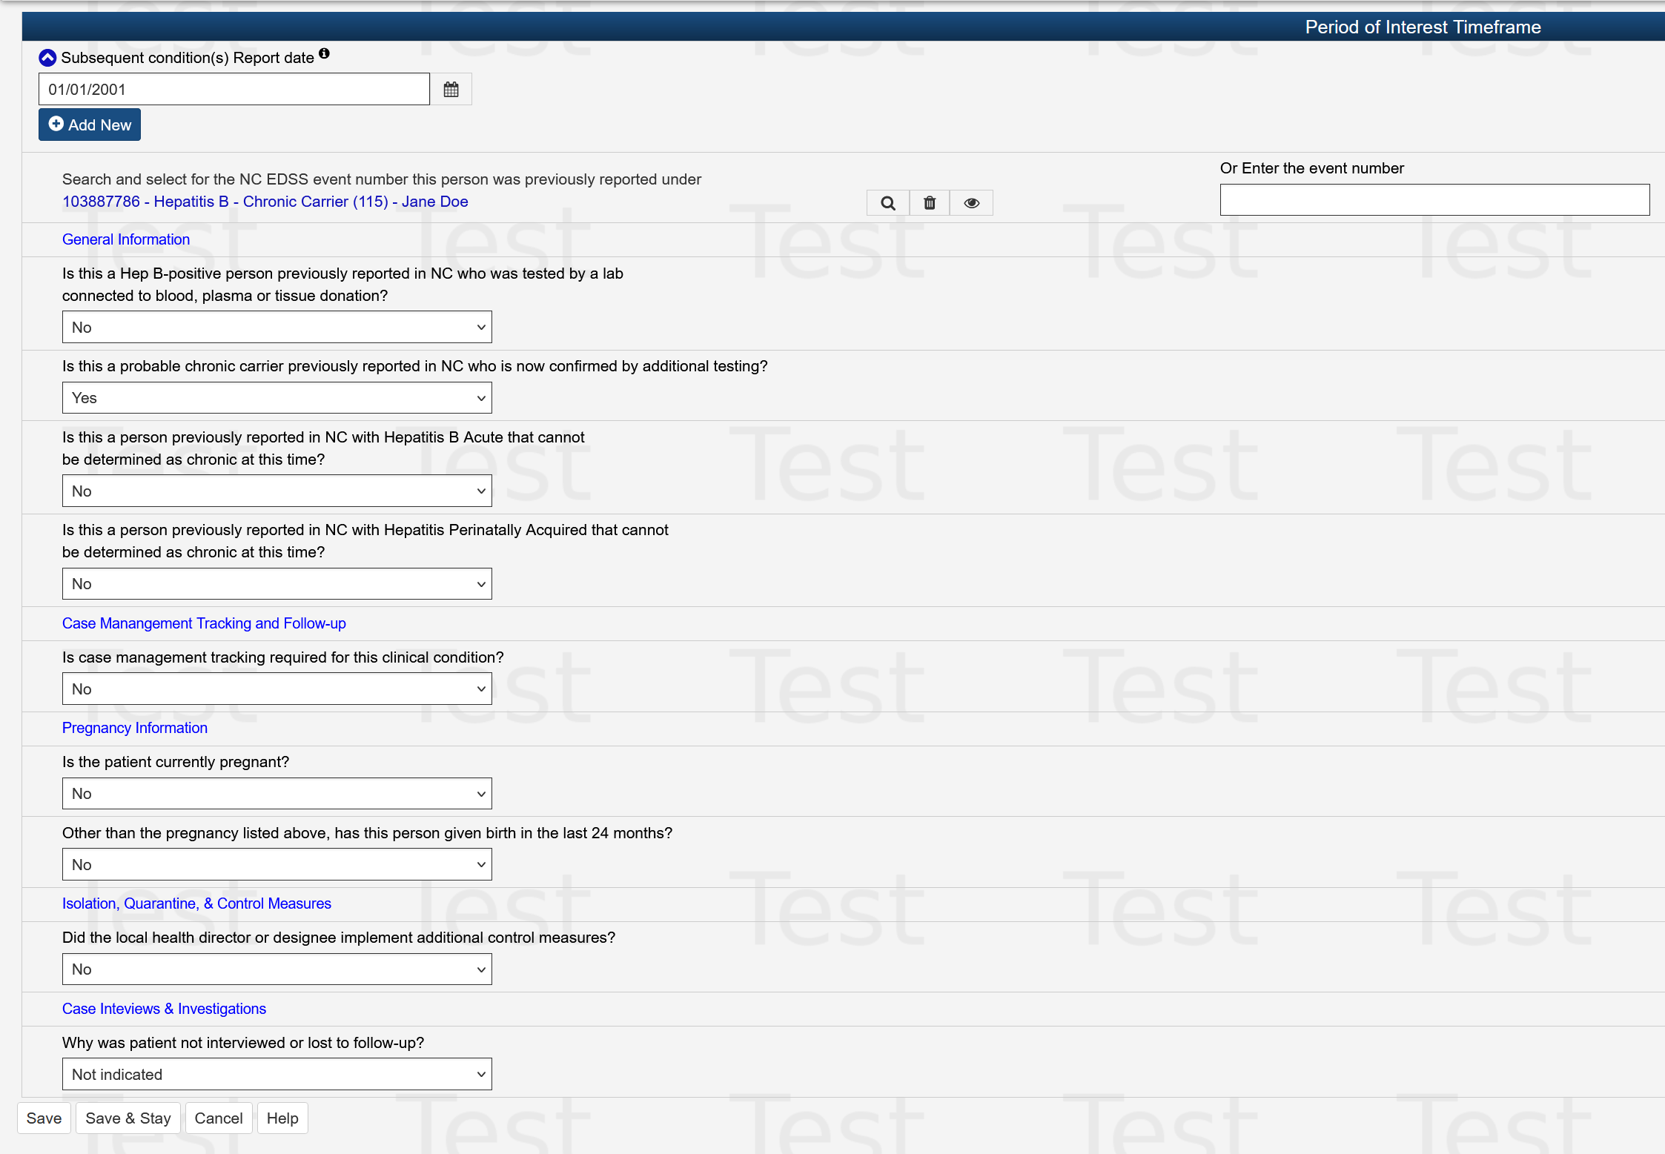
Completing the Subsequent Report Package in NCEDSS
Step 3: Answer the questions listed in the report package. In this instance, the person is a previous probable chronic that can now be confirmed
For females of childbearing age (14-50 years) the pregnancy question must be completed.
Step 4: Save and assign to the state

Slide 31
Completing the Subsequent Report Package in NCEDSS
Chronological listing of subsequent reports should roughly match up to lab dates
Notes:
This is an example of someone with multiple subsequent report packages. The subsequent report packages will merge into the original event and create a chronological history of reporting for that patient. Labs and attachments will also merge into the original event and be available. The dates for the Subsequent Reports should roughly match the specimen dates for labs received after the initial report.

Slide 32
Questions?

Slide 33
Contact Information:
dianne.brewer@dhhs.nc.gov
Office: (984) 236-1474
Joshua.R.Moore@dhhs.nc.gov

