Slide 1
NC Department of Health and Human Services
Gonorrhea Epidemiology in North Carolina 2020
Division of Public Health/Epidemiology Section/Communicable Disease Branch
HIV/STD/Viral Hepatitis Surveillance Unit
October 2021

Slide 2
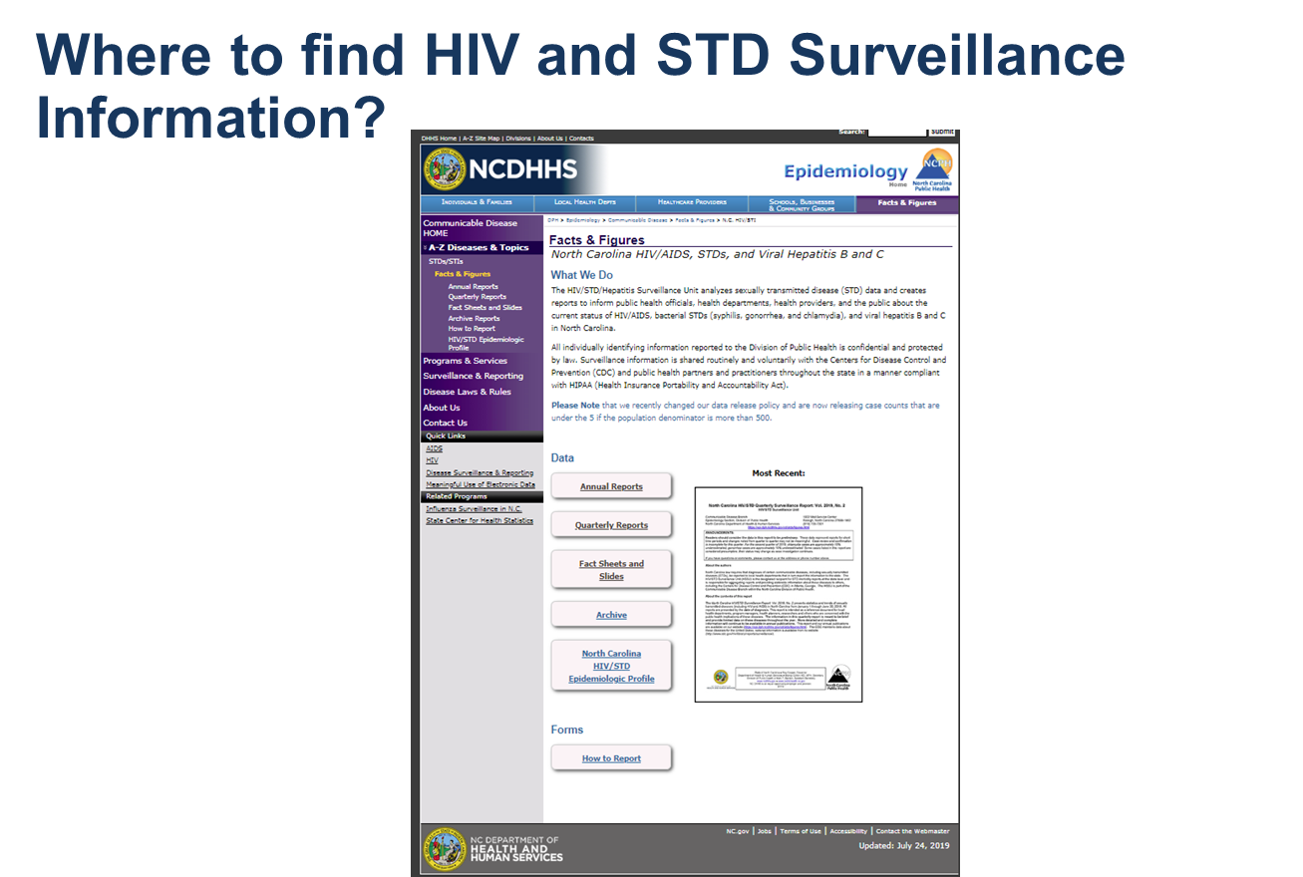
http://epi.publichealth.nc.gov/cd/stds/figures.html

Slide 3
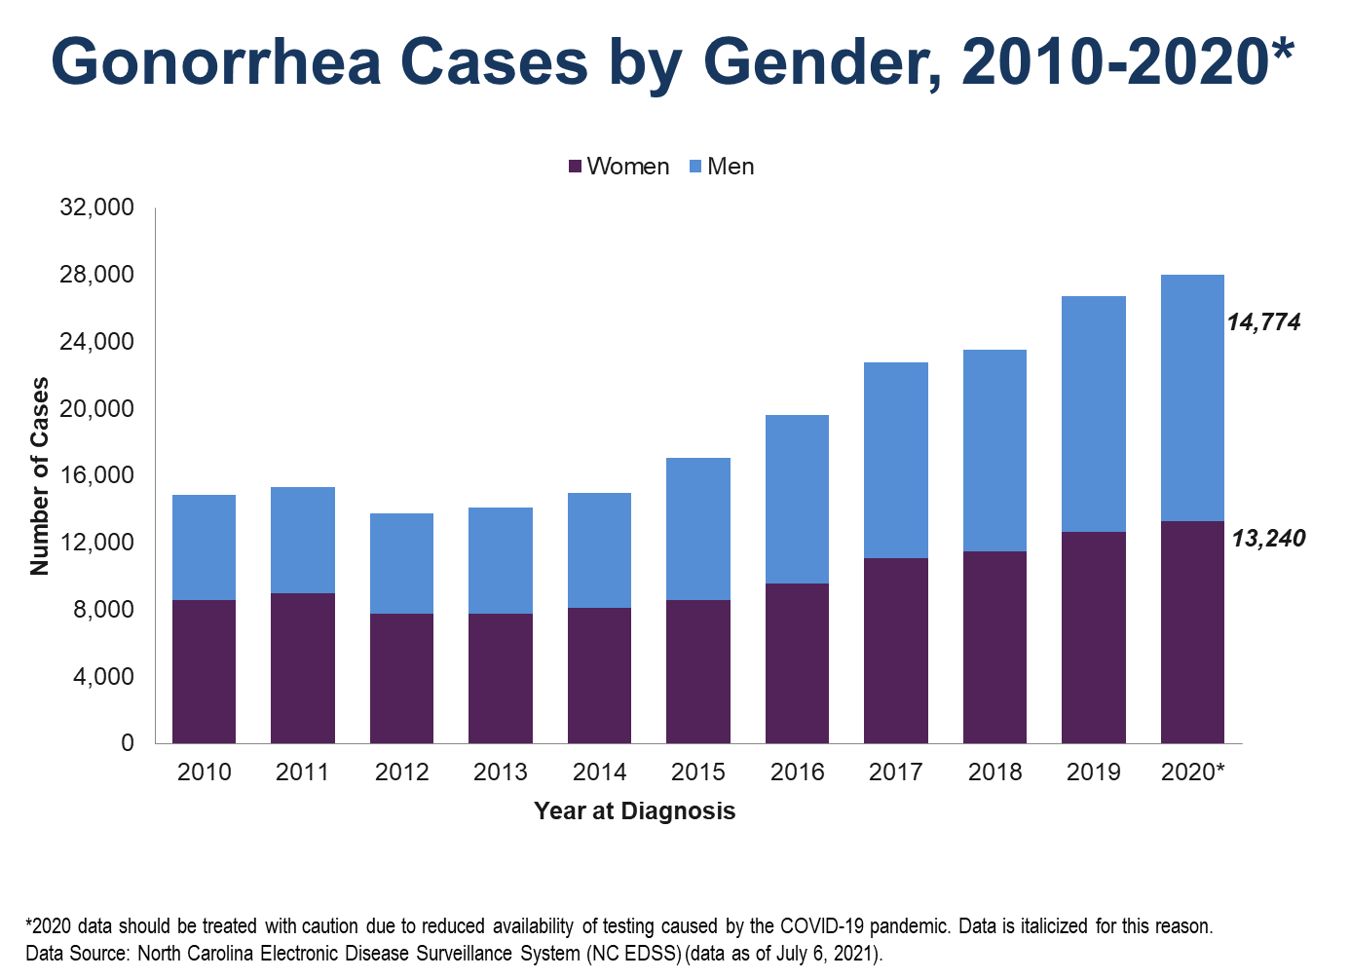

Slide 4
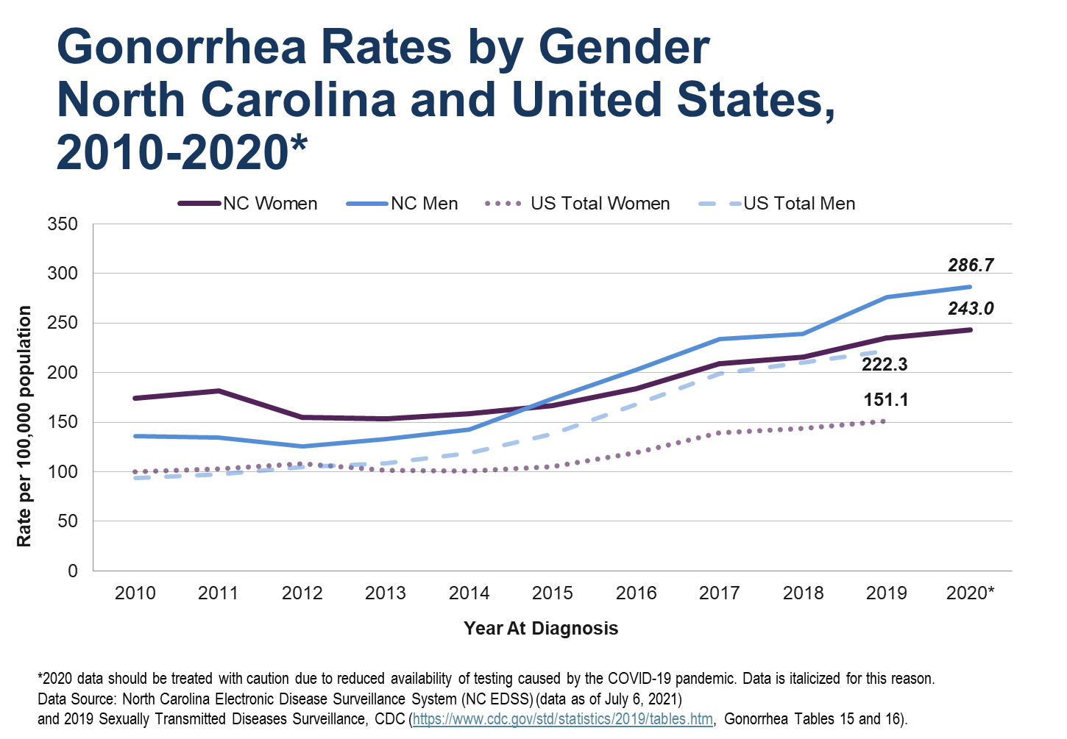

Slide 5
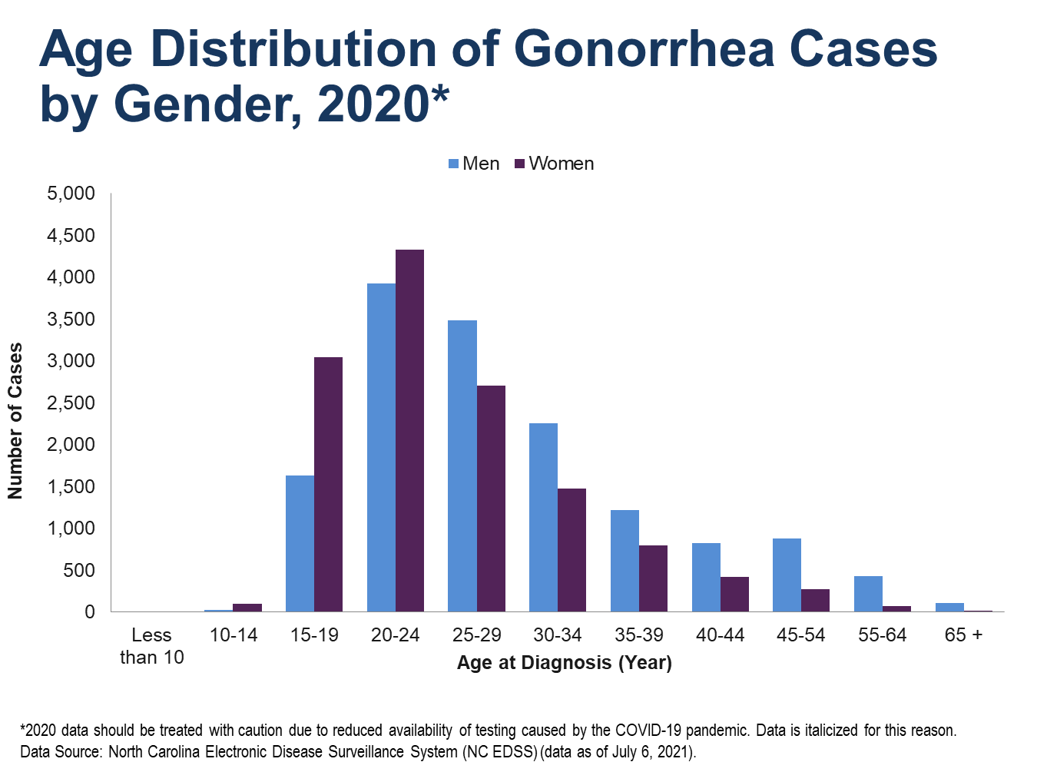

Slide 6
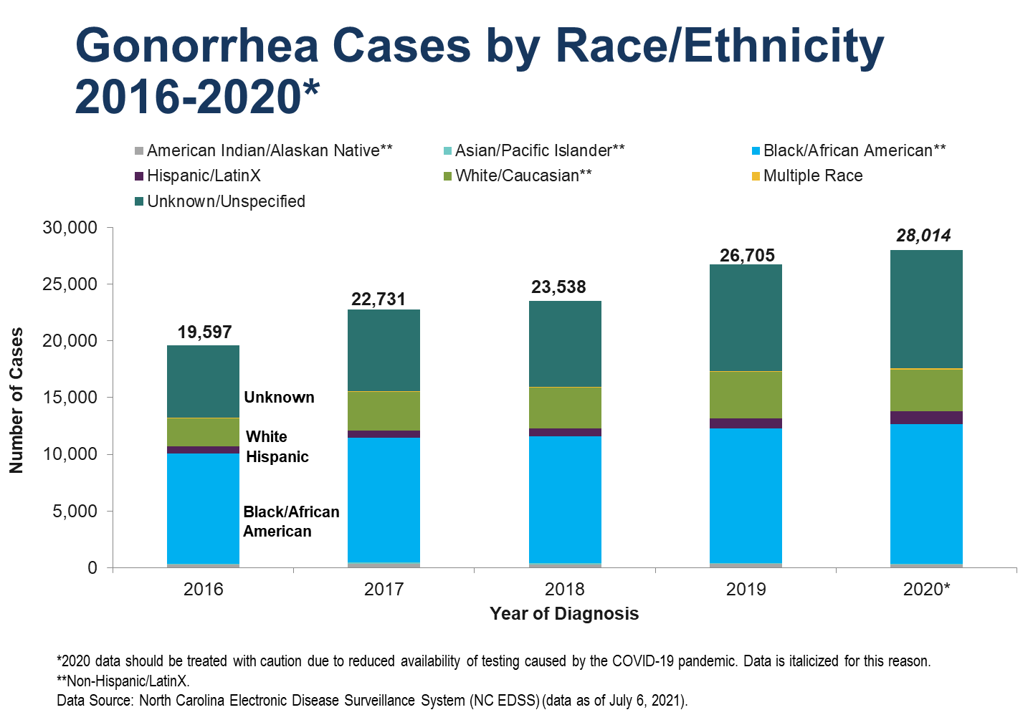

Slide 7
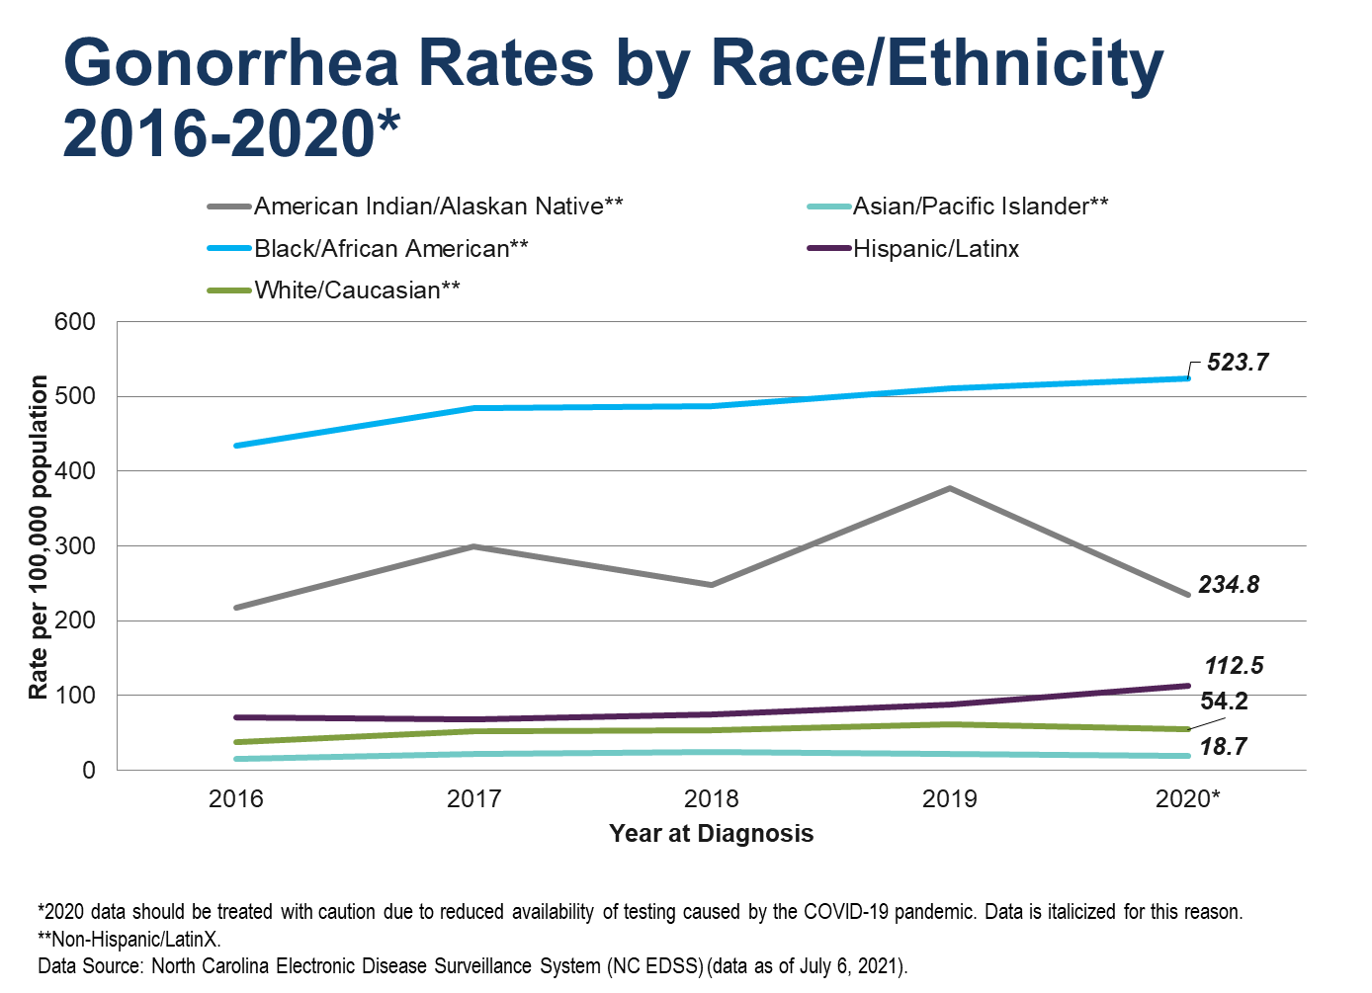

Slide 8
