Slide 1
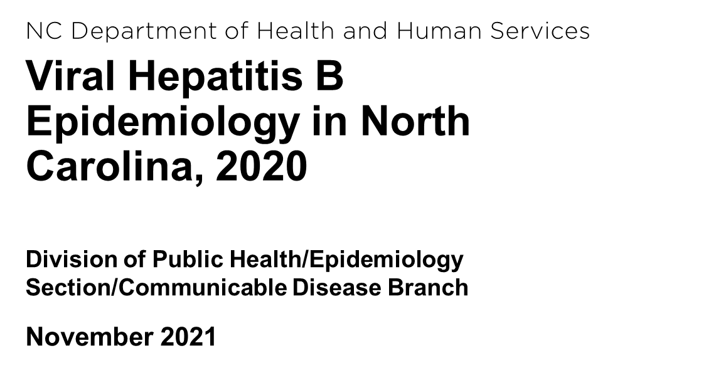

Slide 2
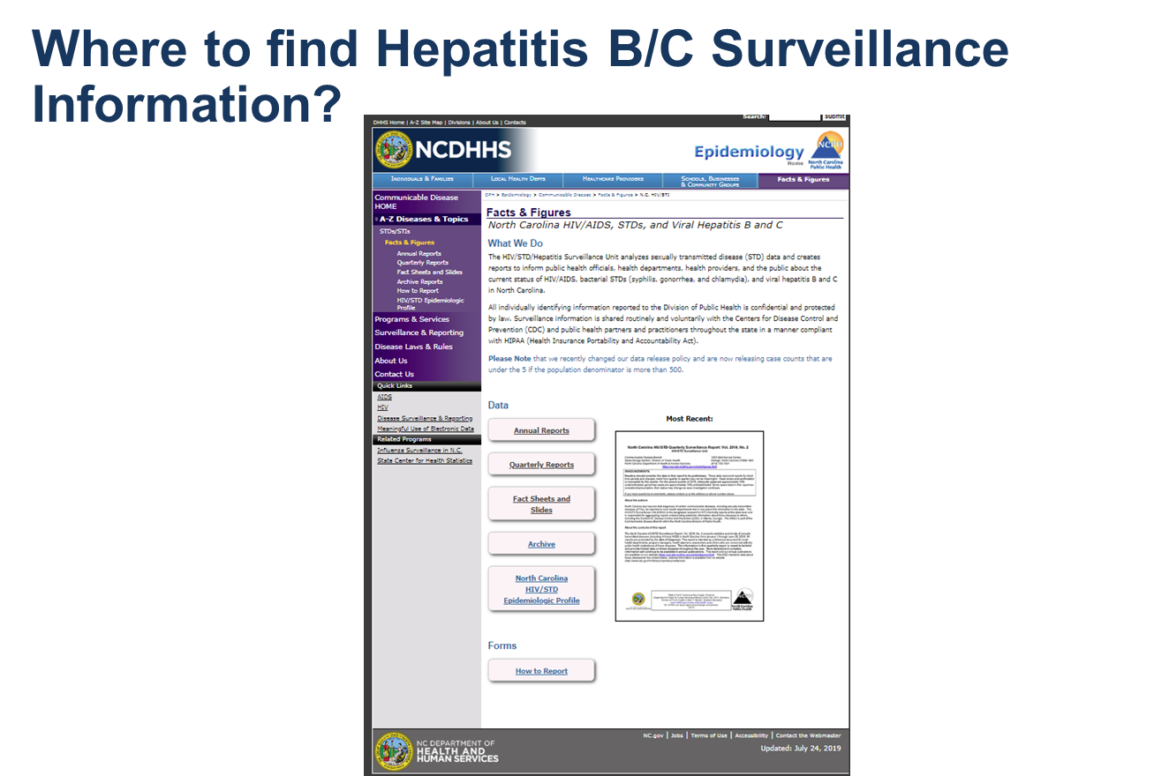
https://epi.dph.ncdhhs.gov/cd/stds/figures.html

Slide 3
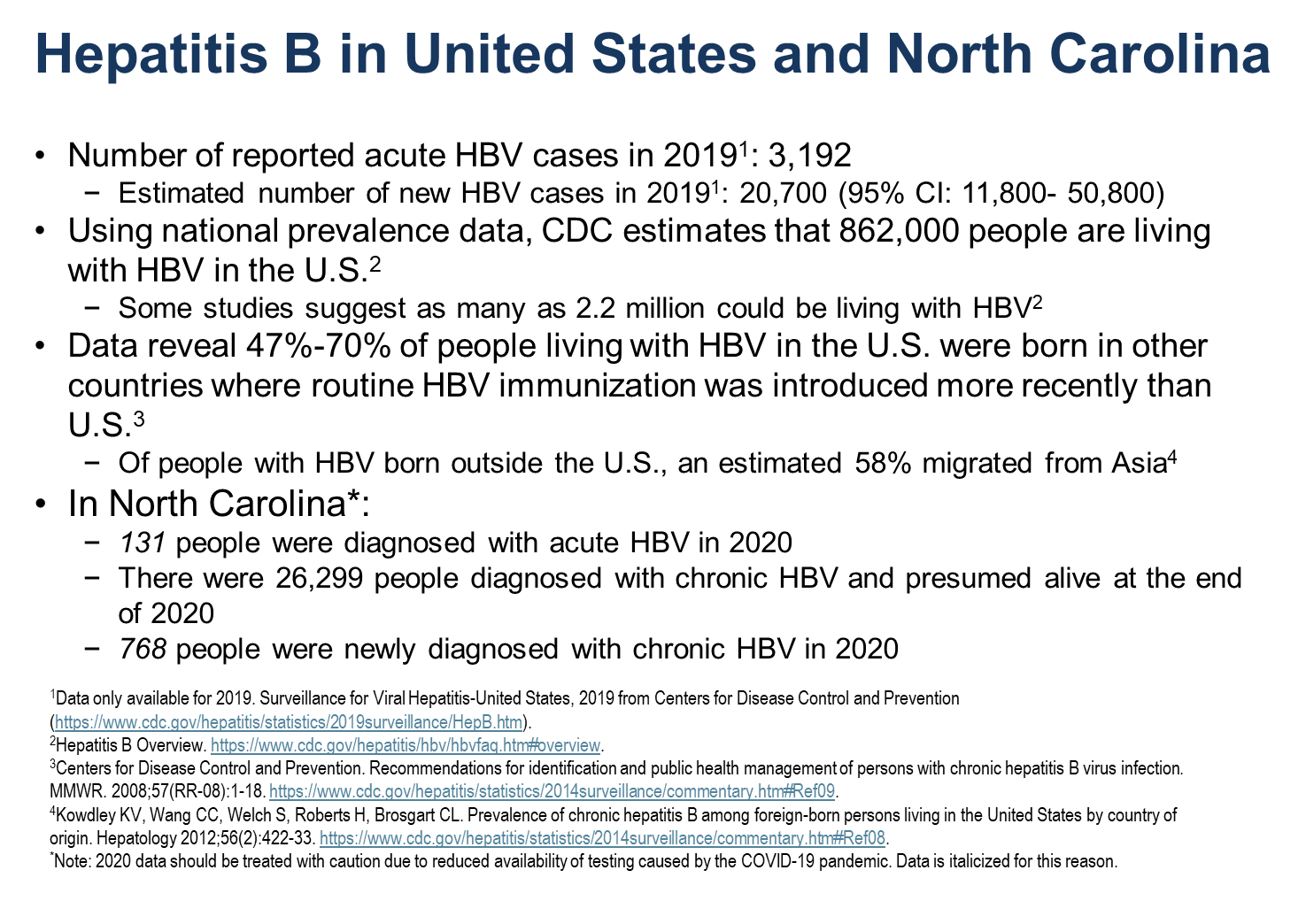

Slide 4
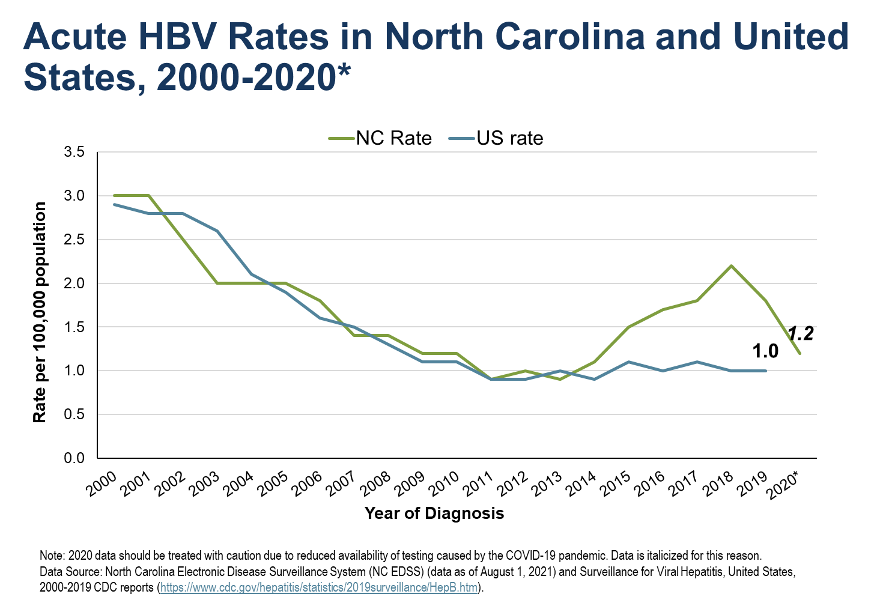

Slide 5
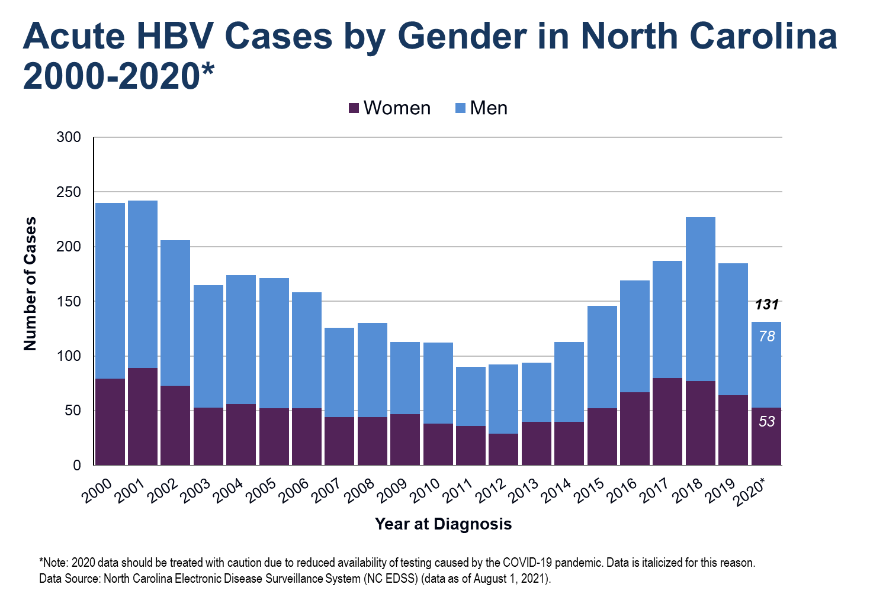

Slide 6
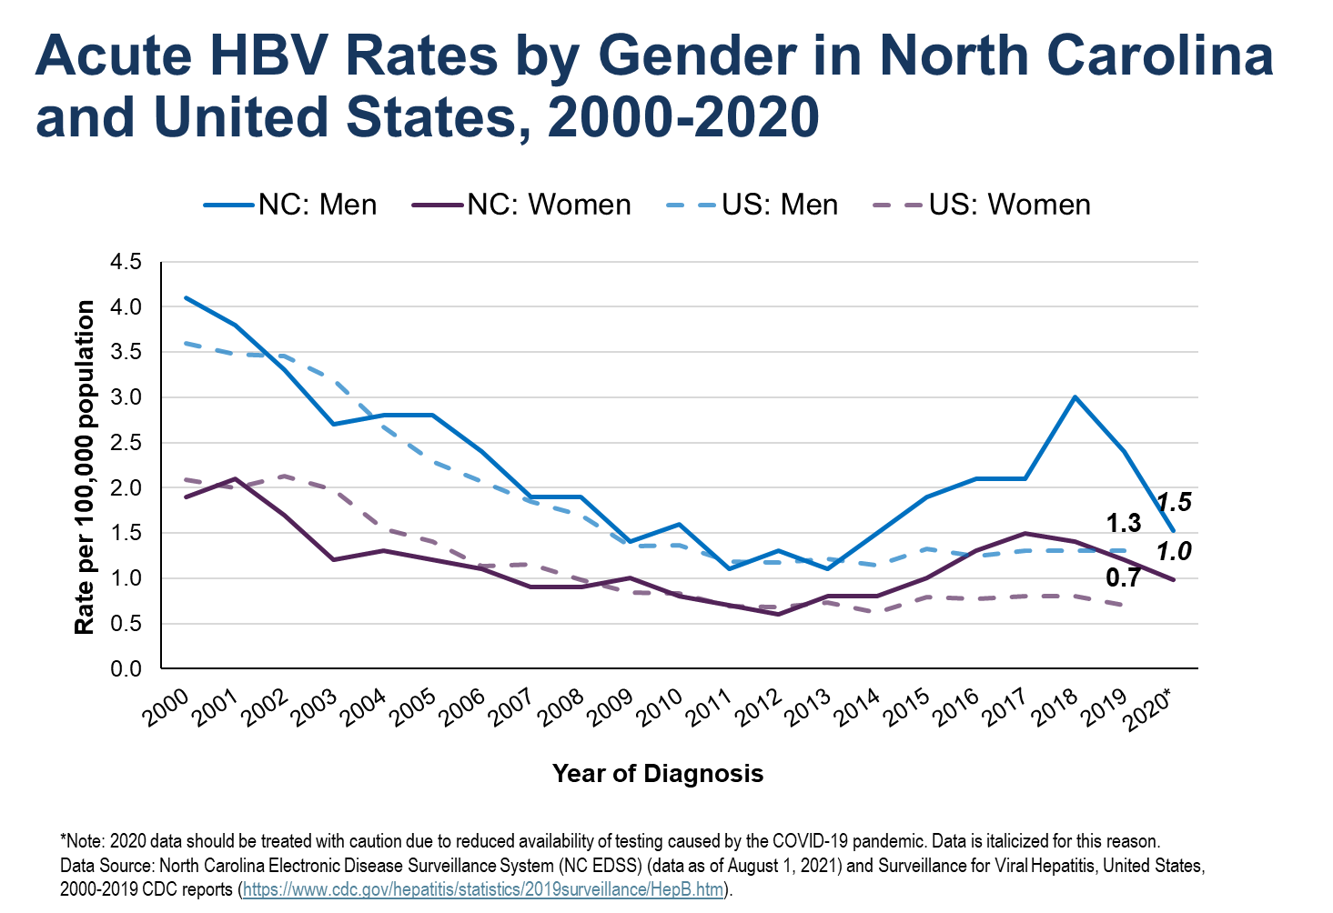

Slide 7
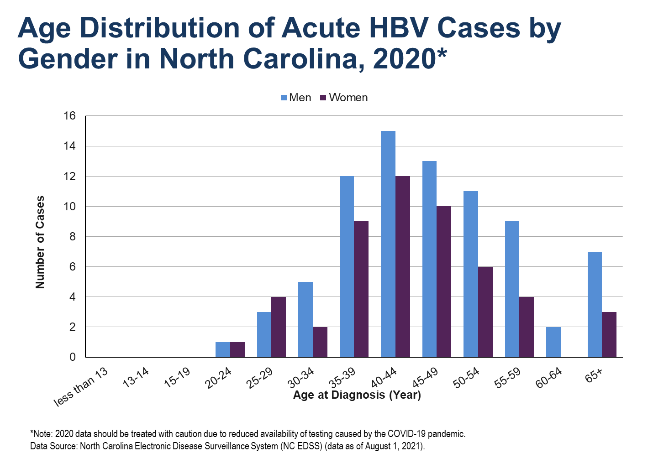

Slide 8
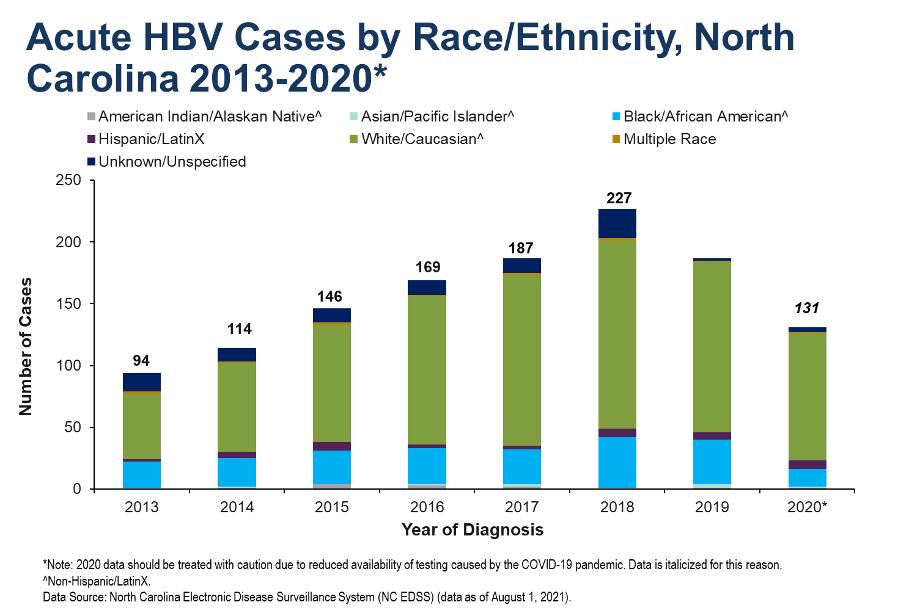

Slide 9
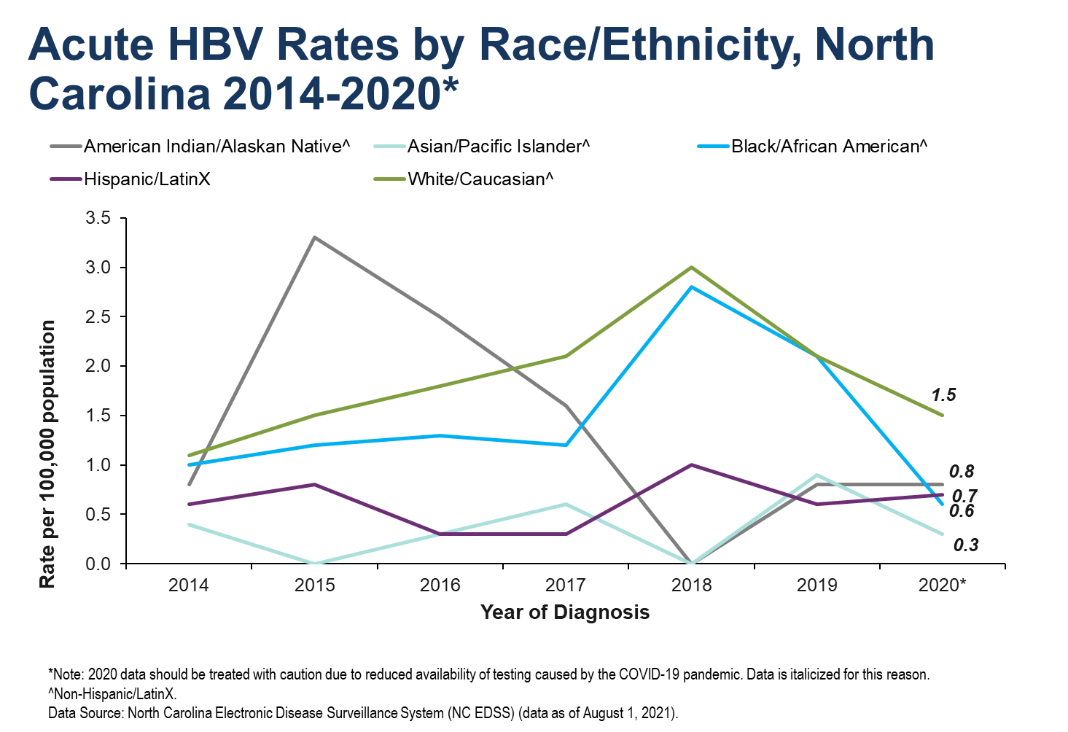

Slide 10
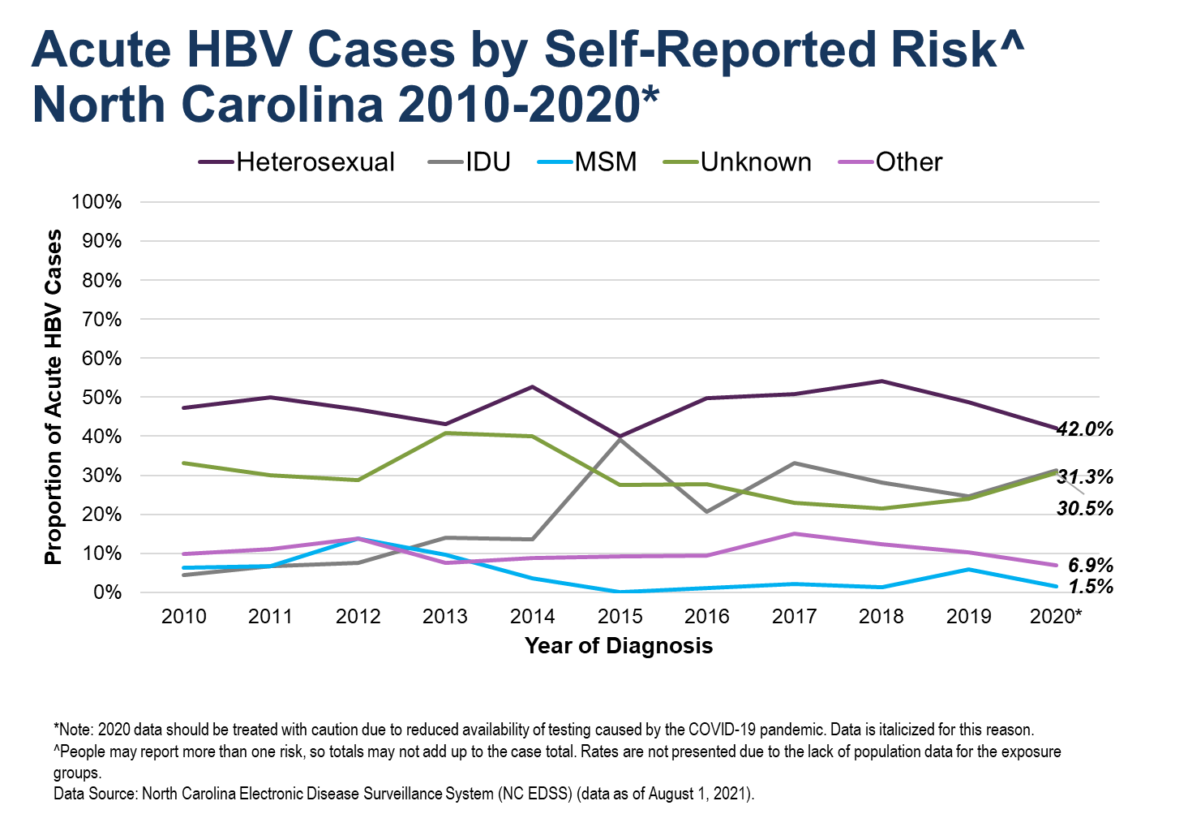
Notes:
Of course IDU maybe appear to us as “unknown”; rising number of unknown may reflect rising % of PWID or county inability/decision not to investigate cases
Updated numbers:
2015: Heterosexual 0.5 to 0.4, IDU 0.2 to 0.392, Other 0.1 to 0.092, Unknown 0.4 to 0.275
2016: Heterosexual 0.5 to 0.414, IDU 0.2 to 0.433, MSM 0 to 0.005, Other 0.1 to 0.044, Unknown 0.4 to 0.236
2017: Heterosexual 0.5 to 0.438, IDU 0.3 to 0.464, MSM 0 to 0.005, Other 0.14 to 0.0625, Unknown 0.3 to 0.266
2018: Heterosexual 0.54 to 0.406, IDU 0.27 to 0.487, MSM 0.1 to 0, Other 0.12 to 0.152, Unknown 0.29 to 0.198

Slide 11
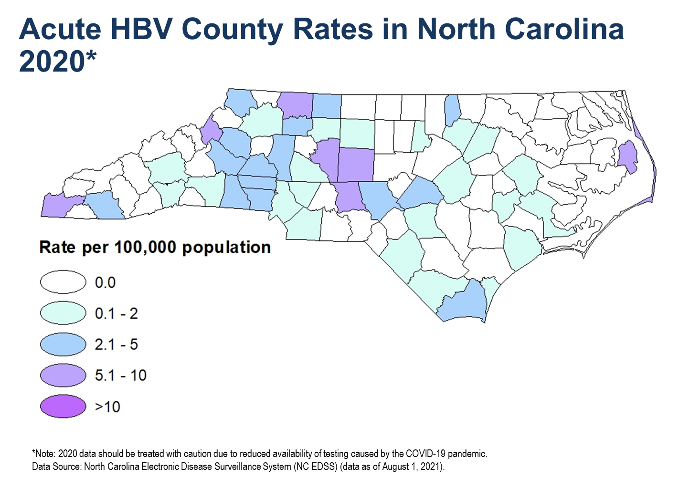

Slide 12
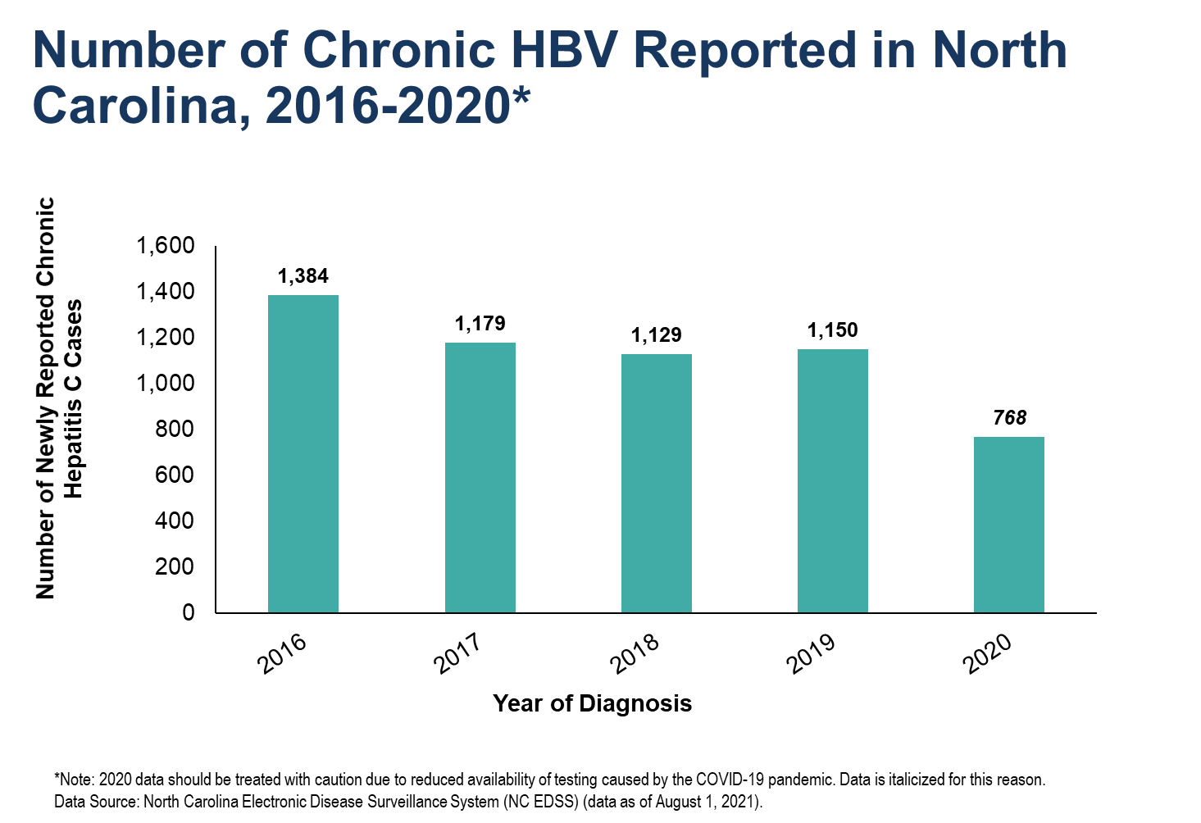

Slide 13
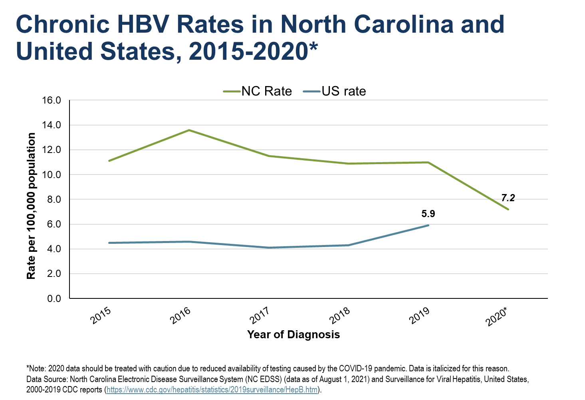

Slide 14
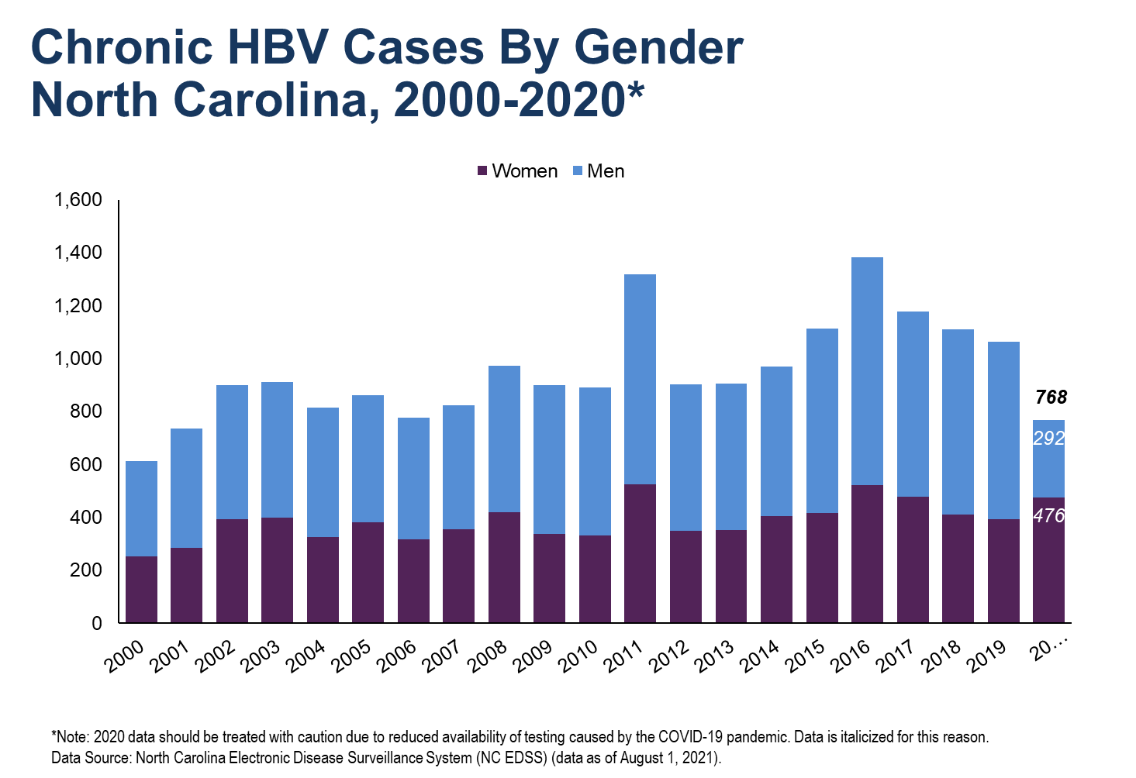

Slide 15
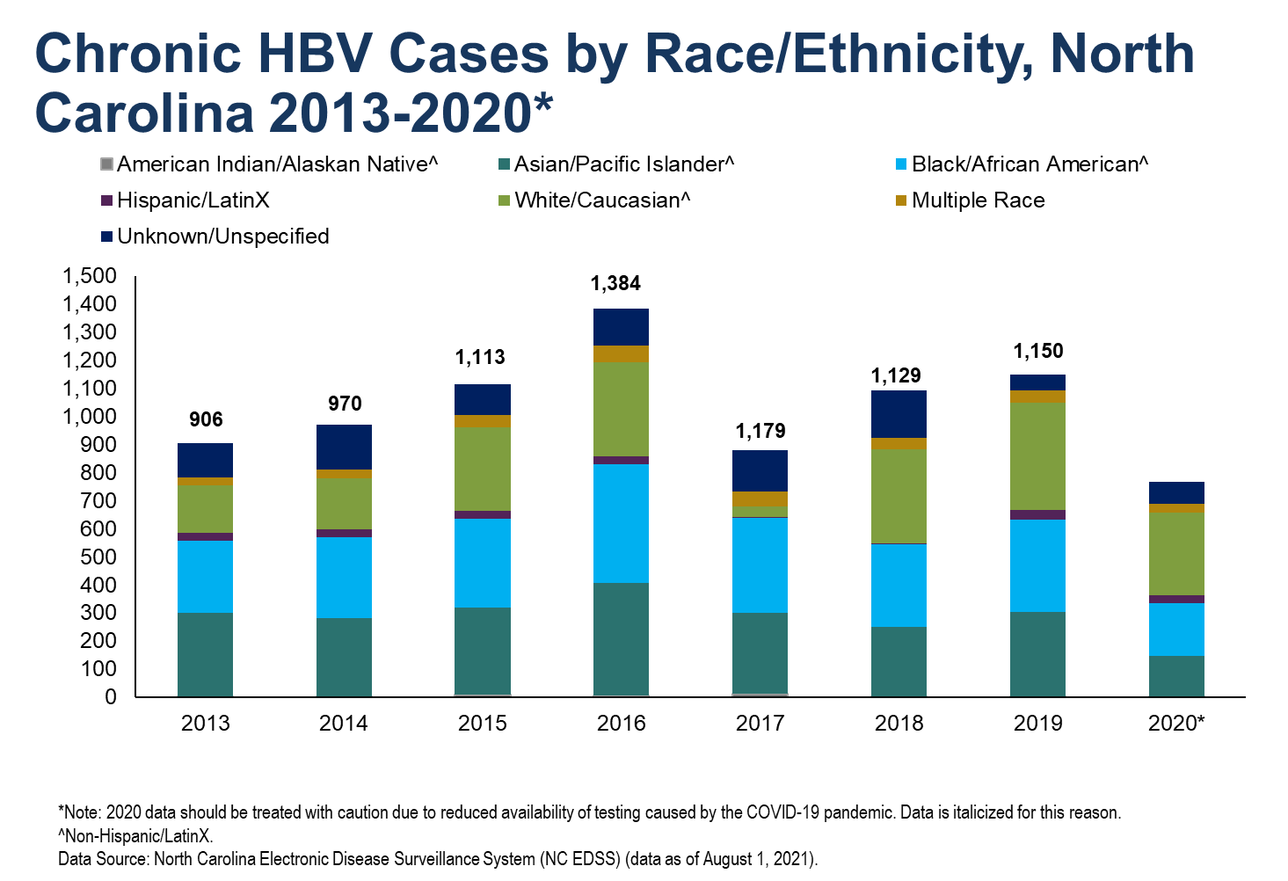

Slide 16
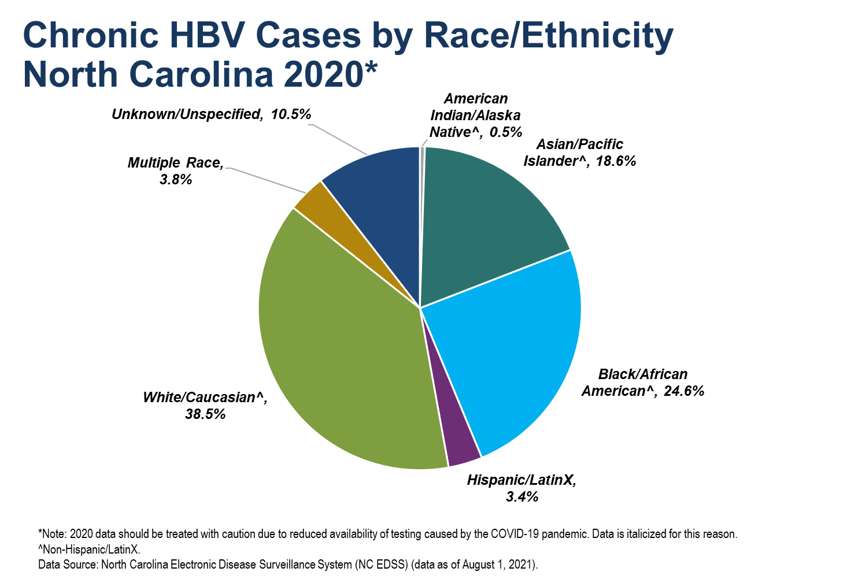

Slide 17
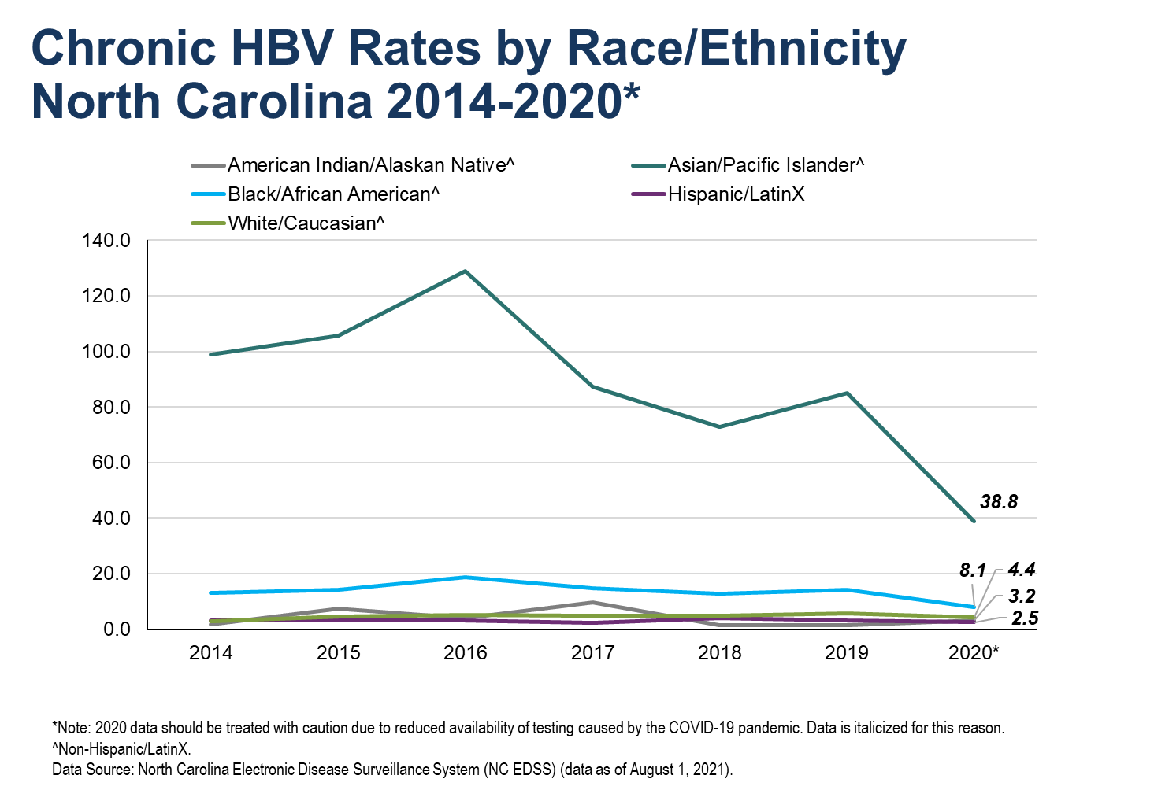

Slide 18
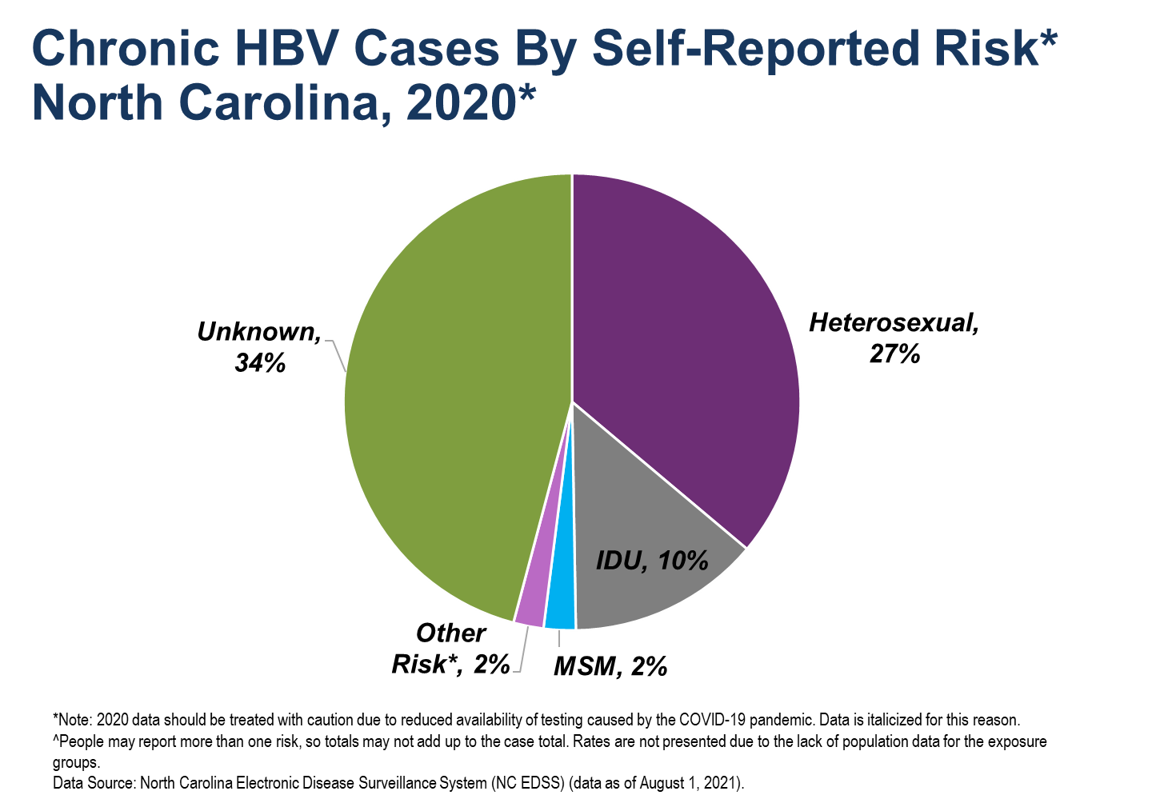

Slide 19
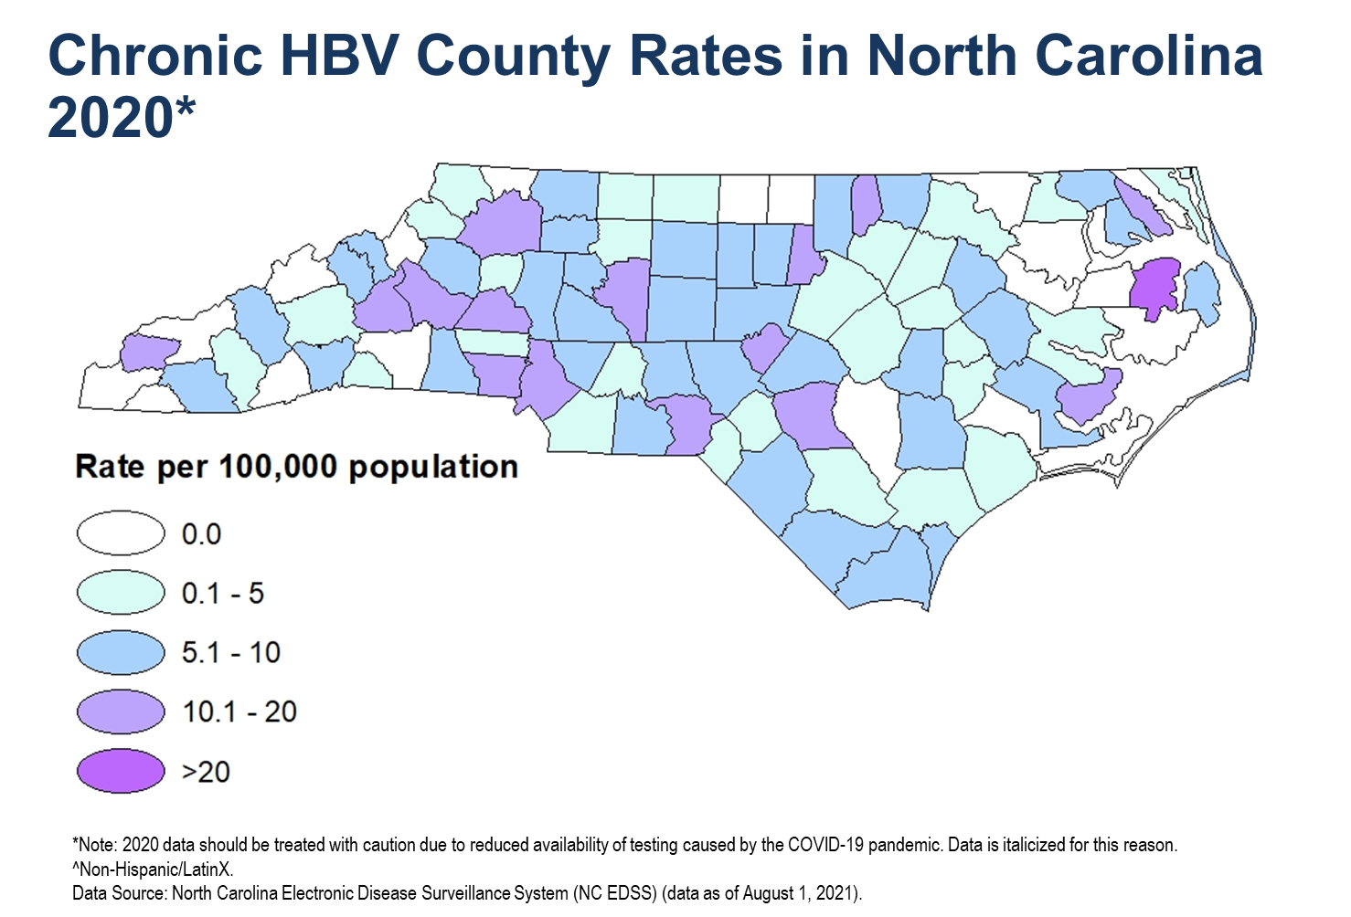

Slide 20


Slide 21
