Slide 1
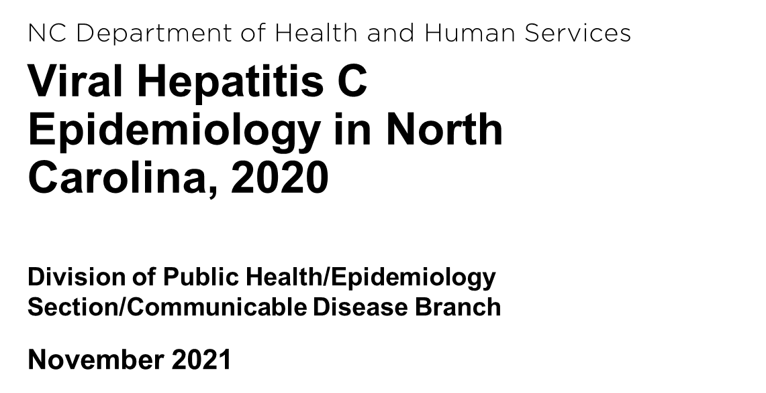

Slide 2
https://epi.dph.ncdhhs.gov/cd/stds/figures.html

Slide 4
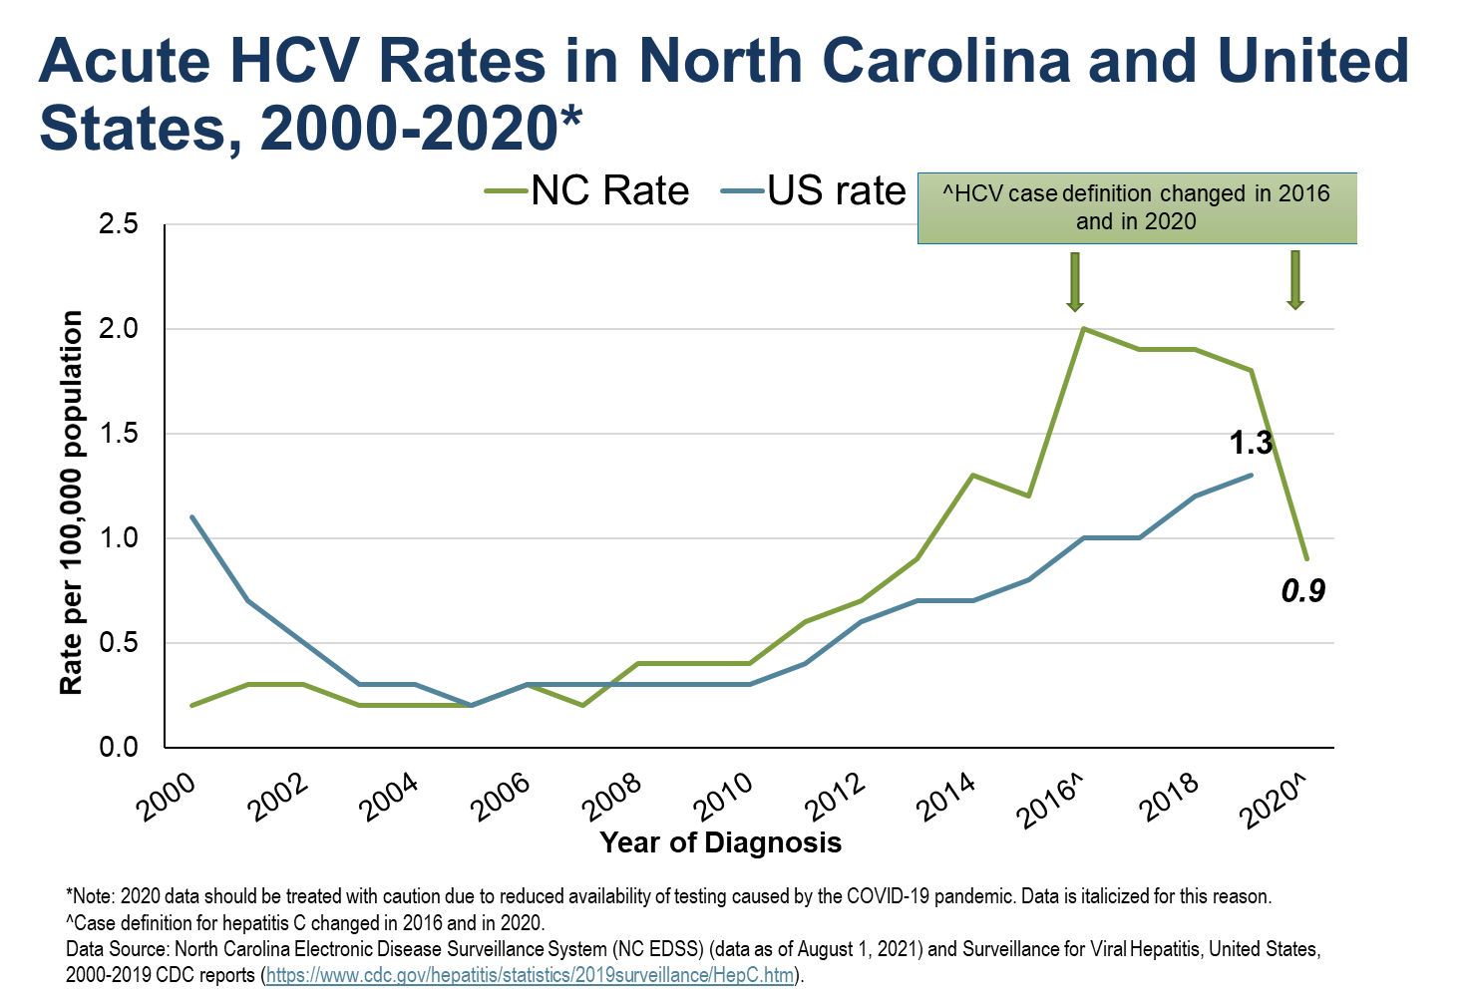

Slide 5
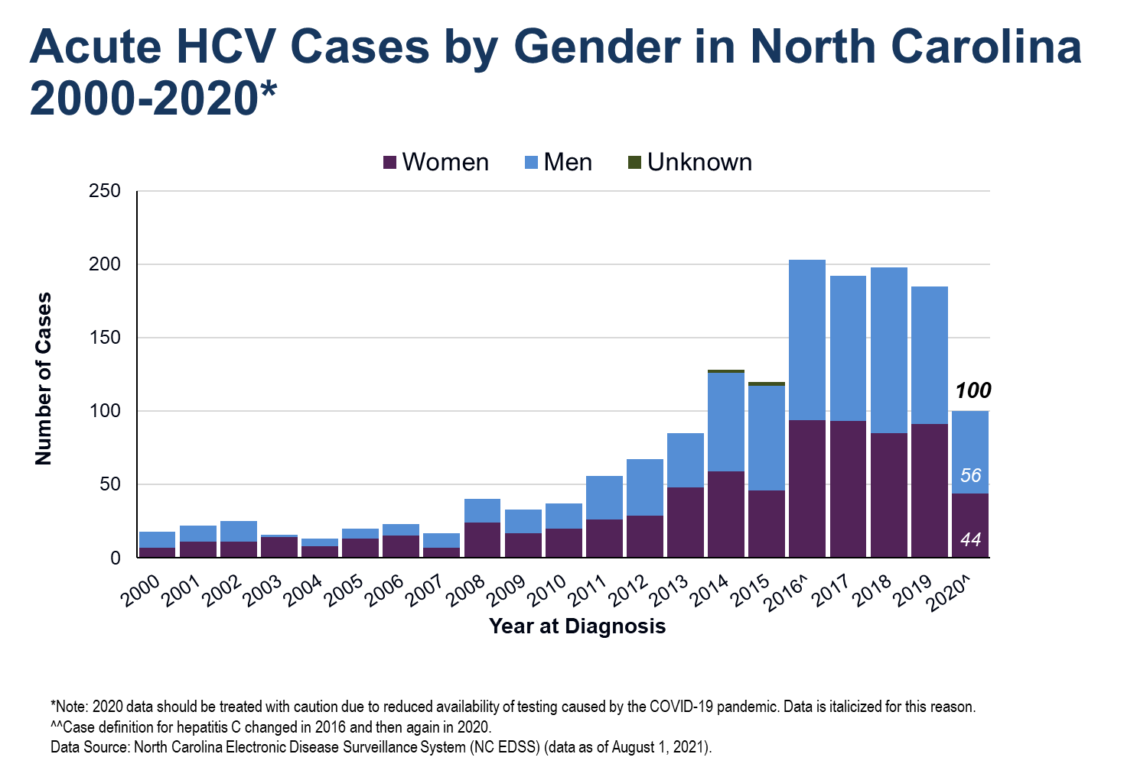

Slide 6
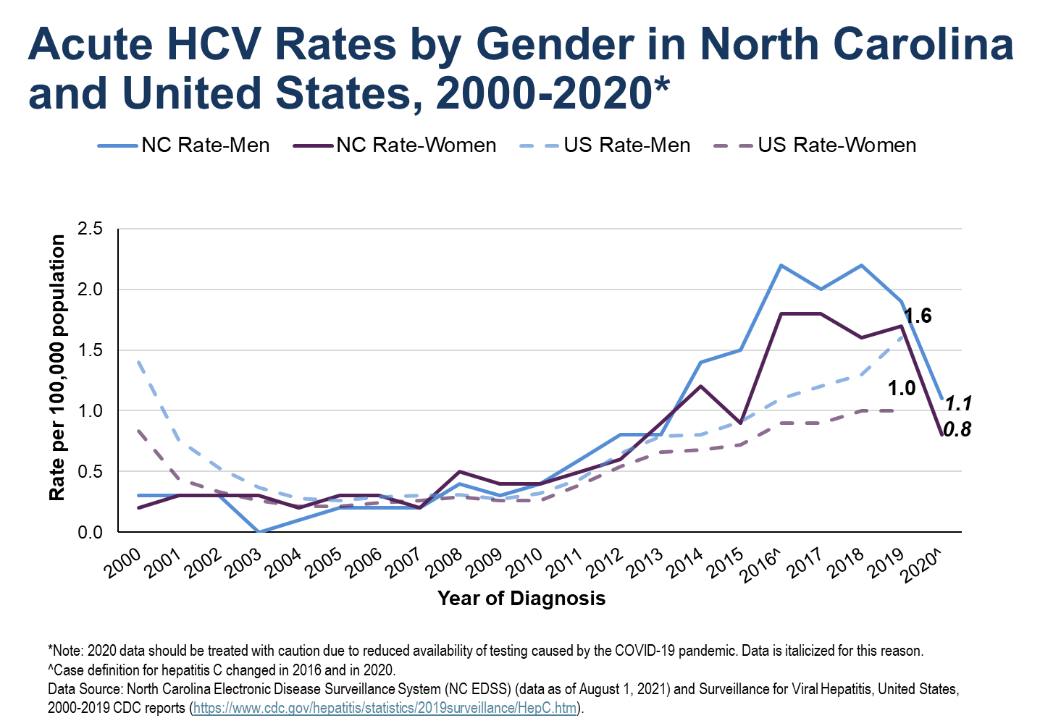

Slide 7
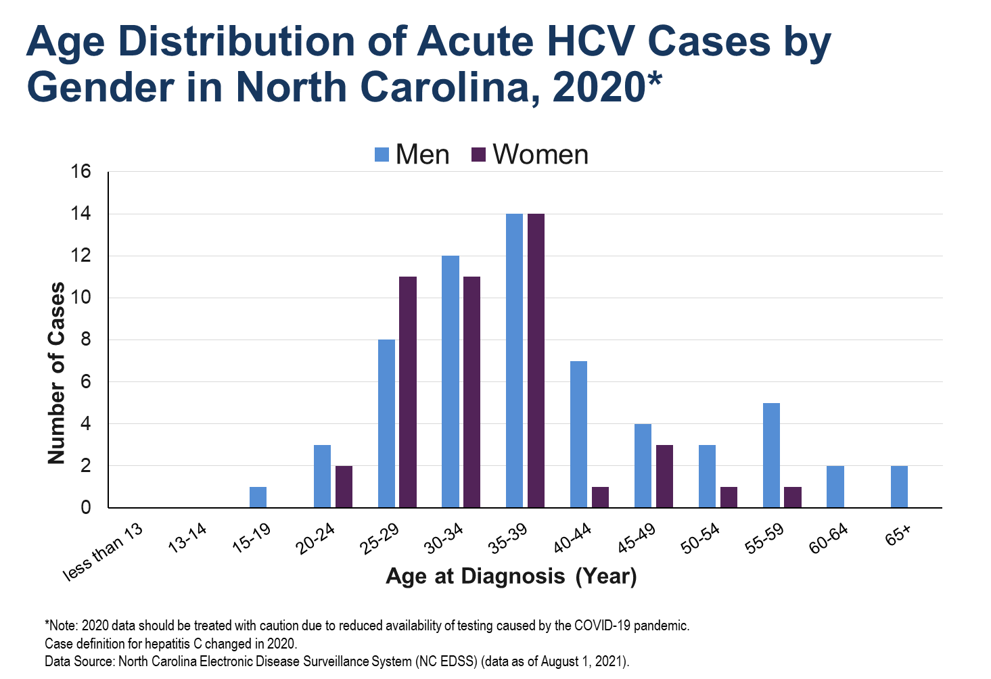

Slide 8
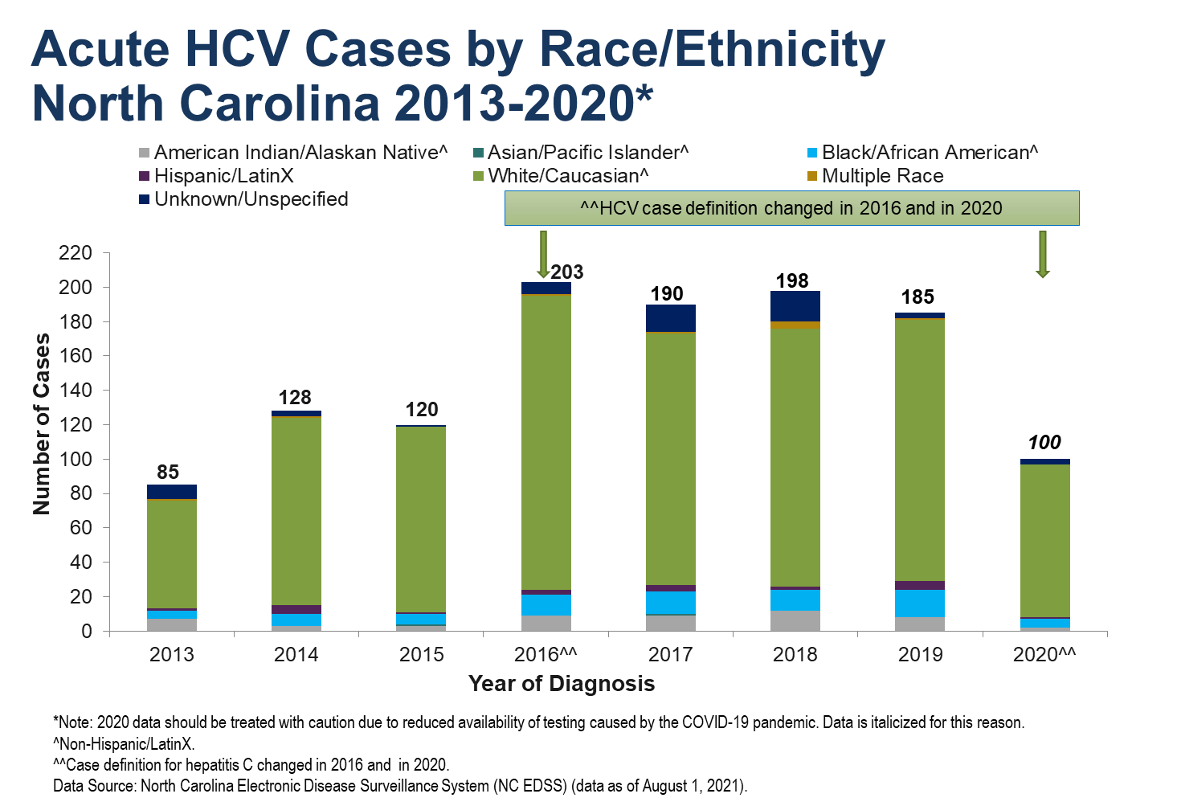

Slide 9
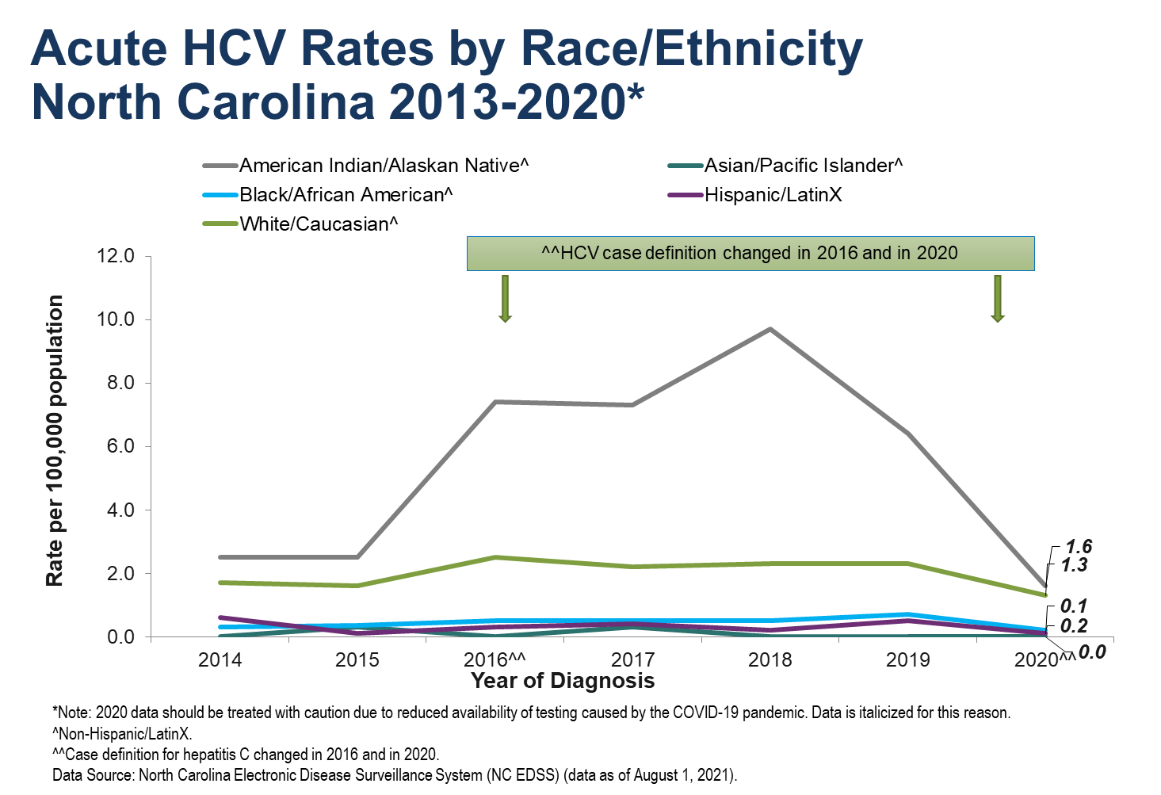

Slide 10
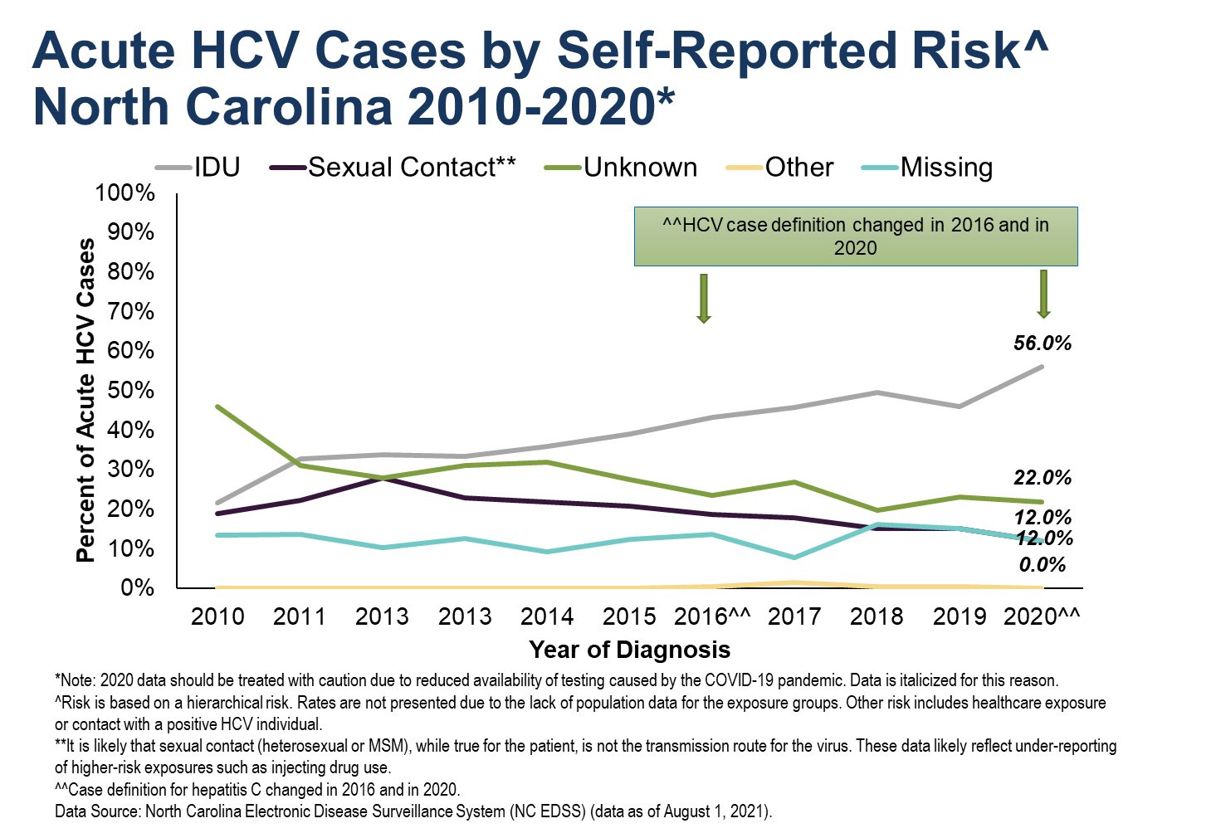
Notes:
For hepatitis C, we look at a hierarchical risk, as opposed to someone fitting in any category. As you can see, IDU is the highest self-reported risk among people newly diagnosed with acute hepatitis C, followed by unknown risk and sexual contact. It is likely that sexual contact (heterosexual or MSM), while true for the patient, is not the transmission route for the virus. These data likely reflect under-reporting of higher-risk exposures such as injecting drug use.

Slide 11
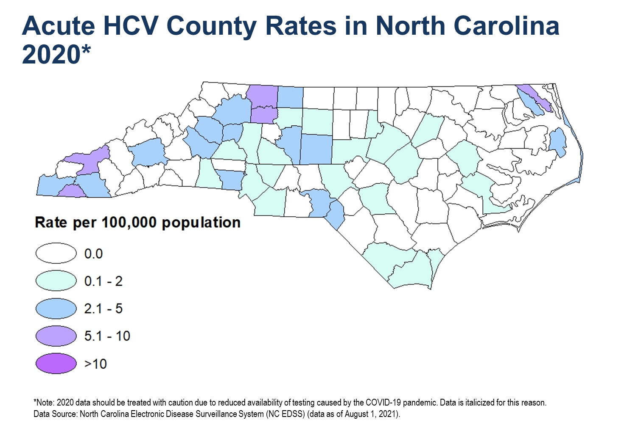

Slide 12
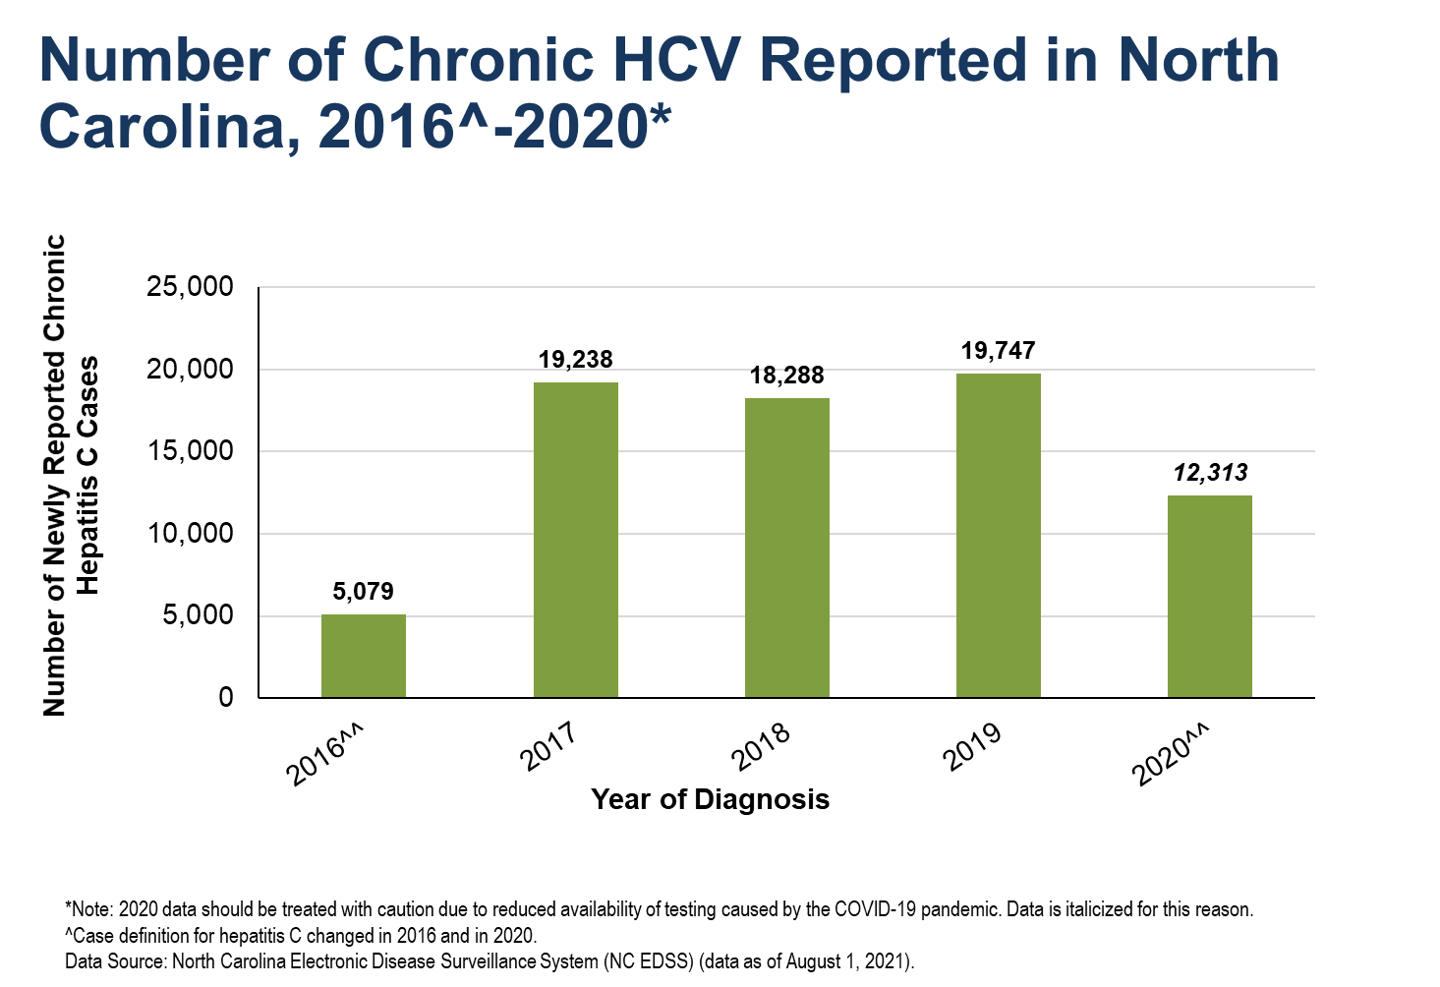

Slide 13
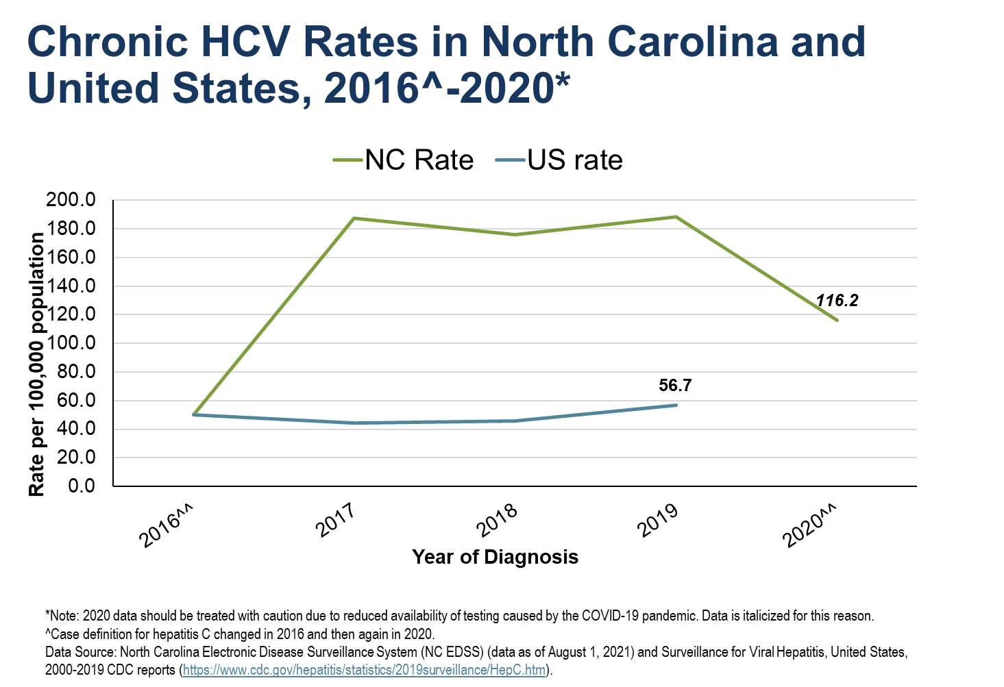

Slide 14
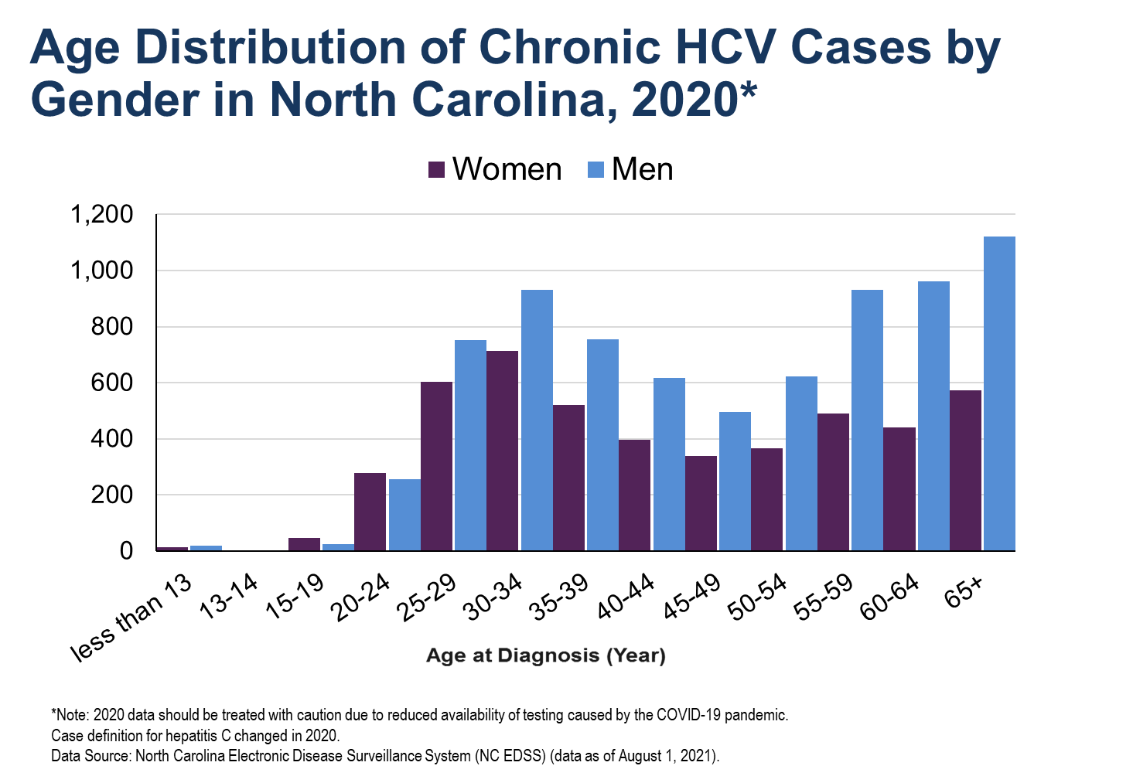

Slide 15
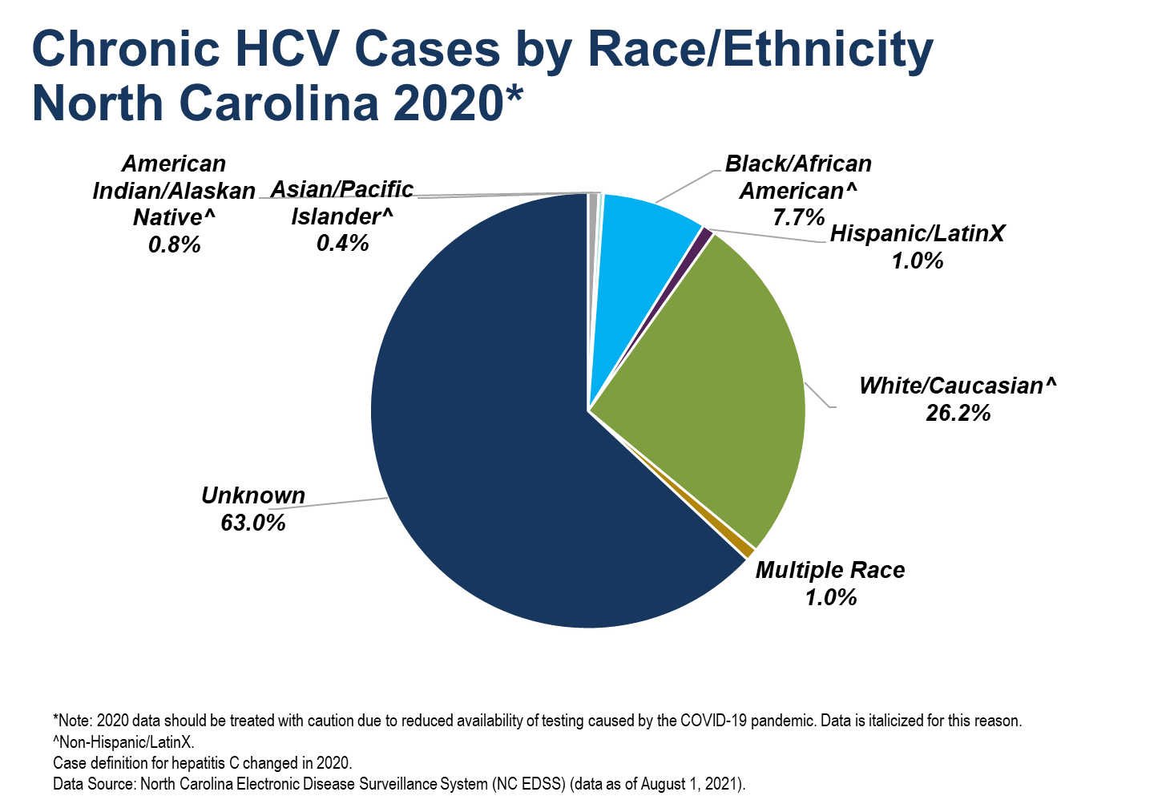

Slide 16
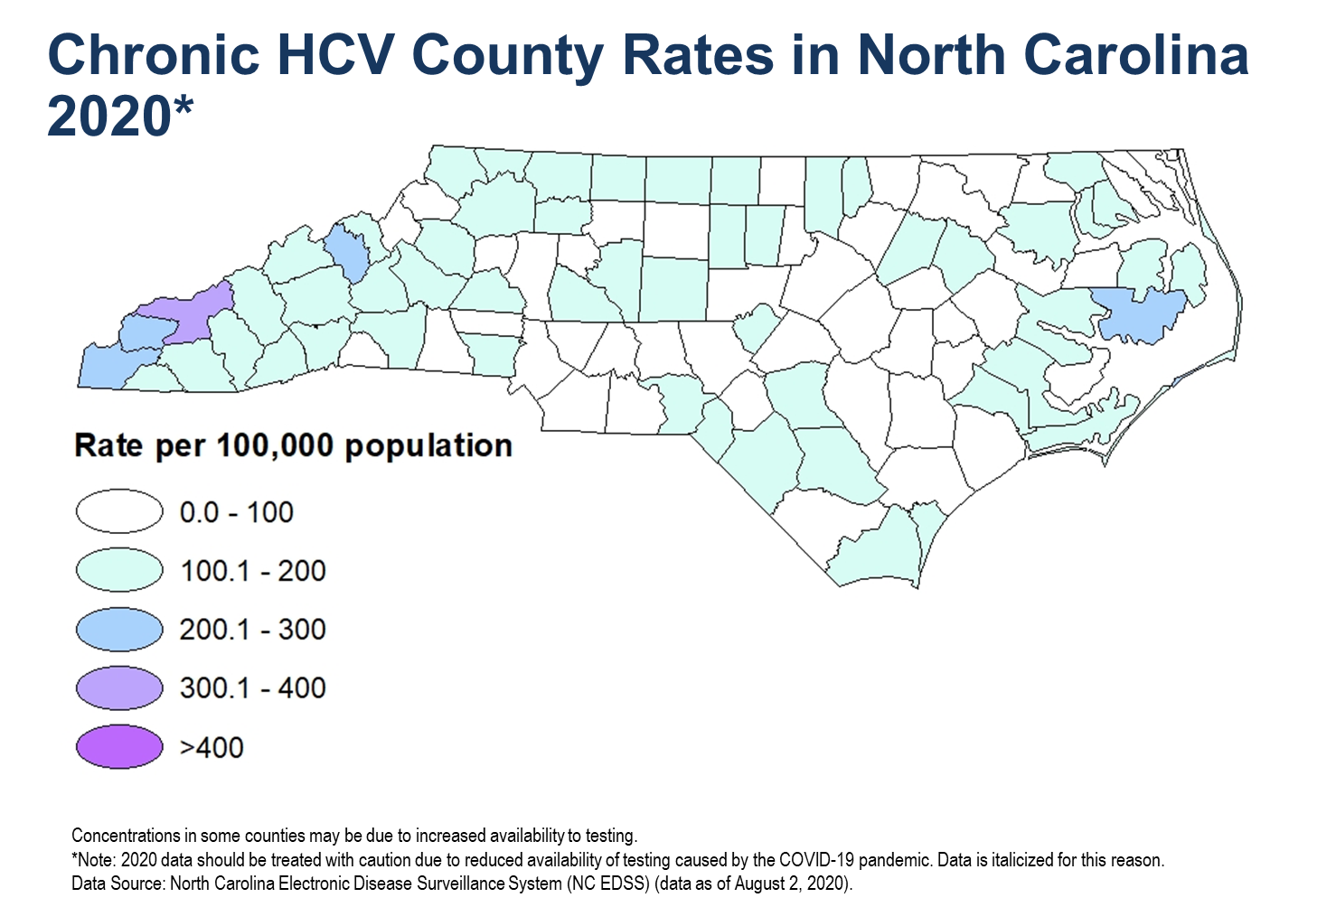

Slide 18
Viral Hepatitis and HIV

Slide 20
