Slide 1
NC Department of Health and Human Services
HIV Epidemiology in North Carolina 2023
Division of Public Health/Epidemiology Section/Communicable Disease Branch
HIV/STD/Viral Hepatitis Surveillance Unit
August 2024

Slide 2
HIV in North Carolina

Slide 3
North Carolina HIV Rates by Year of Diagnosis, 2000-2023
^Note: 2020 data should be treated with caution due to reduced availability of testing caused by the COVID-19 pandemic.
*Based on most recent address in eHARS as of December 31 of the given year.
**New cases are only among adults and adolescents (13 years and older).
Data Source: enhanced HIV/AIDS Reporting System (eHARS) (data as of July 2024) and North Carolina Vital Statistics, Volume 2: Leading Causes of Death 2000-2021.

Slide 4
Age Distribution of People Diagnosed with HIV and Living in NC* by Gender** in 2023
*Based on most recent address or age in eHARS as of December 31 of the given year.
**Transgender status is based on self-report; for exposure category, transgender people are classified by their recorded binary gender. Due to historical and current stigma, the total number of transgender people is likely to be an underestimation. This variable was not routinely captured until 2015 in our surveillance system.
Data Source: enhanced HIV/AIDS Reporting System (eHARS) (data as of July 2024).

Slide 5
Estimated HIV Incidence in NC, 2009-2021^
Estimated incidence using CDC’s “CD4 Model” SAS code from August 2023; this model rounds numbers to nearest 100 to indicate that model is estimating.
^CDC model takes reduced reporting into 2020 into account; note confidence intervals widen
Data Source: enhanced HIV/AIDS Reporting System (eHARS) (data as of June 2023).

Slide 6
Newly Diagnosed HIV among Adult and Adolescents (13 years and older) by Gender*, 2000-2023
1,140
245
^Note: 2020 data should be treated with caution due to reduced availability of testing caused by the COVID-19 pandemic.
*Transgender status is based on self-report; for exposure category, transgender people are classified by their recorded binary gender. Due to historical and current stigma, the total number of transgender people is likely to be an underestimation. This variable was not routinely captured until 2015 in our surveillance system.
Data Source: enhanced HIV/AIDS Reporting System (eHARS) (data as of July 2023) and North Carolina Engagement in Care Database for HIV Outreach (NC ECHO) (data as of July 2024).

Slide 7
Gender Distribution* of Newly Diagnosed HIV among Adult/Adolescent (13 years and older), 2023
*Transgender status is based on self-report; for exposure category, transgender people are classified by their recorded binary gender. Due to historical and current stigma, the total number of transgender people is likely to be an underestimation. This variable was not routinely captured until 2015 in our surveillance system.
Data Source: enhanced HIV/AIDS Reporting System (eHARS) (data as of July 2023) and North Carolina Engagement in Care Database for HIV Outreach (NC ECHO) (data as of July 2024).

Slide 8
Gender Distribution* of Newly Diagnosed HIV among Adult/Adolescent (13 years and older), 2019-2023
^Note: 2020 data should be treated with caution due to reduced availability of testing caused by the COVID-19 pandemic. Data is italicized for this reason.
*Transgender status is based on self-report; for exposure category, transgender people are classified by their recorded binary gender. Due to historical and current stigma, the total number of transgender people is likely to be an underestimation. This variable was not routinely captured until 2015 in our surveillance system, and completeness is improving over time; this may contribute to the appearance of an increase..
Data Source: enhanced HIV/AIDS Reporting System (eHARS) (data as July 2024) and North Carolina Engagement in Care Database for HIV Outreach (NC ECHO) (data as of July 2024).

Slide 9
Newly Diagnosed HIV Rates among Adult/Adolescent (13 years and older) by Gender, 2019-2023
^Note: 2020 data should be treated with caution due to reduced availability of testing caused by the COVID-19 pandemic.
Data Source: enhanced HIV/AIDS Reporting System (eHARS) (data as of July 2024) and North Carolina Engagement in Care Database for HIV Outreach (NC ECHO) (data as July 2024).

Slide 10
Age Distribution of Newly Diagnosed HIV among Adult/Adolescent (13 years and older) by Gender, 2007
Data Source: enhanced HIV/AIDS Reporting System (eHARS) (data as of September 2022).

Slide 11
Age Distribution of Newly Diagnosed HIV among Adult/Adolescent (13 years and older) by Gender, 2012
Data Source: enhanced HIV/AIDS Reporting System (eHARS) (data as of September 2022).

Slide 12
Age Distribution of Newly Diagnosed HIV among Adult/Adolescent (13 years and older) by Gender*, 2023
*Transgender status is based on self-report; for exposure category, transgender people are classified by their recorded binary gender. Due to historical and current stigma, the total number of transgender people is likely to be an underestimation. This variable was not routinely captured until 2015 in our surveillance system.
Data Source: enhanced HIV/AIDS Reporting System (eHARS) (data as of July 2024) and North Carolina Engagement in Care Database for HIV Outreach (NC ECHO) (data as of July 2024).

Slide 13
Newly Diagnosed HIV Rates among Adult/Adolescent (13 years and older) by Age at Diagnosis, 2019-2022
^Note: 2020 data should be treated with caution due to reduced availability of testing caused by the COVID-19 pandemic. Data Source: enhanced HIV/AIDS Reporting System (eHARS) (data as of July 2024) and North Carolina Engagement in Care Database for HIV Outreach (NC ECHO) (data as of July 2024).

Slide 14
Newly Diagnosed HIV Rates among Adult/Adolescent (13 years and older) Men by Age at Diagnosis, 2019-2023
^Note: 2020 data should be treated with caution due to reduced availability of testing caused by the COVID-19 pandemic. Data Source: enhanced HIV/AIDS Reporting System (eHARS) (data as of July 2024) and North Carolina Engagement in Care Database for HIV Outreach (NC ECHO) (data as of July 2024).

Slide 15
Newly Diagnosed HIV Rates among Adult/Adolescent (13 years and older) Women by Age at Diagnosis, 2019-2023
^Note: 2020 data should be treated with caution due to reduced availability of testing caused by the COVID-19 pandemic.
Data Source: enhanced HIV/AIDS Reporting System (eHARS) (data as of July 2024).

Slide 16
Newly Diagnosed HIV Rates among Adult/Adolescent (13 years and older) by Race/Ethnicity, 2019-2023
^Note: 2020 data should be treated with caution due to reduced availability of testing caused by the COVID-19 pandemic.
*Non-Hispanic/LatinX.
Data Source: enhanced HIV/AIDS Reporting System (eHARS) (data as of July 2024).

Slide 17
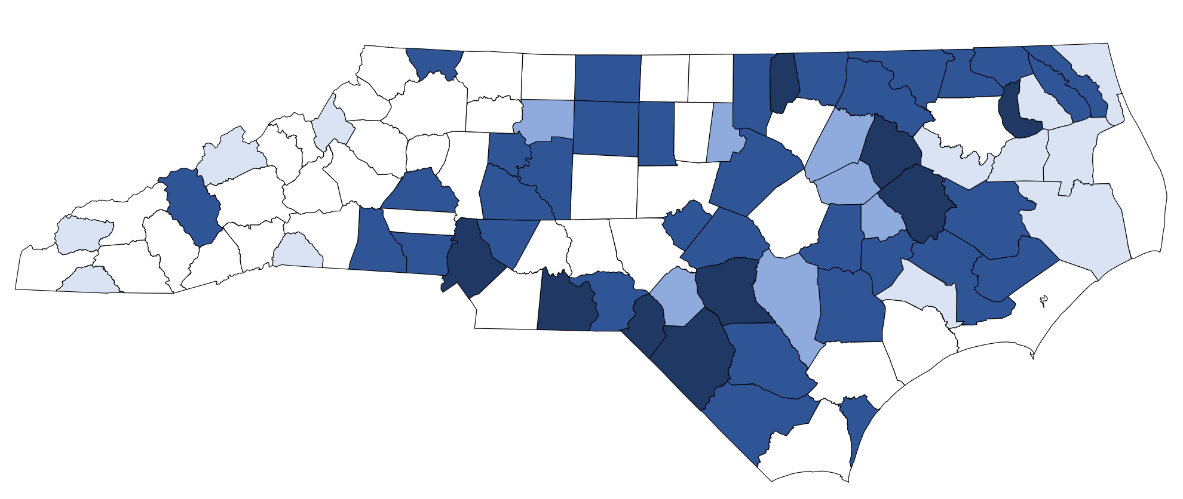
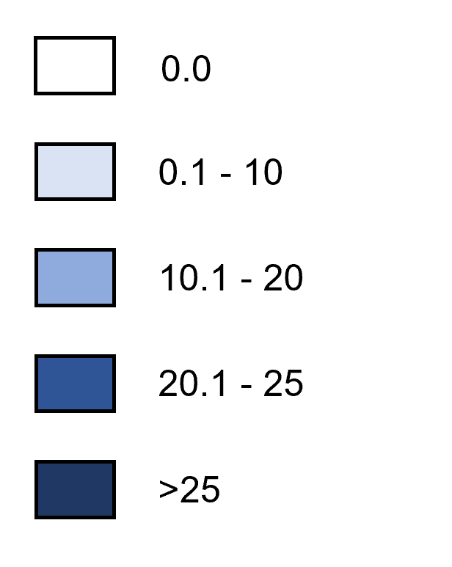
Newly Diagnosed HIV Rates by County, 2023
Rate per 100,000 Population
Data Source: enhanced HIV/AIDS Reporting System (eHARS) (data as of July 2024).

Slide 18
HIV Exposure (Hierarchical Risk)

Slide 19
Newly Diagnosed HIV Hierarchical Risk^^ among Adults and Adolescents in NC
2019-2023
17.7%
56.3%
3.2%
18.9%
^Note: 2020 data should be treated with caution due to reduced availability of testing caused by the COVID-19 pandemic. Data is italicized for this reason.
^^Risk was assigned to each case based on the reported risk that was most likely to have resulted in HIV transmission. While people may have reported more than one behavior that can transmit HIV, each person is only classified with one risk in this chart.
*^^IDU = injection drug use; MSM = men who report sex with men; MSM/IDU = men who report sex with men and injection drug use.
**Other risks include exposure to blood products (adult hemophilia or transfusions), pediatric risk, needle sticks, and health care exposure.
^^^Unknown risk is defined as individuals classified as no identified risk (NIR) and no reported risk (NRR) individuals.
Data Source: enhanced HIV/AIDS Reporting System (eHARS) (data as of July 2024).

Slide 20
Newly Diagnosed HIV Hierarchical Risk^^ (Redistributed*) among Adults and Adolescents in NC, 2023
N = 1,410
^^Risk was assigned to each case based on the reported risk that was most likely to have resulted in HIV transmission. While people may have reported more than one behavior that can transmit HIV, each person is only classified with one risk in this chart.
*Unknown risk has been redistributed.
*Heterosexual-all is defined as a person who does not report IDU or MSM but does report sexual contact with a partner of opposite sex, who is IDU, MSM, or known HIV-positive status. Also, if a person is a victim of sexual assault, exchanges sex for drugs/money, has had a recent STD or has sexual contact while using drugs, they are classified as high risk. It also includes individuals classified as people who reports sex with an opposite sex partner and does not report IDU, MSM, or any other potential "high risk" behaviors.
^^IDU = injection drug use; MSM = men who report sex with men; MSM/IDU = men who report sex with men and injection drug use.
**Other risks include exposure to blood products (adult hemophilia or transfusions), pediatric risk, needle sticks, and health care exposure.
Data Source: enhanced HIV/AIDS Reporting System (eHARS) (data as of July 2024).

Slide 21
Proportion of Newly Diagnosed HIV Hierarchical Risk^^ (Redistributed*) among Adults and Adolescents in NC, 2019-2023
^Note: 2020 data should be treated with caution due to reduced availability of testing caused by the COVID-19 pandemic. Data is italicized for this reason.
^^Risk was assigned to each case based on the reported risk that was most likely to have resulted in HIV transmission. While people may have reported more than one behavior that can transmit HIV, each person is only classified with one risk in this chart.
*Unknown risk has been redistributed.
*Heterosexual-all is defined as a person who does not report IDU or MSM, but does report sexual contact with a partner of opposite sex, who is IDU, MSM, or known HIV-positive status. Also, if a person is a victim of sexual assault, exchanges sex for drugs/money, has had a recent STD or has sexual contact while using drugs, they are classified as high risk. It also includes individuals classified as people who reports sex with an opposite sex partner and does not report IDU, MSM, or any other potential "high risk" behaviors.
^^IDU = injection drug use; MSM = men who report sex with men; MSM/IDU = men who report sex with men and injection drug use.
**Other risks include exposure to blood products (adult hemophilia or transfusions), pediatric risk, needle sticks, and health care exposure.
Data Source: enhanced HIV/AIDS Reporting System (eHARS) (data as of July 2024).

Slide 22
Estimated HIV Infection Rates among Newly Diagnosed Adult and Adolescents (13 years and older) Gay and Bisexual Men and Other Men who have Sex with Other Men^ in North Carolina 2022
North Carolina 2023 HIV Rate: 15.5 per 100,000
^Unknown risk has been redistributed. People who were classified as MSM and IDU were excluded.
^^Grey et al (2016). JMIR Public Health Surveill; 2(1): e14. https://publichealth.jmir.org/2016/1/e14/
*Non-Hispanic/LatinX.
Data Source: enhanced HIV/AIDS Reporting System (eHARS) (data as of June 2023).

Slide 23
Estimated HIV Infection Rates among Newly Diagnosed Adult and Adolescents (13 years and older) Heterosexual Men^ in North Carolina 2022 – only did rate overall hetero
North Carolina 2023 HIV Rate: 15.5 per 100,000
^Unknown risk has been redistributed. People who were classified as MSM and IDU were excluded.
^^Grey et al (2016). JMIR Public Health Surveill; 2(1): e14. https://publichealth.jmir.org/2016/1/e14/
*Non-Hispanic/LatinX.
Data Source: enhanced HIV/AIDS Reporting System (eHARS) (data as of June 2023).

Slide 24
HIV Infection Rates among Newly Diagnosed Adult and Adolescents (13 years and older) Heterosexual Women^ in North Carolina 2023
North Carolina 2023 HIV Rate: 15.5 per 100,000
^Unknown risk has been redistributed. People who were classified as MSM and IDU were excluded.
^^Grey et al (2016). JMIR Public Health Surveill; 2(1): e14. https://publichealth.jmir.org/2016/1/e14/
*Non-Hispanic/LatinX.
Data Source: enhanced HIV/AIDS Reporting System (eHARS) (data as of July 2024).

Slide 25
Late Diagnosis of HIV
(HIV and AIDS within 6 months)

Slide 26
Rate of Late Diagnoses of HIV by Gender, 2010-2023
*Note: 2020 data should be treated with caution due to reduced availability of testing caused by the COVID-19 pandemic.
Data Source: enhanced HIV/AIDS Reporting System (eHARS) (data as of July 2024).

Slide 27
Proportion of Late Diagnosed HIV by Gender and Race/Ethnicity, 2023
^Non-Hispanic/LatinX.
Data Source: enhanced HIV/AIDS Reporting System (eHARS) (data as of July 2024 ).

Slide 28
HIV Comorbidities

Slide 29
Syphilis Coinfection with HIV

Slide 30
People with Early Syphilis^ Coinfected with HIV^^ by Gender, 2001-2023
^Early syphilis is defined as having primary, secondary, or early non-primary non-secondary (formerly early latent) syphilis.
^^HIV diagnosed prior to OR within 30 days of syphilis diagnosis.
*2020 data should be treated with caution due to reduced availability of testing caused by the COVID-19 pandemic. Data is italicized for this reason.
Data Source: North Carolina Electronic Disease Surveillance System (NC EDSS) (data as of July 1, 2024) and enhanced HIV/AIDS Reporting System (eHARS) (data as of July 2024).

Slide 31
People with Early Syphilis^ Coinfected with HIV^^ by Race 2019-2023
^Early syphilis is defined as primary, secondary, or early non-primary non-secondary (formerly early latent) syphilis.
^^HIV diagnosed prior to OR within 30 days of syphilis diagnosis.
*2020 data should be treated with caution due to reduced availability of testing caused by the COVID-19 pandemic. Data is italicized for this reason.
Data Source: North Carolina Electronic Disease Surveillance System (NC EDSS) (data as of July 1, 2024).

Slide 32
People with Early Syphilis^ Coinfected with HIV^^ by Ethnicity 2019-2023
^Early syphilis is defined as primary, secondary, or early non-primary non-secondary (formerly early latent) syphilis.
^^HIV diagnosed prior to OR within 30 days of syphilis diagnosis.
*2020 data should be treated with caution due to reduced availability of testing caused by the COVID-19 pandemic. Data is italicized for this reason.
Data Source: North Carolina Electronic Disease Surveillance System (NC EDSS) (data as of July 1, 2024).

Slide 33
Gonorrhea Coinfection with HIV

Slide 34
People with Gonorrhea Coinfected with HIV^^ by Gender, 2013-2023
^^HIV diagnosed prior to OR within 30 days of gonorrhea diagnosis.
*2020 data should be treated with caution due to reduced availability of testing caused by the COVID-19 pandemic. Data is italicized for this reason.
Data Source: North Carolina Electronic Disease Surveillance System (NC EDSS) (data as of July 1, 2024) and enhanced HIV/AIDS Reporting System (eHARS) (data as of July 2024).

Slide 35
People with Gonorrhea Coinfected with HIV^^ by Race 2019-2023
^^HIV diagnosed prior to OR within 30 days of gonorrhea diagnosis.
*2020 data should be treated with caution due to reduced availability of testing caused by the COVID-19 pandemic. Data is italicized for this reason.
Data Source: North Carolina Electronic Disease Surveillance System (NC EDSS) (data as of July 1, 2024).

Slide 36
People with Gonorrhea Coinfected with HIV^^ by Ethnicity 2019-2023
^^HIV diagnosed prior to OR within 30 days of gonorrhea diagnosis.
*2020 data should be treated with caution due to reduced availability of testing caused by the COVID-19 pandemic. Data is italicized for this reason.
Data Source: North Carolina Electronic Disease Surveillance System (NC EDSS) (data as of July 1, 2024).

Slide 37
Hepatitis Coinfection with HIV

Slide 38
Conquering the Syndemic: The Impact of HCV, HIV, and Opioid Overdoses in North Carolina
HCV
Reported acute HCV, 2022¹ = 75
Estimated people living with chronic HCV in U.S., 2016² = 2.4 million (Trends in mortality and curative treatment indicate the prevalence is lower today.)
Average lifetime treatment cost of chronic HCV³ = $100,000/person
Syndemic
Estimate 7-13% of HIV-infected people in NC are co-infected with HCV (CDC estimates 21%)^{4,5}
At least 7% of people diagnosed with HIV in NC in 2022 were exposed through injection drug use¹
An estimated 62%‒80% of HIV-infected people who inject drugs are co-infected with HCV⁵
Around 40% of people with acute HCV in 2022 reported injection drug use¹
Based on surveillance data, 23% of people coinfected with HIV/HCV achieved SVR through 2022¹
Opioid Overdoses
HIV Infections
Drug overdose deaths in NC, 2022⁶ = 3,876 (36.9 per 100,000)
Fentanyl deaths, 2018⁶ = 3,117 (29.5 per 100,000)
CDC estimates the cost of drug overdose deaths in NC, 2016⁷ = $1.3 billion
Newly reported HIV, 2022¹ = 1,366
People living with HIV, 2022¹ = 36,581
Average lifetime treatment cost of HIV⁸ = >$370,000/person
¹NC HIV/STD/Hepatitis Annual Surveillance Report, 2022; ²CDC Surveillance for Viral Hepatitis (https://www.cdc.gov/hepatitis/hcv/hcvfaq.htm#Ref01). ³In the absence of liver transplant (C. Everett Koop Institute, Dartmouth http://www.epidemic.org/thefacts/theepidemic/USHealthCareCosts/ );⁴Based on estimates from NC Ryan White CAREWare and the Medical Monitoring Project in NC;⁵People Coinfected with HIV and Viral Hepatitis https://www.cdc.gov/hepatitis/populations/hiv.htm; ⁶ Opioid and Substance Use Action Plan Data Dashboard https://injuryfreenc.dph.ncdhhs.gov/DataSurveillance/overdose.htm; ⁷https://www.drugabuse.gov/drug-topics/opioids/opioid-summaries-by-state/north-carolina-opioid-involved-deaths-related-harms. ⁸HIV Cost-effectiveness, CDC: https://www.cdc.gov/hiv/programresources/guidance/costeffectiveness/index.html).

Slide 39
2022 HIV/Hepatitis B/Hepatitis C Coinfection
HCV
N = 87,999
N=1,022
N=1,484
N=71
HBV
N=24,628
HIV
N=33,193
N=1,032
.
Data Source: North Carolina Electronic Disease Surveillance System (NC EDSS) (data as of July 1, 2023) and enhanced HIV/AIDS Reporting System (NC EDSS) (data as of July 2023).

Slide 40
North Carolina HIV Continuum of Care

Slide 41
North Carolina HIV Continuum of Care 2022
*People ≥ 13 years of age and diagnosed and living through December 31 of each calendar year. Data includes labs and services from CAREWare (all Ryan White services excluding Part A), HIV Medication Assistance Program (HMAP), and Medicaid data sources. Estimated proportion living in NC and undiagnosed is from 2020.
**At least 1 care marker (CD4 or VL test, HMAP dispense, or Medicaid claim) in the given calendar year.
*** Retained in care is defined as being virally suppressed within 12 months or having 2 or more care markers (CD4 or VL test, HMAP dispense, or Medicaid claim) at least 90 days apart in the given calendar year.
^Last viral load during the given calendar year <200 copies/ml.
Data Sources: enhanced HIV/AIDS Reporting System (eHARS) (June 2023) and NC ECHO (June 2023).

Slide 42
Upside Down HIV Continuum of Care 2022
*People ≥ 13 years of age estimated to have HIV but not be diagnosed and living through December 31 of each calendar year. Data includes labs and services from CAREWare (all Ryan White services excluding Part A), HIV Medication Assistance Program (HMAP), and Medicaid data sources. Estimated proportion living in NC and undiagnosed is from 2020.
**People without at least 1 care marker (CD4 or VL test, HMAP dispense, or Medicaid claim) in the given calendar year.
***People neither virally suppressed within 12 months nor having 2 or more care markers (CD4 or VL test, HMAP dispense, or Medicaid claim) at least 90 days apart in the given calendar year.
^Last viral load during the given calendar year was more than 200 copies/ml.
Data Sources: enhanced HIV/AIDS Reporting System (eHARS) (June 2023) and NC ECHO (June 2023).

Slide 43
HIV Continuum of Care: North Carolina (2022) and the United States (2021)
*NC data: People ≥ 13 years of age and diagnosed and living through December 31 of each calendar year. Data includes labs and services from CAREWare (all Ryan White services excluding Part A), HIV Medication Assistance Program (HMAP), and Medicaid data sources. Estimated proportion living in NC and undiagnosed is from 2021.
**At least 1 care marker (CD4 or VL test, HMAP dispense, or Medicaid claim) in the given calendar year; US number is people linked to care within 1 month
*** Retained in care is defined as being virally suppressed within 12 months or having 2 or more care markers (CD4 or VL test, HMAP dispense, or Medicaid claim) at least 90 days apart in the given calendar year.
^Last viral load during the given calendar year <200 copies/ml.
Data Sources: enhanced HIV/AIDS Reporting System (eHARS) (September 2023), NC ECHO (August 2023). Most recent CDC continuum is data from 2021 https://ahead.hiv.gov/).

Slide 44
2022 North Carolina Newly Diagnosed HIV Continuum of Care
*People ≥ 13 years of age and diagnosed in and living through December 31 of each calendar year. Data includes labs and services from CAREWare (all Ryan White services excluding Part A), HIV Medication Assistance Program (HMAP), and Medicaid data sources. Data are preliminary (do not include vital records or national death matches).
**At least 1 care marker (CD4 or VL test, HMAP dispense, or Medicaid claim) in the given period.
^Virally suppressed is defined as the last viral load during the year being <200 copies/ml.
Data Sources: enhanced HIV/AIDS Reporting System (eHARS) (June 2023) and NC ECHO (June 2023).

Slide 45
90-90-90 Status in 2022: North Carolina
*People ≥ 13 years of age and diagnosed in and living through December 31 of each calendar year. Data includes labs and services from CAREWare (all Ryan White services excluding Part A), HIV Medication Assistance Program (HMAP), and Medicaid data sources. Data are preliminary (do not include vital records or national death matches).
“*received ARTs is based on the number of people with a viral load or CD4 test in a given year (assumes lab tests imply receipt of ARTs)
^Last viral load during the year <200 copies/ml.
Data Sources: enhanced HIV/AIDS Reporting System (eHARS) (June 2023) and NC ECHO (June 2023).

