Slide 1
NC Department of Health and Human Services
Chlamydia Epidemiology in North Carolina 2021
Division of Public Health/Epidemiology Section/Communicable Disease Branch
HIV/STD/Viral Hepatitis Surveillance Unit
December 2022

Slide 2
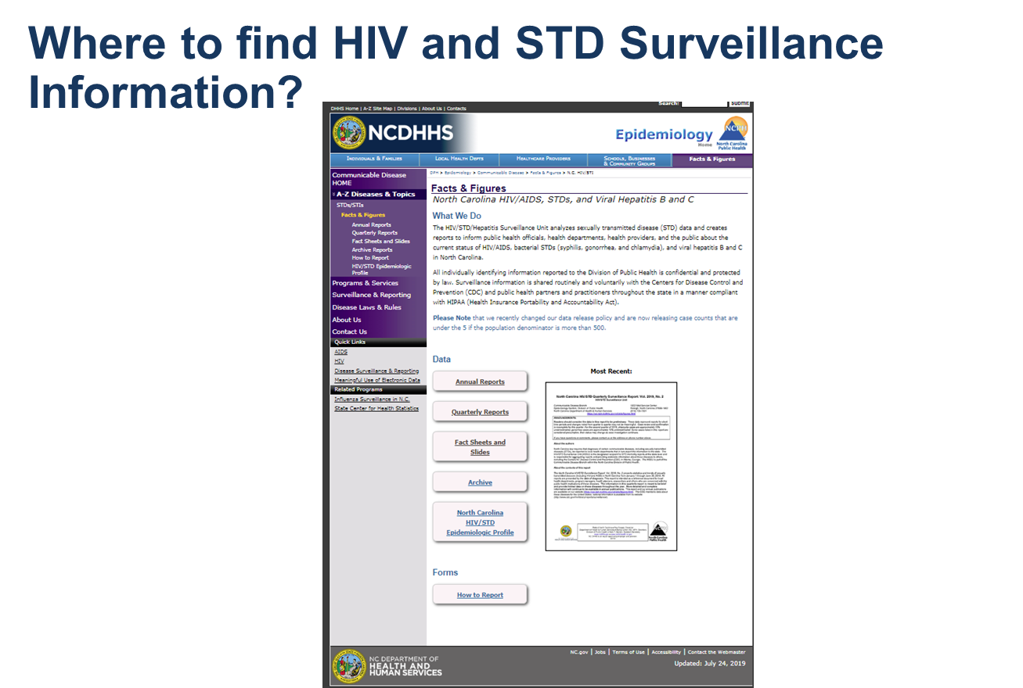
http://epi.publichealth.nc.gov/cd/stds/figures.html

Slide 3
Chlamydia Cases by Gender, 2011-2021
65,107
*2020 data should be treated with caution due to reduced availability of testing caused by the COVID-19 pandemic. Data is italicized for this reason.
Data Source: North Carolina Electronic Disease Surveillance System (NC EDSS) (data as of September 7, 2022).

Slide 4
Chlamydia Rates by Gender
North Carolina and United States
2011-2021
*2020 data should be treated with caution due to reduced availability of testing caused by the COVID-19 pandemic. Data is italicized for this reason.
Data Source: North Carolina Electronic Disease Surveillance System (NC EDSS) (data as of September 7, 2022)
and Preliminary 2021 Sexually Transmitted Diseases Surveillance, CDC (https://www.cdc.gov/std/statistics/2021/default.htm).

Slide 5
Age Distribution of Chlamydia Cases by Gender, 2021
*2020 data should be treated with caution due to reduced availability of testing caused by the COVID-19 pandemic. Data is italicized for this reason.
Data Source: North Carolina Electronic Disease Surveillance System (NC EDSS) (data as of September 7, 2022).

Slide 6
Chlamydia Cases by Race/Ethnicity
2017-2021
71,401
64,514
65,107
*2020 data should be treated with caution due to reduced availability of testing caused by the COVID-19 pandemic. Data is italicized for this reason.
**Non-Hispanic/LatinX.
Data Source: North Carolina Electronic Disease Surveillance System (NC EDSS) (data as of September 7, 2022).

Slide 7
Chlamydia Rates by Race/Ethnicity
2017-2021
*2020 data should be treated with caution due to reduced availability of testing caused by the COVID-19 pandemic. Data is italicized for this reason.
**Non-Hispanic/LatinX.
Data Source: North Carolina Electronic Disease Surveillance System (NC EDSS) (data as of September 7, 2022).

Slide 8
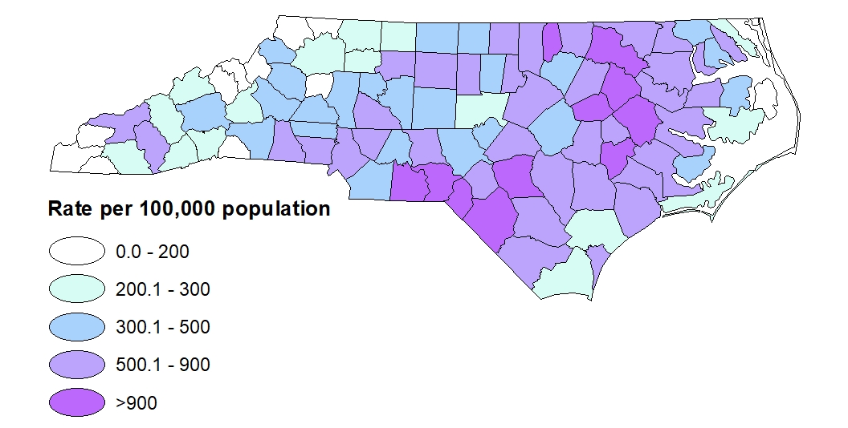
Chlamydia Rates by County, 2021
Data Source: North Carolina Electronic Disease Surveillance System (NC EDSS) (data as of September 7, 2022).

