Slide 1
NC Department of Health and Human Services
Chlamydia Epidemiology in North Carolina 2023
Division of Public Health/Epidemiology Section/Communicable Disease Branch
HIV/STD/Viral Hepatitis Surveillance Unit
August 2024

Slide 2
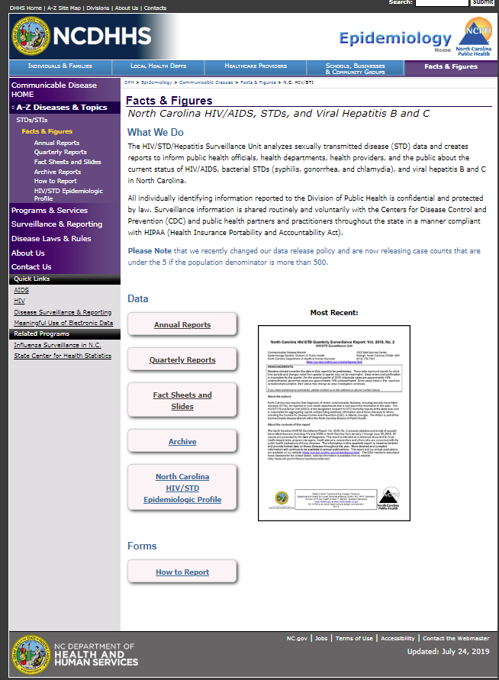
Where to find STI Surveillance information?
http://epi.publichealth.nc.gov/cd/stds/figures.html

Slide 3
Chlamydia Cases by Gender, 2013-2023
65,906
*2020 data should be treated with caution due to reduced availability of testing caused by the COVID-19 pandemic.
Data Source: North Carolina Electronic Disease Surveillance System (NC EDSS) (data as of July 1, 2024).

Slide 4
Chlamydia Rates by Gender
North Carolina and United States
2013-2023
*2020 data should be treated with caution due to reduced availability of testing caused by the COVID-19 pandemic.
Data Source: North Carolina Electronic Disease Surveillance System (NC EDSS) (data as of July 1, 2024)
and 2022 Sexually Transmitted Diseases Surveillance, CDC (https://www.cdc.gov/std/statistics/2022/default.htm).

Slide 5
Age Distribution of Chlamydia Cases by Gender, 2023
Data Source: North Carolina Electronic Disease Surveillance System (NC EDSS) (data as of July 1, 2024).

Slide 6
Chlamydia Cases by Race 2019-2023
71,381
64,495
65,153
64,671
65,906
539
*2020 data should be treated with caution due to reduced availability of testing caused by the COVID-19 pandemic. Data is italicized for this reason.
Data Source: North Carolina Electronic Disease Surveillance System (NC EDSS) (data as of July 1, 2024).

Slide 7
Chlamydia Cases by Ethnicity 2019-2023
71,381
64,495
65,153
64,671
65,906
*2020 data should be treated with caution due to reduced availability of testing caused by the COVID-19 pandemic. Data is italicized for this reason.
Data Source: North Carolina Electronic Disease Surveillance System (NC EDSS) (data as of July 1, 2024).

Slide 8
Chlamydia Rates by Race 2019-2023
*2020 data should be treated with caution due to reduced availability of testing caused by the COVID-19 pandemic.
Data Source: North Carolina Electronic Disease Surveillance System (NC EDSS) (data as of July 1, 2024).

Slide 9
Chlamydia Rates by Ethnicity 2019-2023
*2020 data should be treated with caution due to reduced availability of testing caused by the COVID-19 pandemic.
Data Source: North Carolina Electronic Disease Surveillance System (NC EDSS) (data as of July 1, 2024).

Slide 10
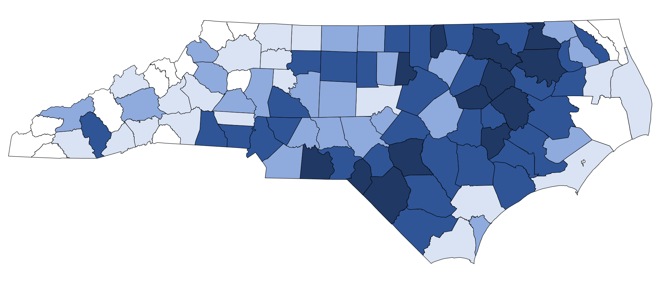
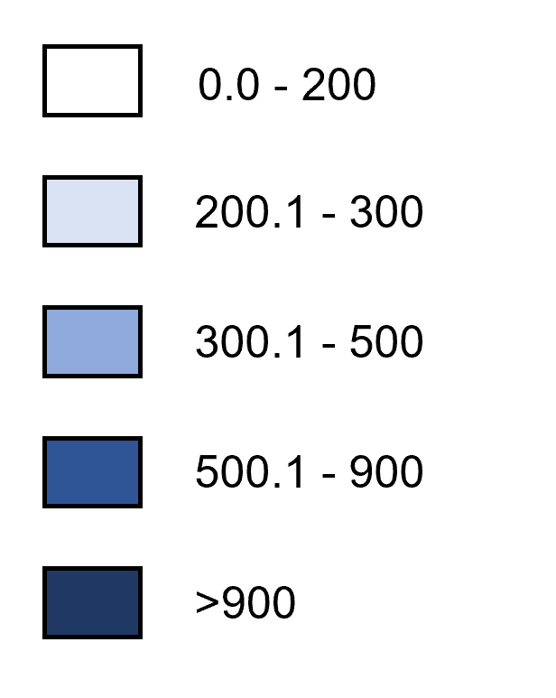
Chlamydia Rates by County, 2023
Rate per 100,000 Population
Data Source: North Carolina Electronic Disease Surveillance System (NC EDSS) (data as of July 1, 2024).

