Slide 1
NC Department of Health and Human Services
Early Syphilis Epidemiology in North Carolina 2023
Division of Public Health/Epidemiology Section/Communicable Disease Branch
HIV/STD/Viral Hepatitis Surveillance Unit
August 2024

Slide 2
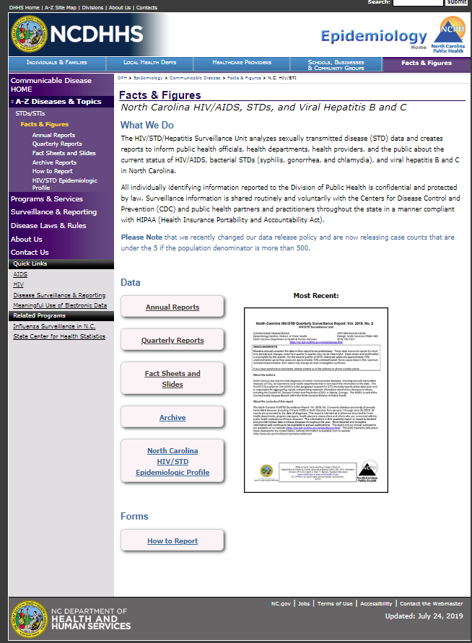
Where to find STI Surveillance information?
http://epi.publichealth.nc.gov/cd/stds/figures.html

Slide 3
Early Syphilis^ Cases by Gender
2001-2023
^Early syphilis is defined as primary, secondary, or early non-primary non-secondary (formerly early latent) syphilis.
*2020 data should be treated with caution due to reduced availability of testing caused by the COVID-19 pandemic.
Data Source: North Carolina Electronic Disease Surveillance System (NC EDSS) (data as of July 1, 2024).

Slide 4
Early Syphilis^ Rates, 2001-2023
^Early syphilis is defined as primary, secondary, or early non-primary non-secondary (formerly early latent) syphilis.
*2020 data should be treated with caution due to reduced availability of testing caused by the COVID-19 pandemic.
Data Source: North Carolina Electronic Disease Surveillance System (NC EDSS) (data as of July 1, 2024).

Slide 5
Age Distribution of Early Syphilis^ Cases by Gender, 2023
^Early syphilis is defined as primary, secondary, or early non-primary non-secondary (formerly early latent) syphilis.
Data Source: North Carolina Electronic Disease Surveillance System (NC EDSS) (data as of July 1, 2024).

Slide 6
Early Syphilis^ Cases by Race 2019-2023
4,127
3,846
3,168
2,340
2,106
^Early syphilis is defined as primary, secondary, or early non-primary non-secondary (formerly early latent) syphilis.
*2020 data should be treated with caution due to reduced availability of testing caused by the COVID-19 pandemic.
Data Source: North Carolina Electronic Disease Surveillance System (NC EDSS) (data as of July 1, 2024).

Slide 7
Early Syphilis^ Cases by Ethnicity 2019-2023
4,127
3,846
3,168
2,340
2,106
^Early syphilis is defined as primary, secondary, or early non-primary non-secondary (formerly early latent) syphilis.
*2020 data should be treated with caution due to reduced availability of testing caused by the COVID-19 pandemic.
Data Source: North Carolina Electronic Disease Surveillance System (NC EDSS) (data as of July 1, 2024).

Slide 8
Early Syphilis^ Rates by Race 2019-2023
^Early syphilis is defined as primary, secondary, or early non-primary non-secondary (formerly early latent) syphilis.
*2020 data should be treated with caution due to reduced availability of testing caused by the COVID-19 pandemic.
Data Source: North Carolina Electronic Disease Surveillance System (NC EDSS) (data as of July 1, 2024).

Slide 9
Early Syphilis^ Rates by Ethnicity 2019-2023
^Early syphilis is defined as primary, secondary, or early non-primary non-secondary (formerly early latent) syphilis.
*2020 data should be treated with caution due to reduced availability of testing caused by the COVID-19 pandemic.
Data Source: North Carolina Electronic Disease Surveillance System (NC EDSS) (data as of July 1, 2024).

Slide 10
Primary, Secondary, and Other Early^ Syphilis Rates by Gender, 2011-2023
^Other early syphilis is defined as early non-primary non-secondary (formerly early latent) syphilis.
*2020 data should be treated with caution due to reduced availability of testing caused by the COVID-19 pandemic.
Data Source: North Carolina Electronic Disease Surveillance System (NC EDSS) (data as of July 1, 2024).

Slide 11
Primary, Secondary, and Other Early^ Syphilis Rates in North Carolina and the United States, 2017-2023
^Other early syphilis non-primary non-secondary (formerly early latent) syphilis.
*2020 data should be treated with caution due to reduced availability of testing caused by the COVID-19 pandemic.
Data Source: North Carolina Electronic Disease Surveillance System (NC EDSS) (data as of July 1, 2024) and 2022 Sexually Transmitted Diseases Surveillance, CDC (https://www.cdc.gov/std/statistics/2022/default.htm).

Slide 12
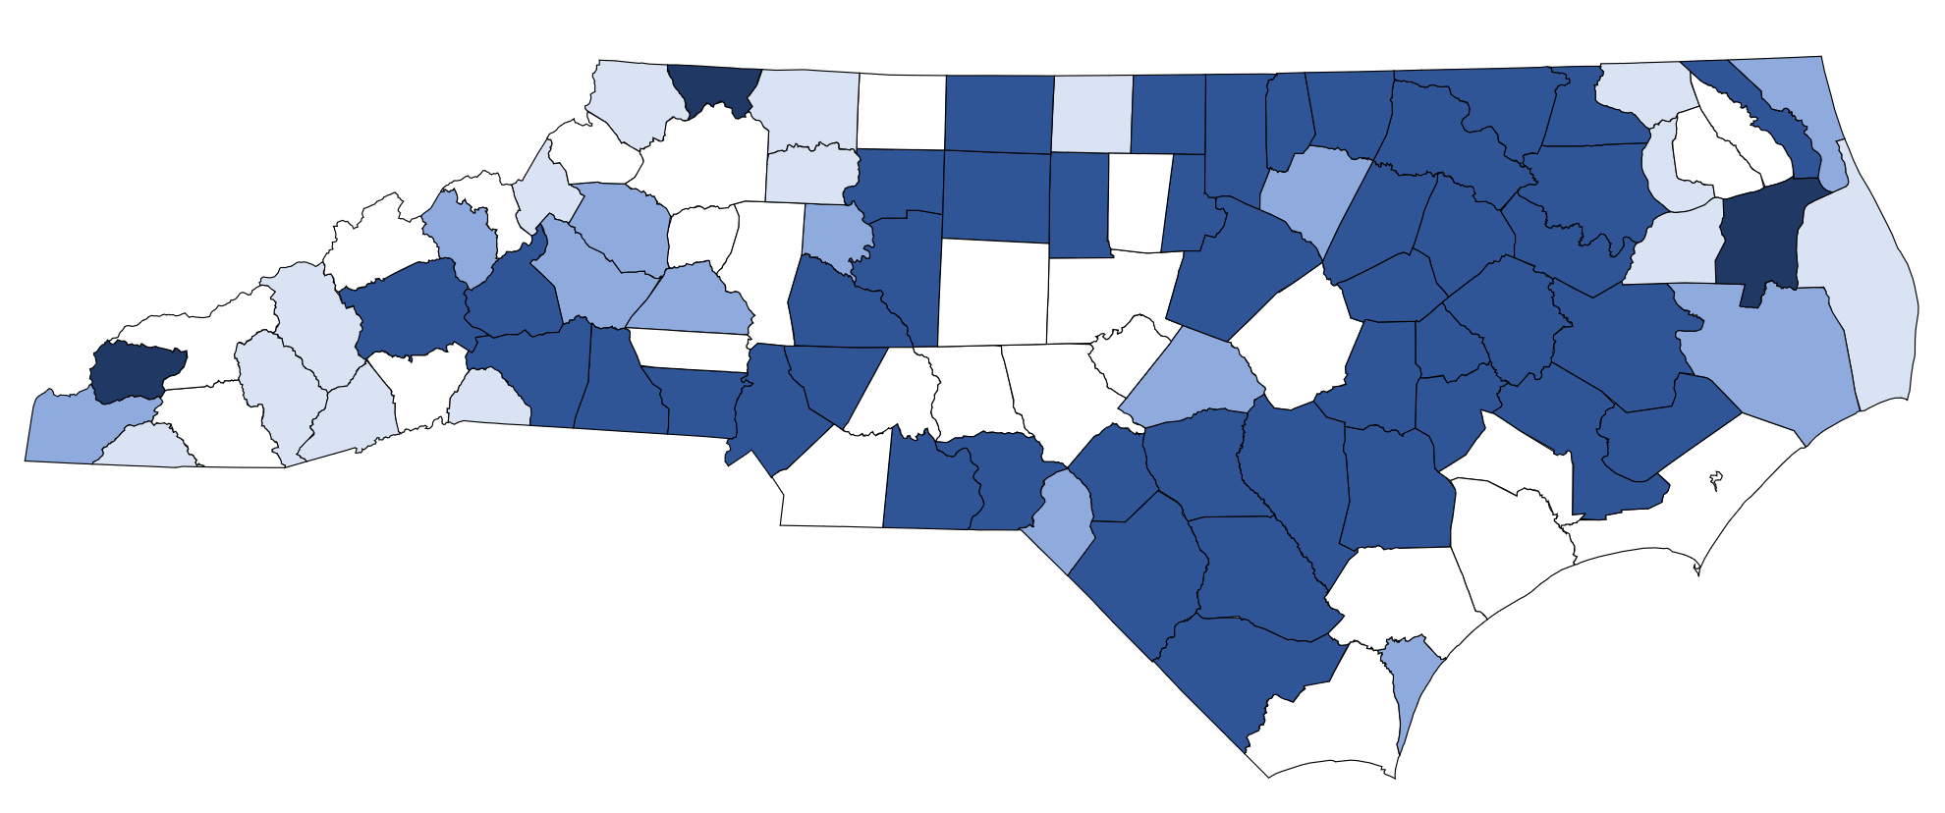
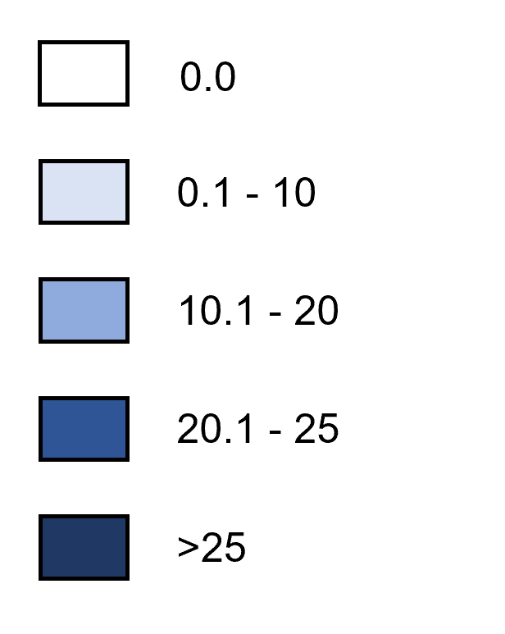
Early Syphilis^ Rates by County, 2023
Rate per 100,000 Population
^Early syphilis is defined as primary, secondary, or early non-primary non-secondary (formerly early latent) syphilis.
Data Source: North Carolina Electronic Disease Surveillance System (NC EDSS) (data as of July 1, 2024).

Slide 13
Congenital Syphilis Cases by Birth Year
2012-2023
72
*2020 data should be treated with caution due to reduced availability of testing caused by the COVID-19 pandemic.
Data Source: Sexually Transmitted Disease Management Information System (STD*MIS) and North Carolina Electronic Disease Surveillance System (NC EDSS) (data as of July 1, 2024).

Slide 14
Syphilis Coinfection with HIV

Slide 15
People with Early Syphilis^ Coinfected with HIV^^ by Gender, 2001-2023
^Early syphilis is defined as having primary, secondary, or early non-primary non-secondary (formerly early latent) syphilis.
^^HIV diagnosed prior to OR within 30 days of syphilis diagnosis.
*2020 data should be treated with caution due to reduced availability of testing caused by the COVID-19 pandemic.
Data Source: North Carolina Electronic Disease Surveillance System (NC EDSS) (data as of July 1, 2024) and enhanced HIV/AIDS Reporting System (eHARS) (data as of July 1, 2024).

Slide 16
People with Early Syphilis^ Coinfected with HIV^^ by Race 2019-2023
^Early syphilis is defined as primary, secondary, or early non-primary non-secondary (formerly early latent) syphilis.
^^HIV diagnosed prior to OR within 30 days of syphilis diagnosis.
*2020 data should be treated with caution due to reduced availability of testing caused by the COVID-19 pandemic.
Data Source: North Carolina Electronic Disease Surveillance System (NC EDSS) (data as of July 1, 2024).

Slide 17
People with Early Syphilis^ Coinfected with HIV^^ by Ethnicity 2019-2023
^Early syphilis is defined as primary, secondary, or early non-primary non-secondary (formerly early latent) syphilis.
^^HIV diagnosed prior to OR within 30 days of syphilis diagnosis.
*2020 data should be treated with caution due to reduced availability of testing caused by the COVID-19 pandemic.
Data Source: North Carolina Electronic Disease Surveillance System (NC EDSS) (data as of July 1, 2024).

