Slide 1
NC Department of Health and Human Services
Gonorrhea Epidemiology in North Carolina 2021
Division of Public Health/Epidemiology Section/Communicable Disease Branch
HIV/STD/Viral Hepatitis Surveillance Unit
December 2022

Slide 2
http://epi.publichealth.nc.gov/cd/stds/figures.html

Slide 3
Gonorrhea Cases by Gender, 2011-2021
29,177
*2020 data should be treated with caution due to reduced availability of testing caused by the COVID-19 pandemic. Data is italicized for this reason.
Data Source: North Carolina Electronic Disease Surveillance System (NC EDSS) (data as of September 7, 2022).

Slide 4
Gonorrhea Rates by Gender North Carolina and United States, 2011-2021
*2020 data should be treated with caution due to reduced availability of testing caused by the COVID-19 pandemic. Data is italicized for this reason.
Data Source: North Carolina Electronic Disease Surveillance System (NC EDSS) (data as of September 7, 2022)
and Preliminary 2021 Sexually Transmitted Diseases Surveillance, CDC (https://www.cdc.gov/std/statistics/2021/default.htm)).

Slide 5
Age Distribution of Gonorrhea Cases by Gender, 2021
*2020 data should be treated with caution due to reduced availability of testing caused by the COVID-19 pandemic. Data is italicized for this reason.
Data Source: North Carolina Electronic Disease Surveillance System (NC EDSS) (data as of September 7, 2022).

Slide 6
Gonorrhea Cases by Race/Ethnicity 2017-2021
Multiple Race
*2020 data should be treated with caution due to reduced availability of testing caused by the COVID-19 pandemic. Data is italicized for this reason.
**Non-Hispanic/LatinX.
Data Source: North Carolina Electronic Disease Surveillance System (NC EDSS) (data as of September 7, 2022).

Slide 7
Gonorrhea Rates by Race/Ethnicity 2017-2021
*2020 data should be treated with caution due to reduced availability of testing caused by the COVID-19 pandemic. Data is italicized for this reason.
**Non-Hispanic/LatinX.
Data Source: North Carolina Electronic Disease Surveillance System (NC EDSS) (data as of September 7, 2022).

Slide 8
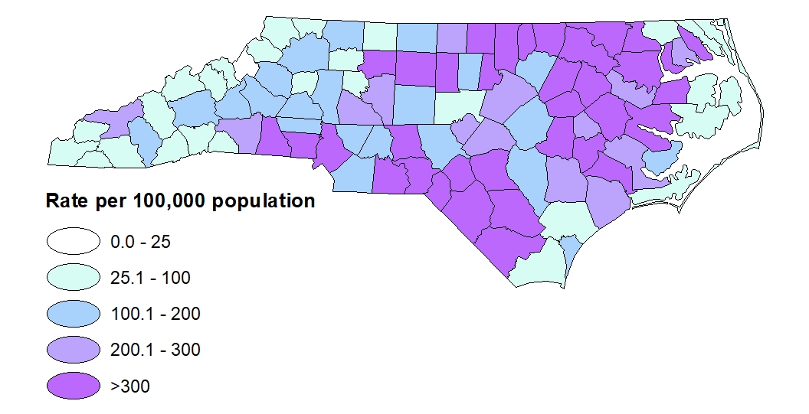
Gonorrhea Rates by County, 2021
Data Source: North Carolina Electronic Disease Surveillance System (NC EDSS) (data as of September 7, 2022).

Slide 9
Gonorrhea Coinfection with HIV

Slide 10
People with Gonorrhea Coinfected with HIV^^ by Gender, 2011-2021
^^HIV diagnosed prior to OR within 30 days of gonorrhea diagnosis.
*2020 data should be treated with caution due to reduced availability of testing caused by the COVID-19 pandemic. Data is italicized for this reason.
Data Source: North Carolina Electronic Disease Surveillance System (NC EDSS) (data as of September 7, 2022) and enhanced HIV/AIDS Reporting System (eHARS) (data as of September 2022).

Slide 11
People with Gonorrhea Coinfected with HIV^^ by Race/Ethnicity, 2017-2021
Unknown
Multiple Race
White
Hispanic
Black/African American
^^HIV diagnosed prior to OR within 30 days of gonorrhea diagnosis.
*2020 data should be treated with caution due to reduced availability of testing caused by the COVID-19 pandemic. Data is italicized for this reason.
Data Source: North Carolina Electronic Disease Surveillance System (NC EDSS) (data as of September 7, 2022) and enhanced HIV/AIDS Reporting System (eHARS) (data as of September 2022).

