Slide 1
NC Department of Health and Human Services
Gonorrhea Epidemiology in North Carolina 2023
Division of Public Health/Epidemiology Section/Communicable Disease Branch
HIV/STD/Viral Hepatitis Surveillance Unit
August 2024

Slide 2
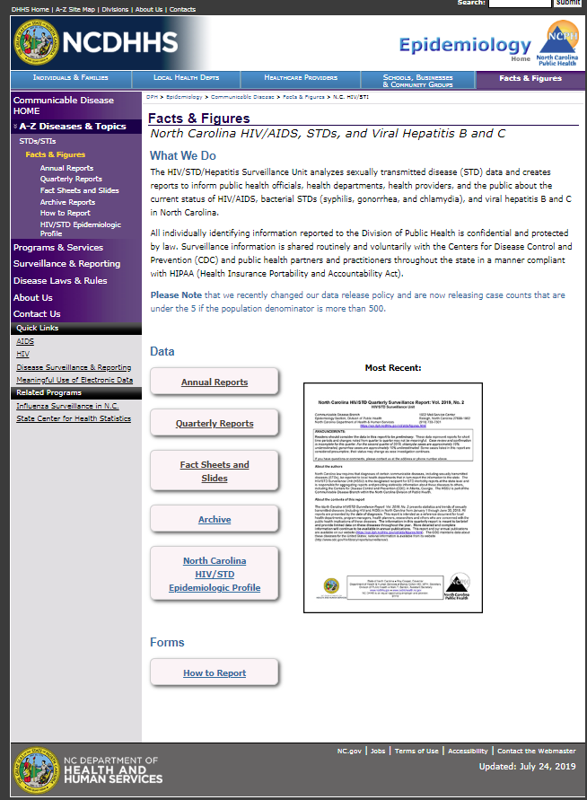
Where to find STI Surveillance information?
http://epi.publichealth.nc.gov/cd/stds/figures.html

Slide 3
Gonorrhea Cases by Gender, 2013-2023
26,382
*2020 data should be treated with caution due to reduced availability of testing caused by the COVID-19 pandemic.
Data Source: North Carolina Electronic Disease Surveillance System (NC EDSS) (data as of July 1, 2024).

Slide 4
Gonorrhea Rates by Gender North Carolina and United States, 2013-2023
*2020 data should be treated with caution due to reduced availability of testing caused by the COVID-19 pandemic.
Data Source: North Carolina Electronic Disease Surveillance System (NC EDSS) (data as of July 1, 2024)
and 2022 Sexually Transmitted Diseases Surveillance, CDC (https://www.cdc.gov/std/statistics/2022/default.htm)).

Slide 5
Age Distribution of Gonorrhea Cases by Gender, 2023
Data Source: North Carolina Electronic Disease Surveillance System (NC EDSS) (data as of July 1, 2024).

Slide 6
Gonorrhea Cases by Race 2019-2023
28,094
29,226
26,851
26,878
26,382
*2020 data should be treated with caution due to reduced availability of testing caused by the COVID-19 pandemic. Data is italicized for this reason.
Data Source: North Carolina Electronic Disease Surveillance System (NC EDSS) (data as of July 1, 2024).

Slide 7
Gonorrhea Cases by Ethnicity 2019-2023
28,094
29,226
26,851
26,878
26,382
*2020 data should be treated with caution due to reduced availability of testing caused by the COVID-19 pandemic. Data is italicized for this reason.
Data Source: North Carolina Electronic Disease Surveillance System (NC EDSS) (data as of July 1, 2024).

Slide 8
Gonorrhea Rates by Race 2019-2023
*2020 data should be treated with caution due to reduced availability of testing caused by the COVID-19 pandemic.
Data Source: North Carolina Electronic Disease Surveillance System (NC EDSS) (data as of July 1, 2024).

Slide 9
Gonorrhea Rates by Ethnicity 2019-2023
*2020 data should be treated with caution due to reduced availability of testing caused by the COVID-19 pandemic.
Data Source: North Carolina Electronic Disease Surveillance System (NC EDSS) (data as of July 1, 2024).

Slide 10
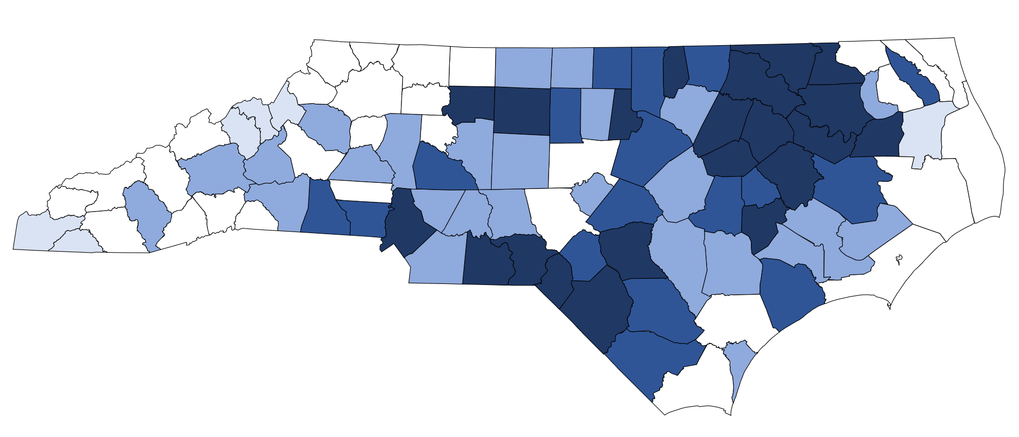
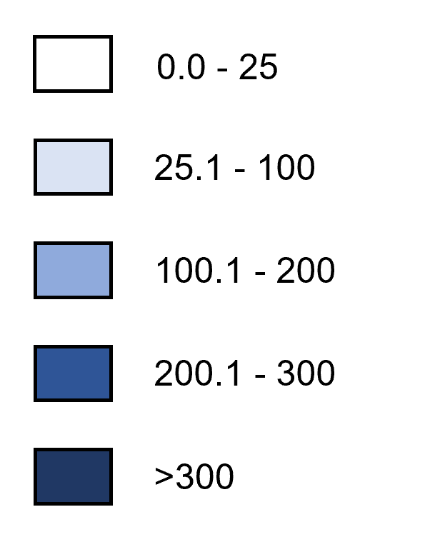
Gonorrhea Rates by County, 2023
Rate per 100,000 Population
Data Source: North Carolina Electronic Disease Surveillance System (NC EDSS) (data as of July 1, 2024).

Slide 11
Gonorrhea Coinfection with HIV

Slide 12
People with Gonorrhea Coinfected with HIV^^ by Gender, 2013-2023
^^HIV diagnosed prior to OR within 30 days of gonorrhea diagnosis.
*2020 data should be treated with caution due to reduced availability of testing caused by the COVID-19 pandemic. Data is italicized for this reason.
Data Source: North Carolina Electronic Disease Surveillance System (NC EDSS) (data as of July 1, 2024) and enhanced HIV/AIDS Reporting System (eHARS) (data as of July 2024).

Slide 13
People with Gonorrhea Coinfected with HIV^^ by Race 2019-2023
^^HIV diagnosed prior to OR within 30 days of gonorrhea diagnosis.
*2020 data should be treated with caution due to reduced availability of testing caused by the COVID-19 pandemic. Data is italicized for this reason.
Data Source: North Carolina Electronic Disease Surveillance System (NC EDSS) (data as of July 1, 2024).

Slide 14
People with Gonorrhea Coinfected with HIV^^ by Ethnicity 2019-2023
^^HIV diagnosed prior to OR within 30 days of gonorrhea diagnosis.
*2020 data should be treated with caution due to reduced availability of testing caused by the COVID-19 pandemic. Data is italicized for this reason.
Data Source: North Carolina Electronic Disease Surveillance System (NC EDSS) (data as of July 1, 2024).

